Slide 1
K (A/m) and uniform winding surface separations scans in QHS46 AND QAS
John Schmitt
Madison, WI
2018-March-23

Slide 2
Outline
2-slide summary of old material
These slides -> Cut coils, look at equilibrium
  QHS46
    K - Separation scan
    # of Coils
  QAS
    K - Separation scan
    # of Coils
To-do list
Backup slides at end

Slide 3
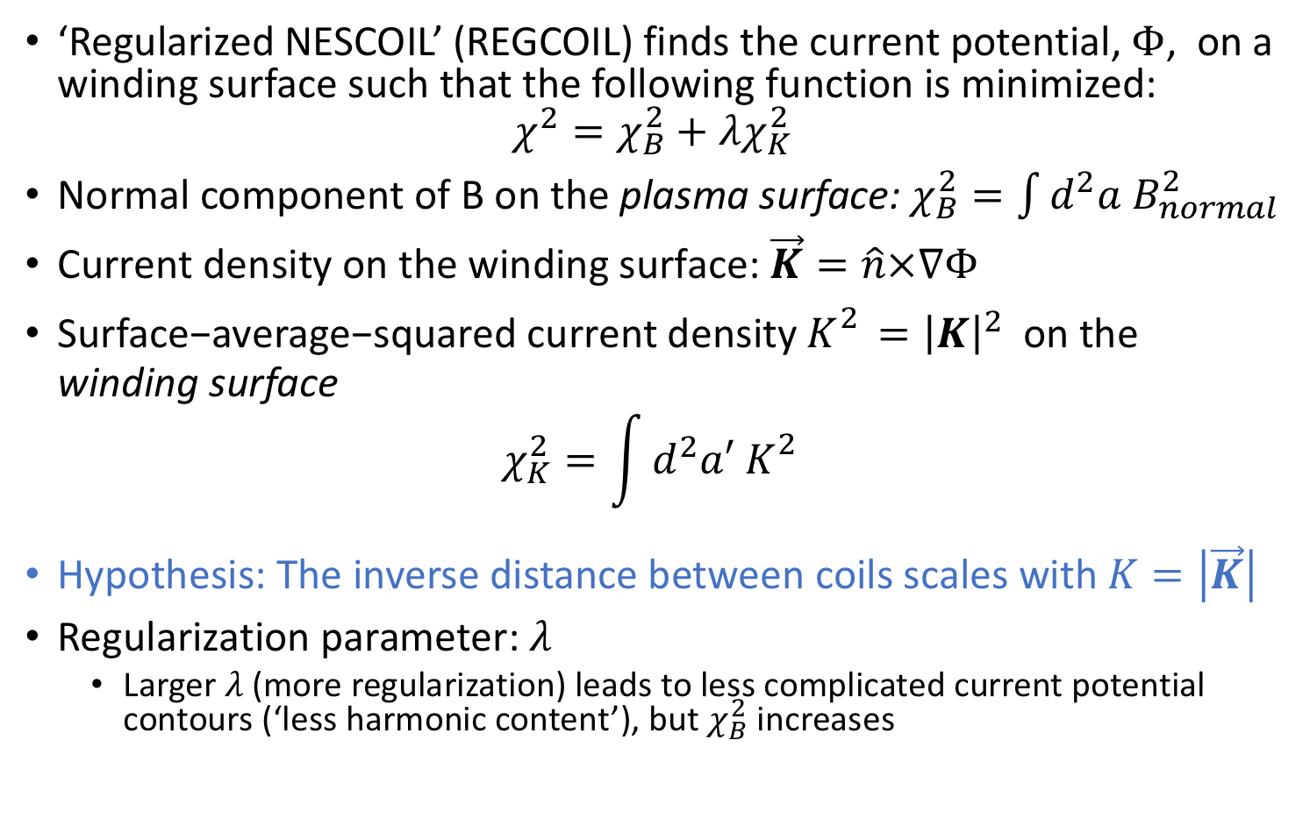
Background about REGCOIL^{1,2}, 1
‘Regularized NESCOIL’ (REGCOIL) finds the current potential, $Φ$, on a winding surface such that the following function is minimized:
$$χ^{2}=χ_{B}^{2}+λχ_{K}^{2}$$
Normal component of B on the plasma surface: $χ_{B}^{2}=\int{d^{2}a B_{normal}^{2}}$
Current density on the winding surface: $\vec{K}=\hat{n}×∇Φ$
$\text{Surface}\text{−}\text{average}\text{−}\text{squared} \text{current} \text{density}{ K}_{}^{2}={\left|K\right|}^{2} \text{on} \text{the} \text{winding} \text{surface}$
$$χ_{K}^{2}=\int{d^{2}a′ K_{}^{2}}$$
Hypothesis: The inverse distance between coils scales with $K=\left|\vec{K}\right|$
Regularization parameter: $λ$
  Larger $λ$ (more regularization) leads to less complicated current potential contours (‘less harmonic content’), but $χ_{B}^{2}$ increases
(Check Normalization)
¹ M. Landreman, Nuclear Fusion 57, 046003 (2017).
² https://github.com/landreman/regcoil

Slide 4

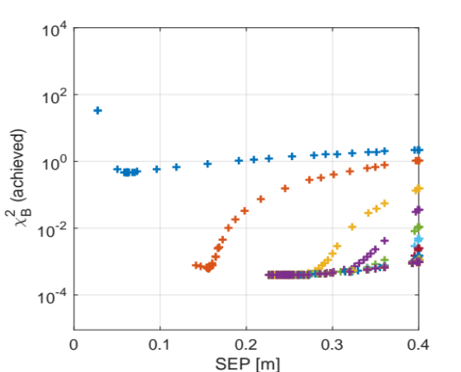
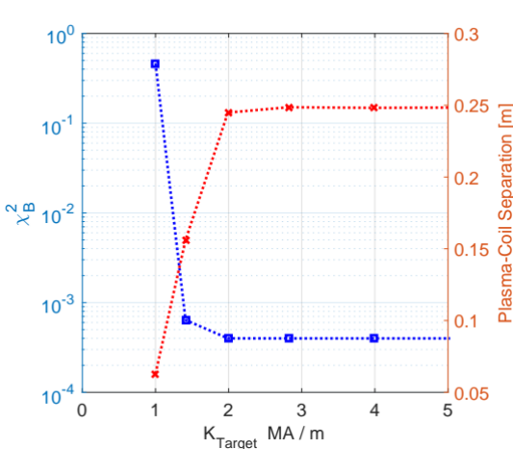
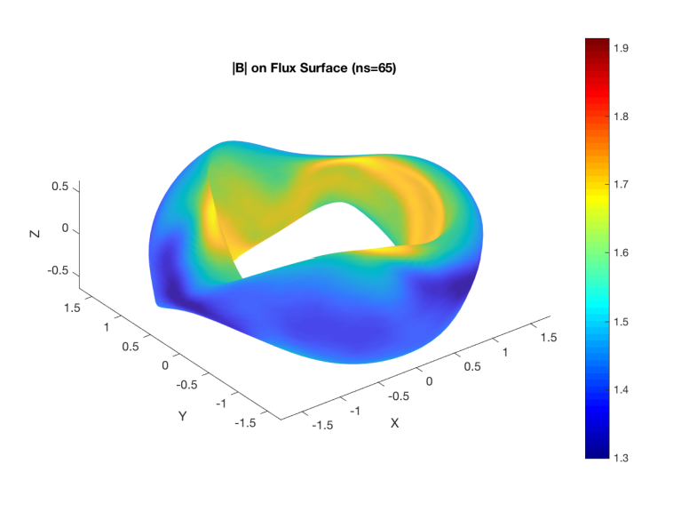
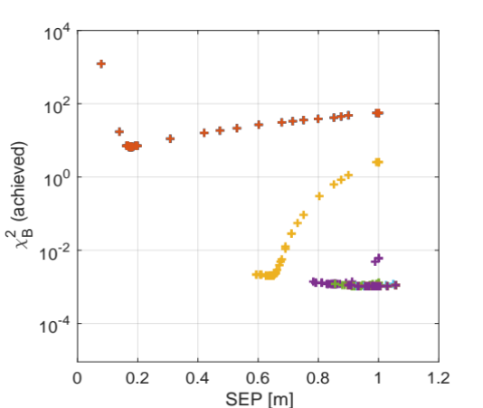
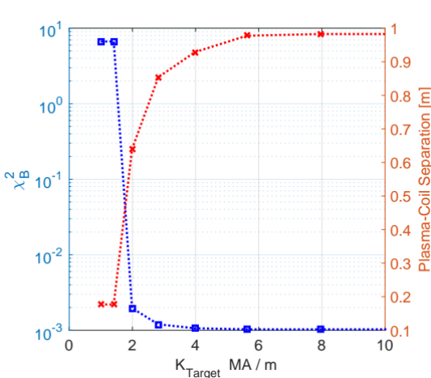
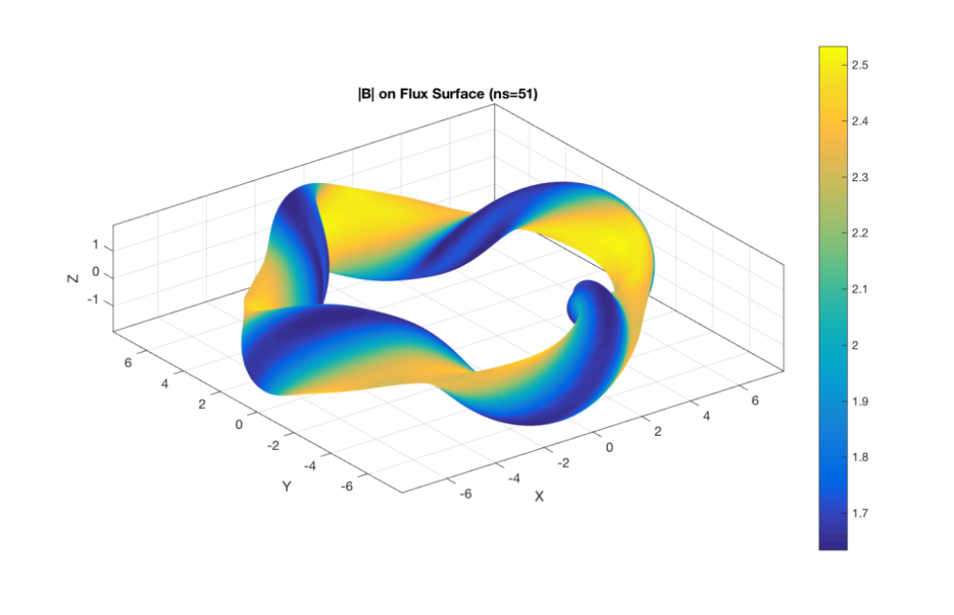
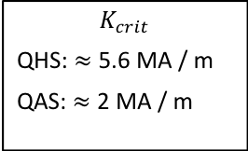
REGCOIL with STELLOPT
QHS46 and QAS configurations show that optimal separation and $χ_{B}^{2}$ asymptote above $K≥K_{crit}$
$$K_{crit}$$
QHS: $≈$ 5.6 MA / m
QAS: $≈$2 MA / m
Scans complete for ‘separation’, the uniform distance between plasma and winding surface
Winding surface have geometric difficulties for largest separations
QAS
Increasing RMS current density on winding surface
QHS46
Increasing RMS current density on winding surface

Slide 5
REGCOIL with STELLOPT
QHS46 and QAS configurations show that optimal separation and $χ_{B}^{2}$ asymptote above $K≥K_{crit}$
$$K_{crit}$$
QHS: $≈$ 5.6 MA / m
QAS: $≈$2 MA / m
Scans complete for ‘separation’, the uniform distance between plasma and winding surface
Winding surface have geometric difficulties for largest separations
QAS
Increasing RMS current density on winding surface
Inspecting scans here
QHS46
Increasing RMS current density on winding surface
Inspecting scans here

Slide 6
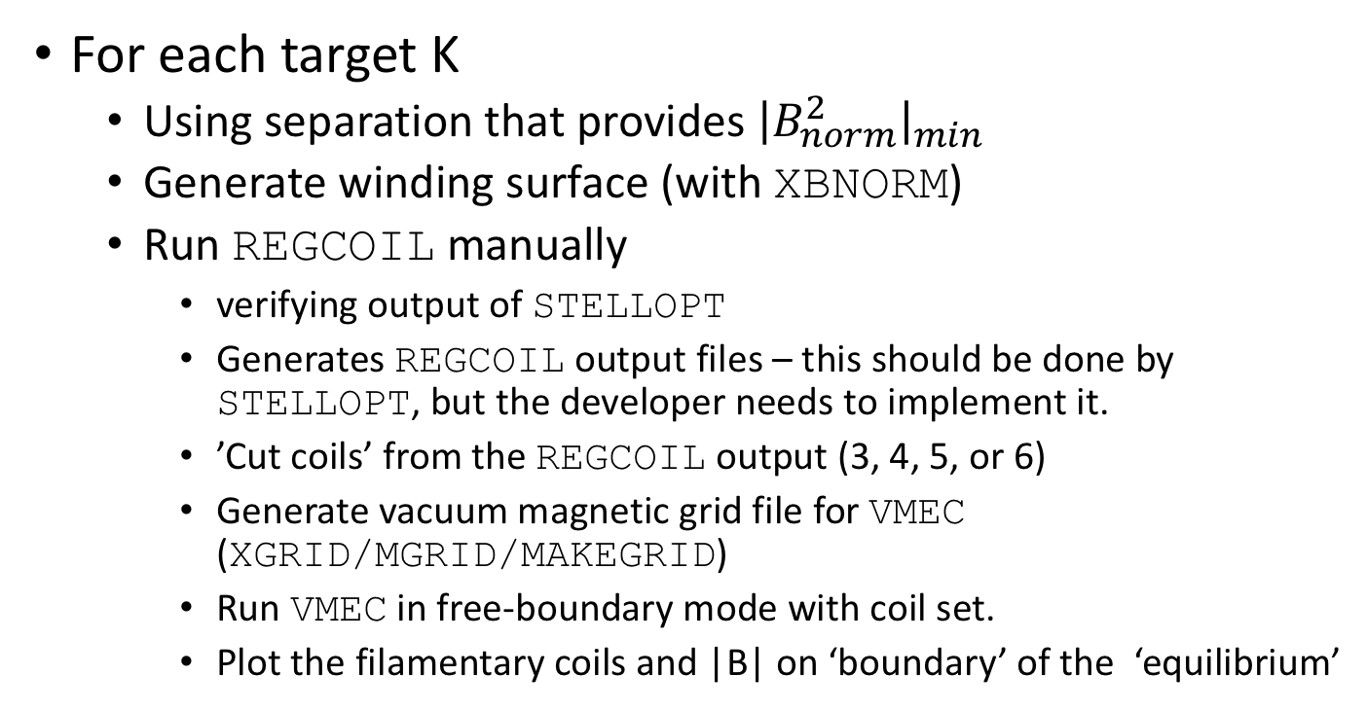
Next step: Cut coils, look at equilibrium
For each target K
  Using separation that provides $⁡{\left|B_{norm}^{2}\right|}_{min}$
  Generate winding surface (with XBNORM)
  Run REGCOIL manually
    verifying output of STELLOPT
    Generates REGCOIL output files – this should be done by STELLOPT, but the developer needs to implement it.
    ’Cut coils’ from the REGCOIL output (3, 4, 5, or 6)
    Generate vacuum magnetic grid file for VMEC (XGRID/MGRID/MAKEGRID)
    Run VMEC in free-boundary mode with coil set.
    Plot the filamentary coils and |B| on ‘boundary’ of the ‘equilibrium’

Slide 7
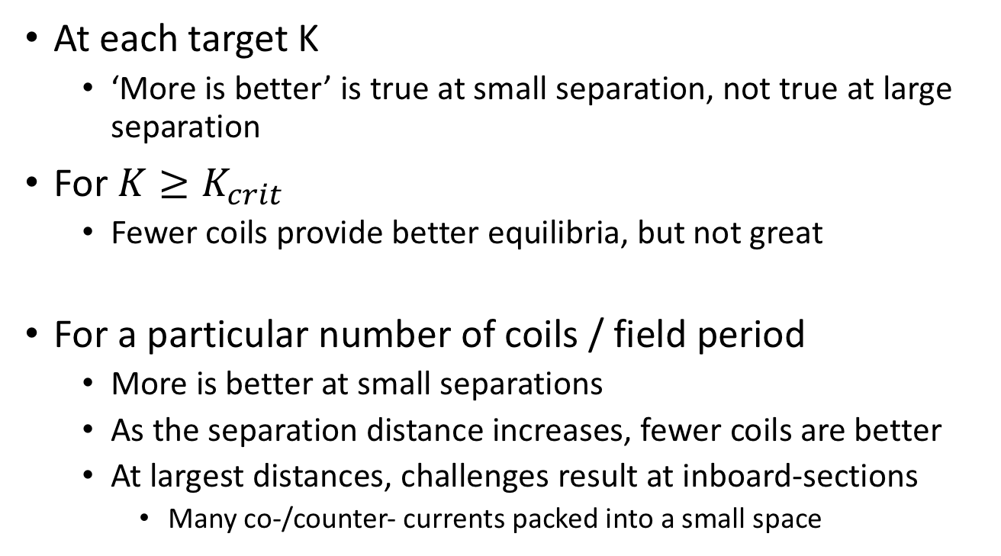
Number of coils / field period clearly has an impact on the ‘quality’ of the surfaces
At each target K
  ‘More is better’ is true at small separation, not true at large separation
For $K≥K_{crit}$
  Fewer coils provide better equilibria, but not great
For a particular number of coils / field period
  More is better at small separations
  As the separation distance increases, fewer coils are better
  At largest distances, challenges result at inboard-sections
    Many co-/counter- currents packed into a small space

Slide 8
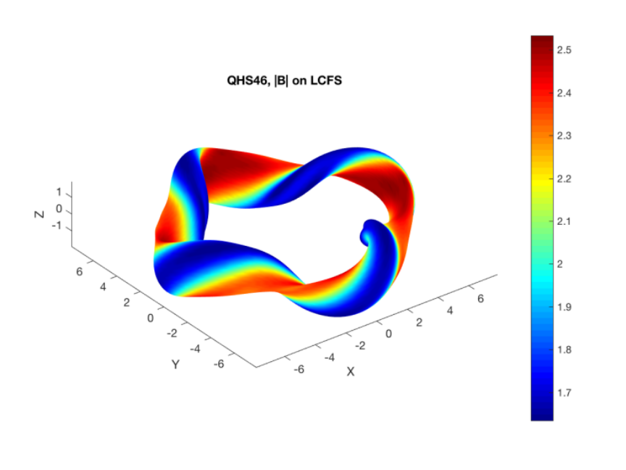
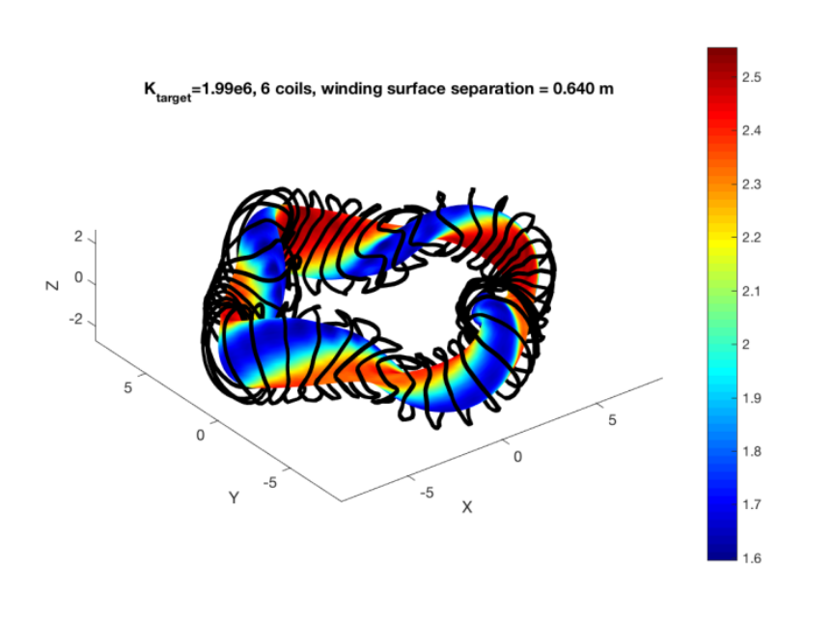
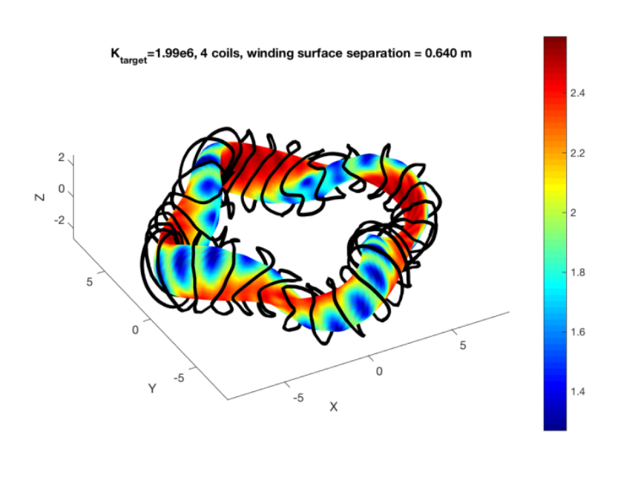
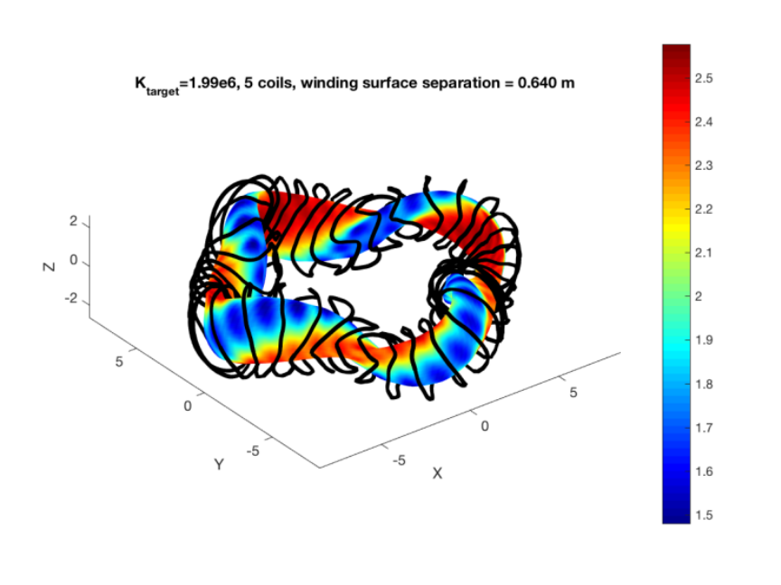
QHS46, 1.99e6 A/m

Slide 9
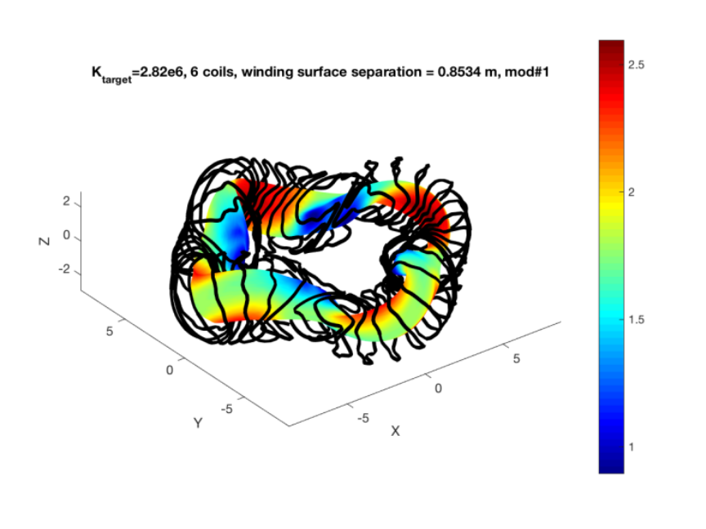
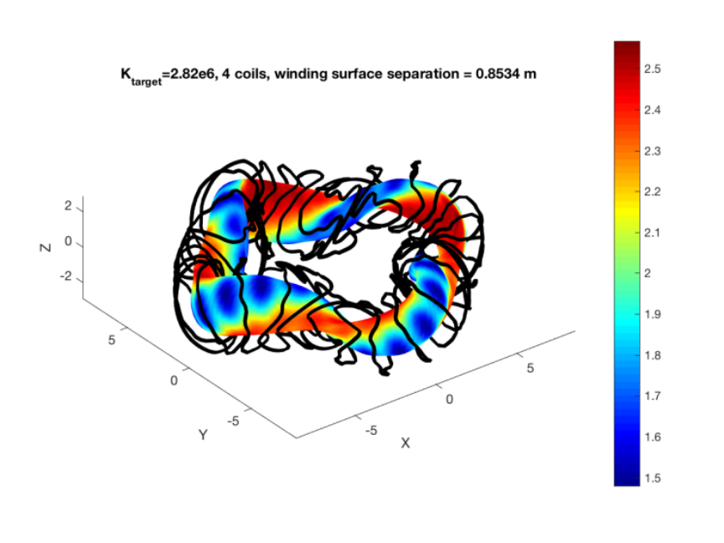
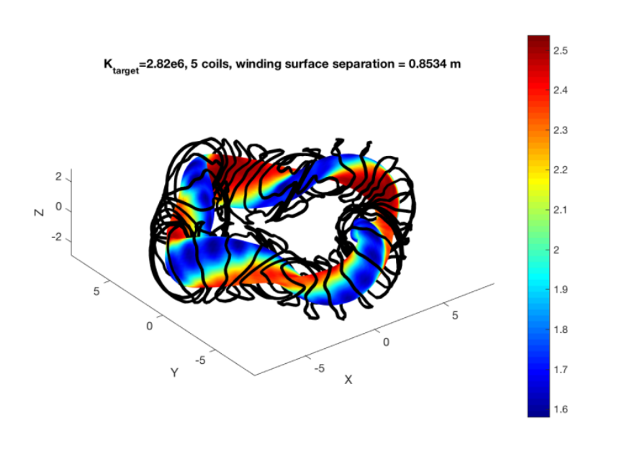
QHS46, 2.82e6 A/m

Slide 10

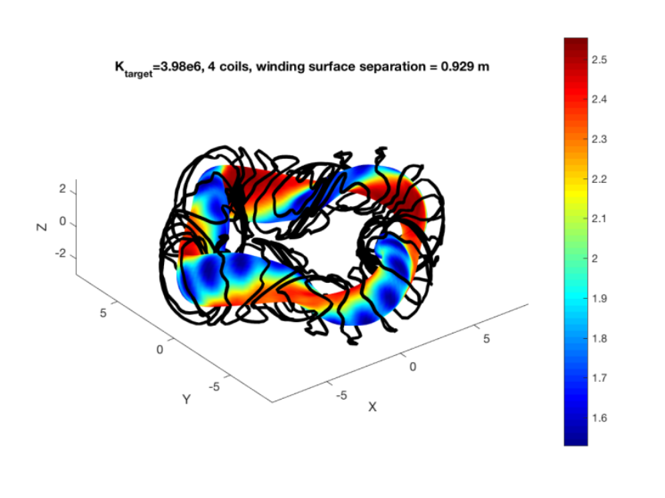

QHS46, 3.98e6

Slide 11
QHS46, 4 coils
Inboard, Low-field section
  Need low |B|
  B needs to point along a helical trajectory
  Restricted to a large separation away from plasma
  Lots of winding, back-and-forth contours

Slide 12
QHS46, 5 coils
Inboard, Low-field section
  Need low |B|
  B needs to point along a helical trajectory
  Restricted to a large separation away from plasma
  Lots of winding, back-and-forth contours

Slide 13
QHS, 6 coils
Inboard, Low-field section
  Need low |B|
  B needs to point along a helical trajectory
  Restricted to a large separation away from plasma
  Lots of winding, back-and-forth contours

Slide 14
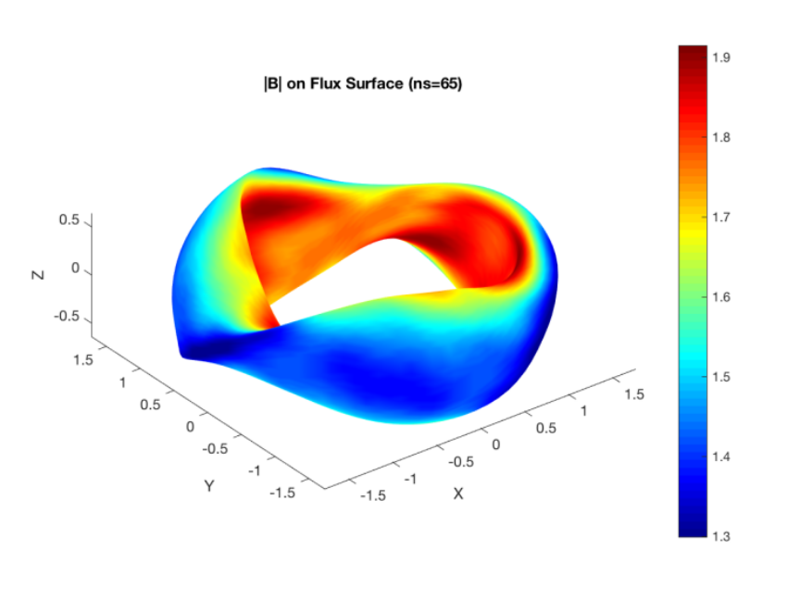
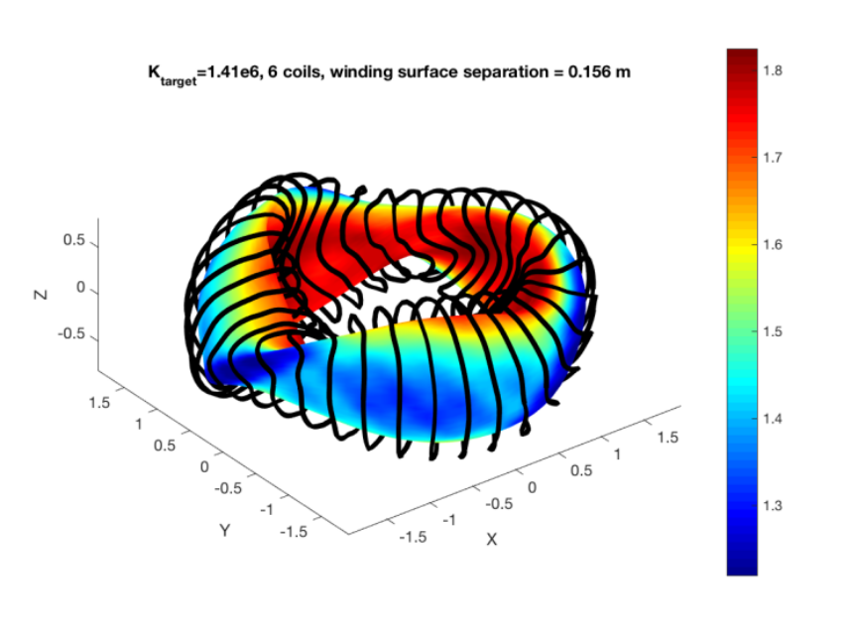
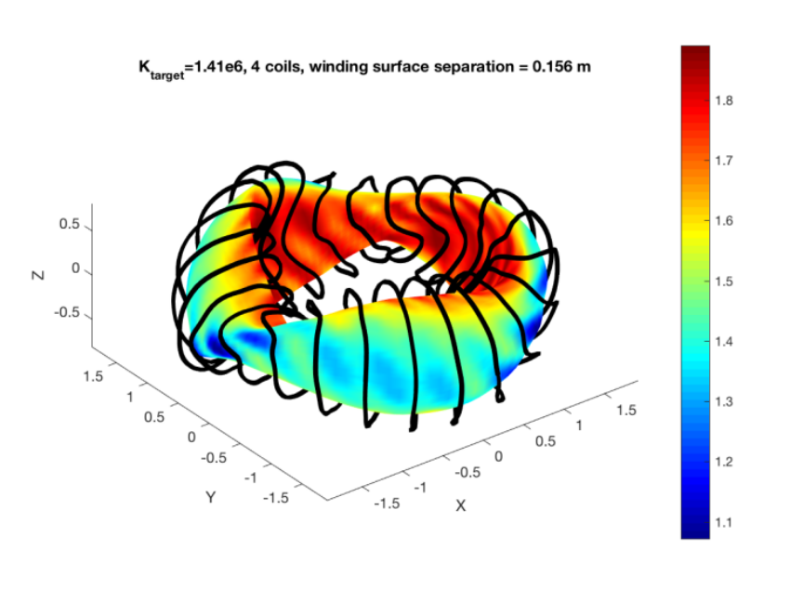
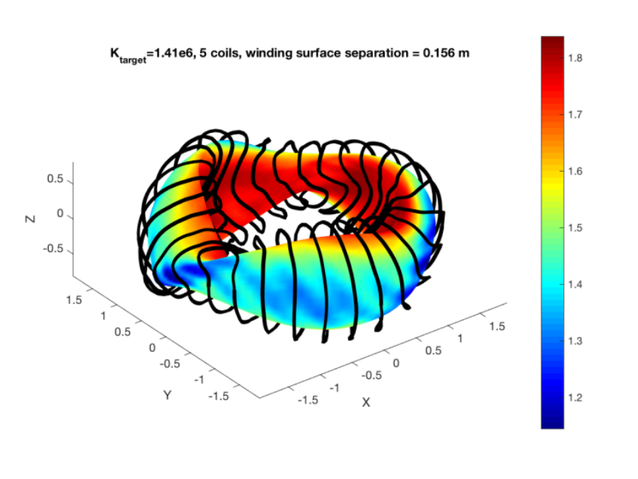
QAS, 1.41e6 A/m

Slide 15
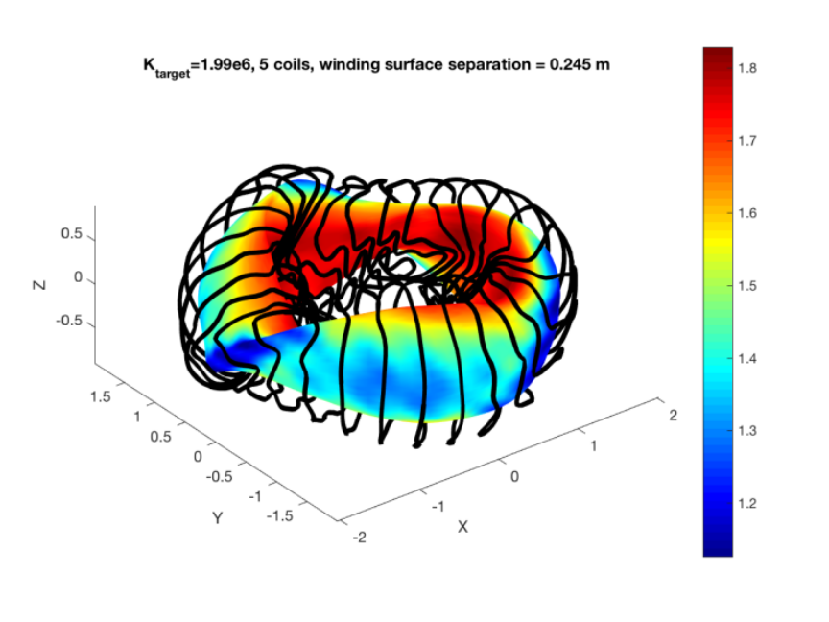
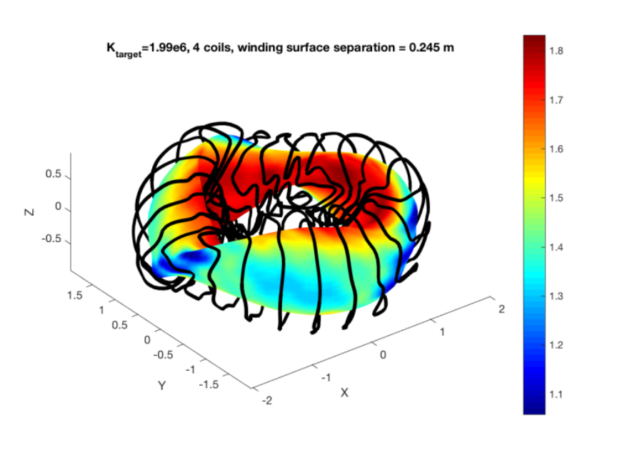
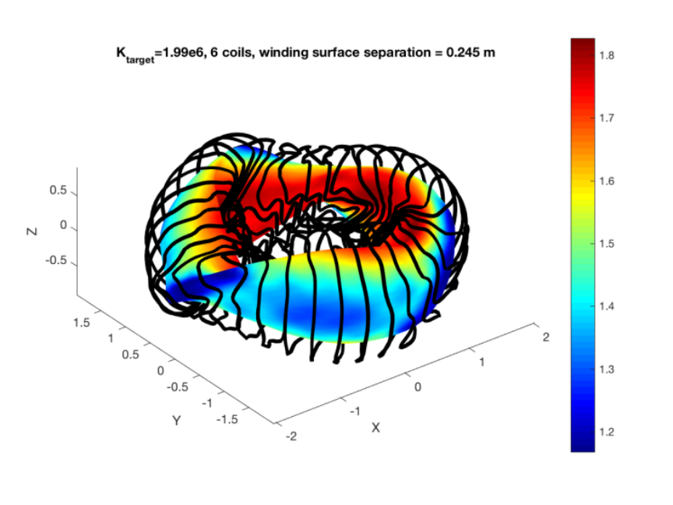
QAS, 1.99e6 A/m

Slide 16

QAS 2.82e6 A/m

Slide 17
QAS, 3 coil
Inboard, ‘bullet’ section
  Need high |B|
  B needs to point along a toroidal trajectory
  Restricted to a large separation away from plasma
  Some winding, back-and-forth contours
Outboard low-field section
  See comments about QHS low-field in-board section

Slide 18
QAS, 4 coil
Inboard, ‘bullet’ section
  Need high |B|
  B needs to point along a toroidal trajectory
  Restricted to a large separation away from plasma
  Some winding, back-and-forth contours
Outboard low-field section
  See comments about QHS low-field in-board section

Slide 19
QAS, 5 coil
Inboard, ‘bullet’ section
  Need high |B|
  B needs to point along a toroidal trajectory
  Restricted to a large separation away from plasma
  Some winding, back-and-forth contours
Outboard low-field section
  See comments about QHS low-field in-board section

Slide 20
QAS, 6 coil
Inboard, ‘bullet’ section
  Need high |B|
  B needs to point along a toroidal trajectory
  Restricted to a large separation away from plasma
  Some winding, back-and-forth contours
Outboard low-field section
  See comments about QHS low-field in-board section

Slide 21
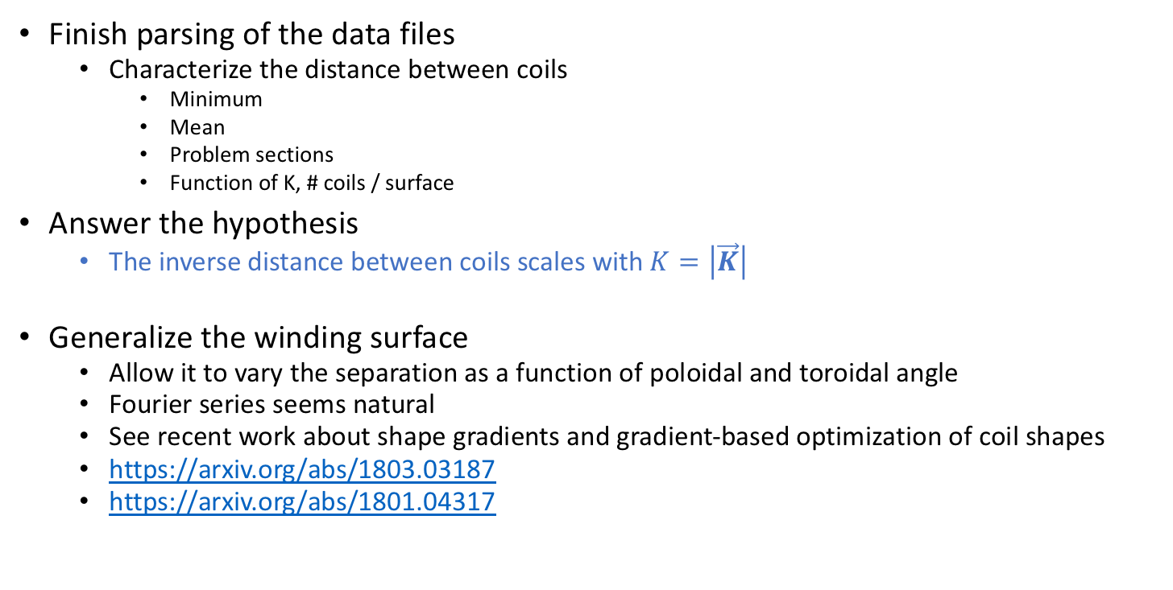
To do list
Finish parsing of the data files
  Characterize the distance between coils
    Minimum
    Mean
    Problem sections
    Function of K, # coils / surface
Answer the hypothesis
  The inverse distance between coils scales with $K=\left|\vec{K}\right|$
Generalize the winding surface
  Allow it to vary the separation as a function of poloidal and toroidal angle
  Fourier series seems natural
  See recent work about shape gradients and gradient-based optimization of coil shapes
  https://arxiv.org/abs/1803.03187
  https://arxiv.org/abs/1801.04317

Slide 22
Backup slides below

Slide 23
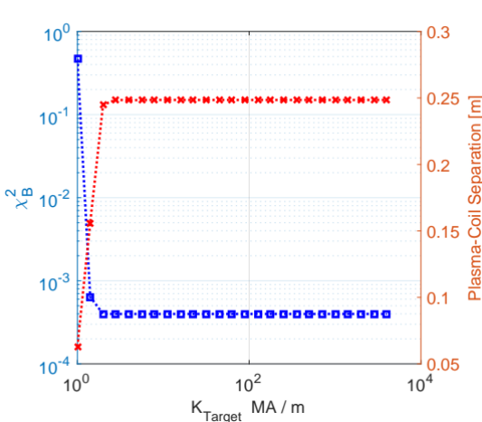
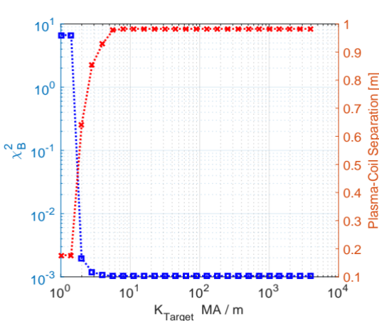
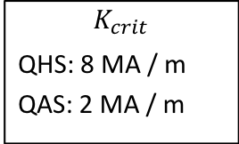
REGCOIL with STELLOPT
QHS46 and QAS configurations show that optimal separation and $χ_{B}^{2}$ asymptote above $K≥K_{crit}$
$$K_{crit}$$
QHS: 8 MA / m
QAS: 2 MA / m
Scans complete for ‘separation’, the uniform distance between plasma and winding surface
Winding surface have geometric difficulties for largest separations
QAS
Increasing RMS current density on winding surface
QHS46
Increasing RMS current density on winding surface

Slide 24
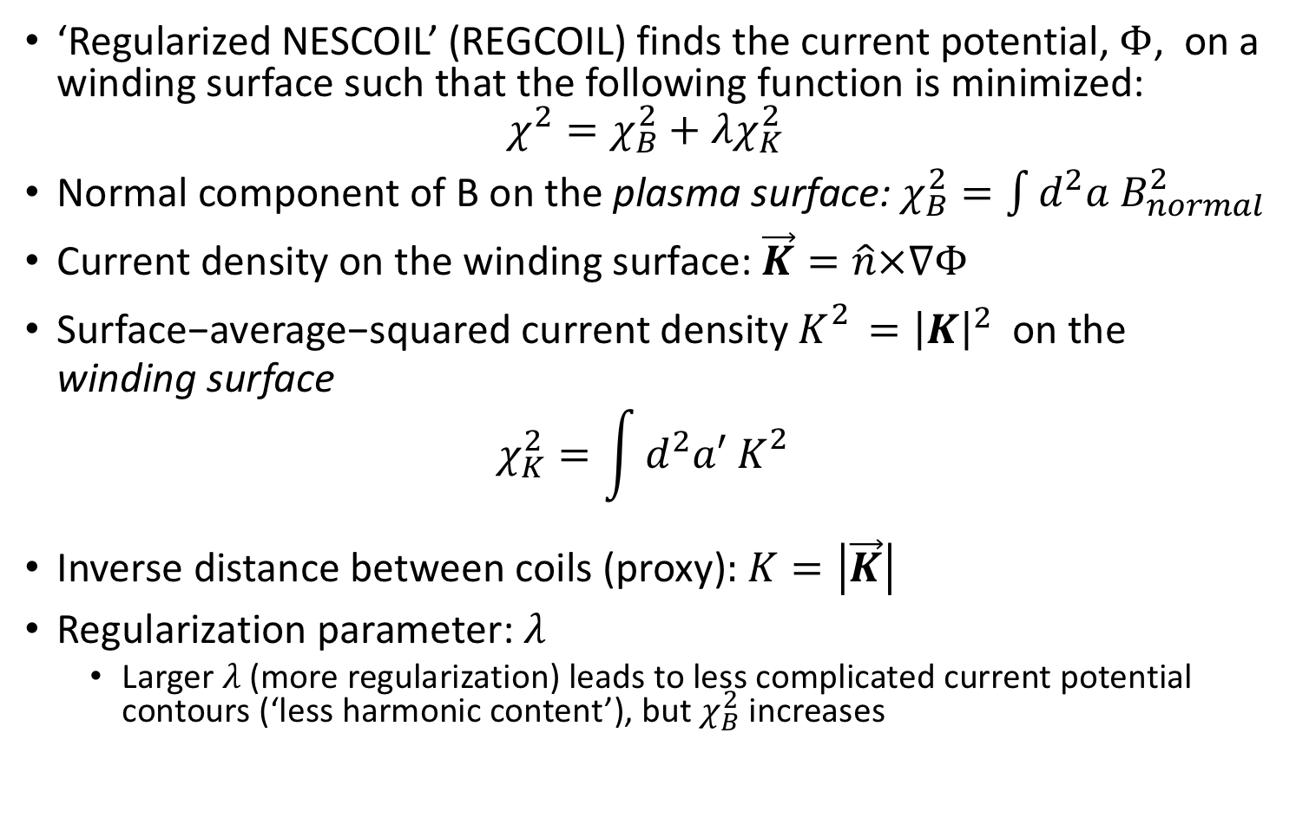
Background about REGCOIL^{1,2}, 1
‘Regularized NESCOIL’ (REGCOIL) finds the current potential, $Φ$, on a winding surface such that the following function is minimized:
$$χ^{2}=χ_{B}^{2}+λχ_{K}^{2}$$
Normal component of B on the plasma surface: $χ_{B}^{2}=\int{d^{2}a B_{normal}^{2}}$
Current density on the winding surface: $\vec{K}=\hat{n}×∇Φ$
$\text{Surface}\text{−}\text{average}\text{−}\text{squared} \text{current} \text{density}{ K}_{}^{2}={\left|K\right|}^{2} \text{on} \text{the} \text{winding} \text{surface}$
$$χ_{K}^{2}=\int{d^{2}a′ K_{}^{2}}$$
Inverse distance between coils (proxy): $K=\left|\vec{K}\right|$
Regularization parameter: $λ$
  Larger $λ$ (more regularization) leads to less complicated current potential contours (‘less harmonic content’), but $χ_{B}^{2}$ increases
(Check Normalization)
¹ M. Landreman, Nuclear Fusion 57, 046003 (2017).
² https://github.com/landreman/regcoil

Slide 25
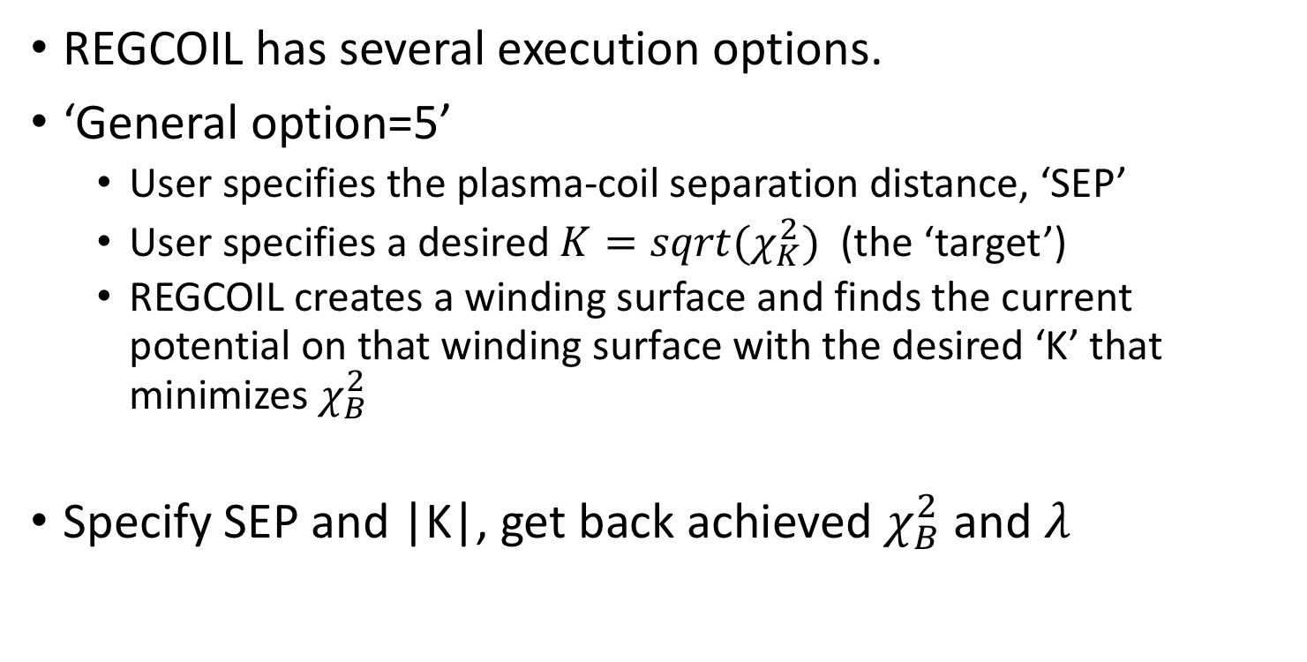
Background about REGCOIL, 2
REGCOIL has several execution options.
‘General option=5’
  User specifies the plasma-coil separation distance, ‘SEP’
  User specifies a desired ${K=sqrt(χ}_{K}^{2})$ (the ‘target’)
  REGCOIL creates a winding surface and finds the current potential on that winding surface with the desired ‘K’ that minimizes $χ_{B}^{2}$
Specify SEP and |K|, get back achieved $χ_{B}^{2}$ and $λ$

Slide 26
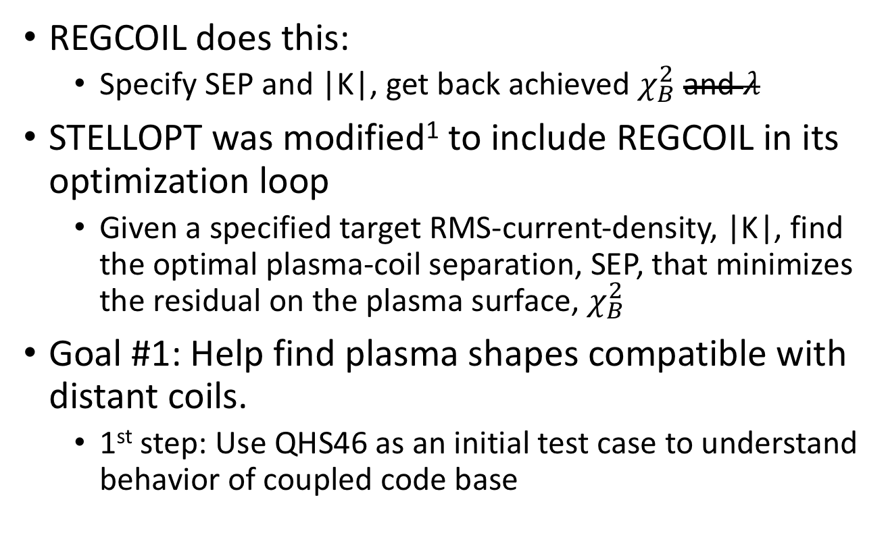
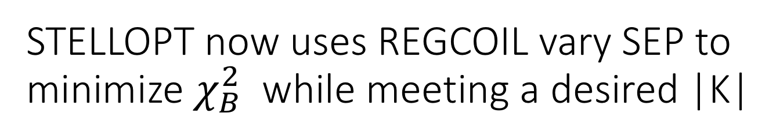
STELLOPT now uses REGCOIL vary SEP to minimize $χ_{B}^{2}$ while meeting a desired |K|
REGCOIL does this:
  Specify SEP and |K|, get back achieved $χ_{B}^{2}$ and $λ$
STELLOPT was modified¹ to include REGCOIL in its optimization loop
  Given a specified target RMS-current-density, |K|, find the optimal plasma-coil separation, SEP, that minimizes the residual on the plasma surface, $χ_{B}^{2}$
Goal #1: Help find plasma shapes compatible with distant coils.
  1st step: Use QHS46 as an initial test case to understand behavior of coupled code base
¹ http://vmecwiki.pppl.wikispaces.net/Stellopt_Adding_new_code

Slide 27
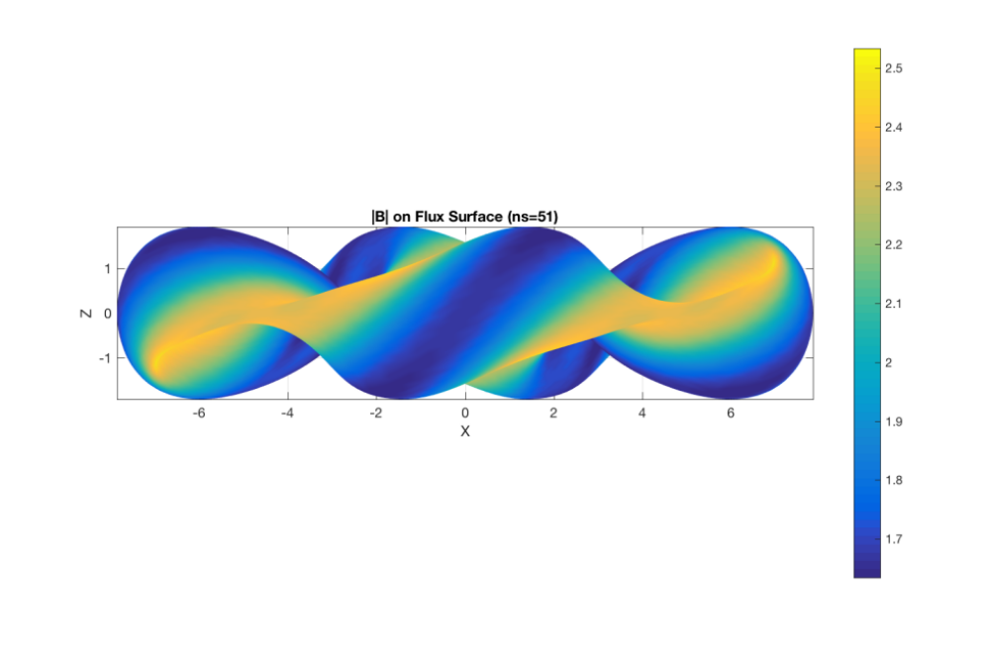
QHS46 Configuration: “6-m HSX”

Slide 28
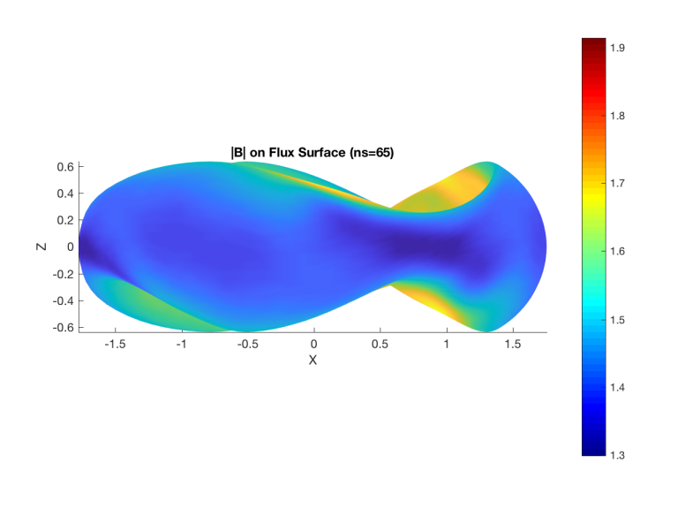
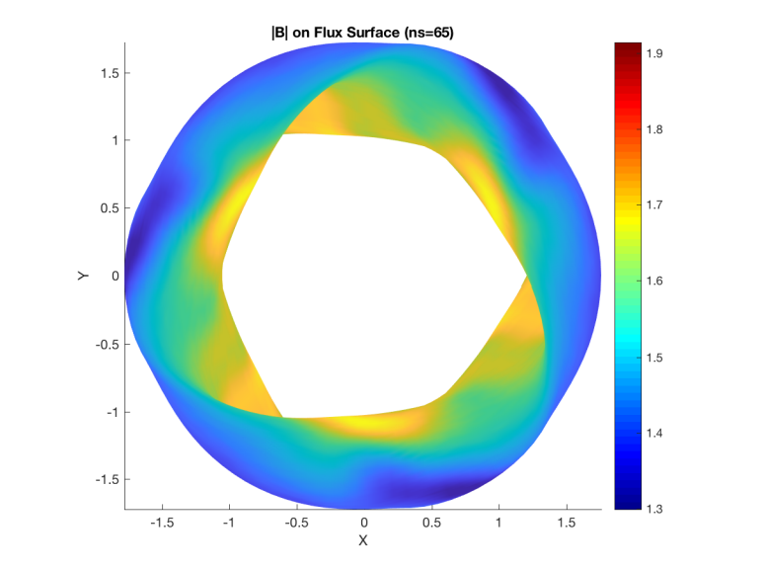
QAS, 5% Beta case
(STELLOPT Benchmark)

Slide 29
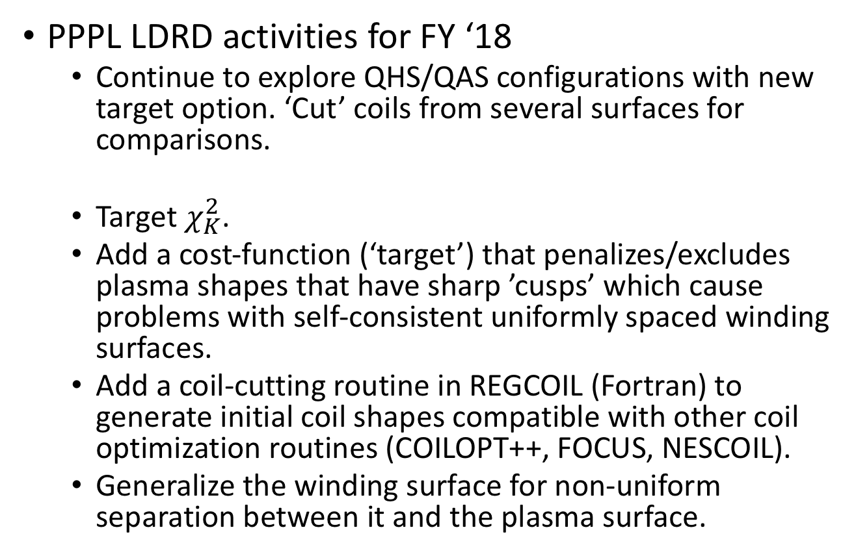
Next steps
PPPL LDRD activities for FY ‘18
  Continue to explore QHS/QAS configurations with new target option. ‘Cut’ coils from several surfaces for comparisons.
  Target $χ_{K}^{2}$.
  Add a cost-function (‘target’) that penalizes/excludes plasma shapes that have sharp ’cusps’ which cause problems with self-consistent uniformly spaced winding surfaces.
  Add a coil-cutting routine in REGCOIL (Fortran) to generate initial coil shapes compatible with other coil optimization routines (COILOPT++, FOCUS, NESCOIL).
  Generalize the winding surface for non-uniform separation between it and the plasma surface.

