Slide 1
Part 1: Using STELLOPT/REGCOIL and to find a better winding surface for QHS46
Part 2: Discrete coils, free-boundary VMEC MHD solutions and Boozer spectra
John C. Schmitt
A. Bader, M. Landreman, S. Lazerson, E. Paul
Internal Draft Slides, April 2018

Slide 2
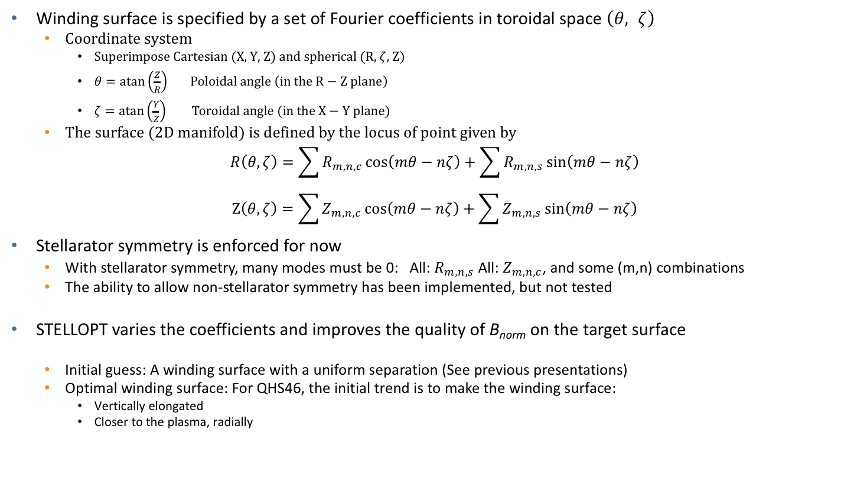
STELLOPT can now manipulate the set of Fourier coefficients that describe the coil winding surface
Winding surface is specified by a set of Fourier coefficients in toroidal space $\left(θ, ζ\right)$
  Coordinate system
    Superimpose Cartesian (X, Y, Z) and spherical (R, $ζ$, Z)
    $θ=\operatorname{atan}\left(\frac{Z}{R}\right) Poloidal angle \left(in the R−Z plane\right)$
    $ζ=\operatorname{atan}\left(\frac{Y}{Z}\right) Toroidal angle (in the X−Y plane)$
  The surface (2D manifold) is defined by the locus of point given by
$$R\left(θ, ζ\right)=\sum{R_{m,n,c}\cos\left(mθ−nζ\right)}+\sum{R_{m,n,s}\sin\left(mθ−nζ\right)}$$
$$Z\left(θ, ζ\right)=\sum{Z_{m,n,c}\cos\left(mθ−nζ\right)}+\sum{Z_{m,n,s}\sin\left(mθ−nζ\right)}$$
Stellarator symmetry is enforced for now
  With stellarator symmetry, many modes must be 0: All: $R_{m,n,s}$ All: $Z_{m,n,c}$, and some (m,n) combinations
  The ability to allow non-stellarator symmetry has been implemented, but not tested
STELLOPT varies the coefficients and improves the quality of B_{norm} on the target surface
  Initial guess: A winding surface with a uniform separation (See previous presentations)
  Optimal winding surface: For QHS46, the initial trend is to make the winding surface:
    Vertically elongated
    Closer to the plasma, radially

Slide 3
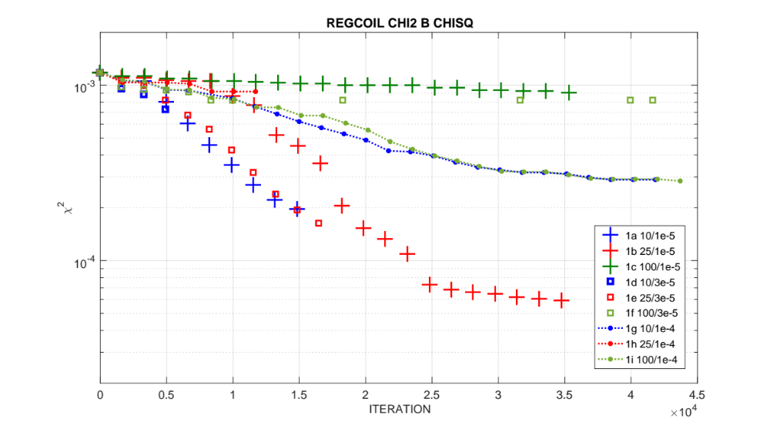

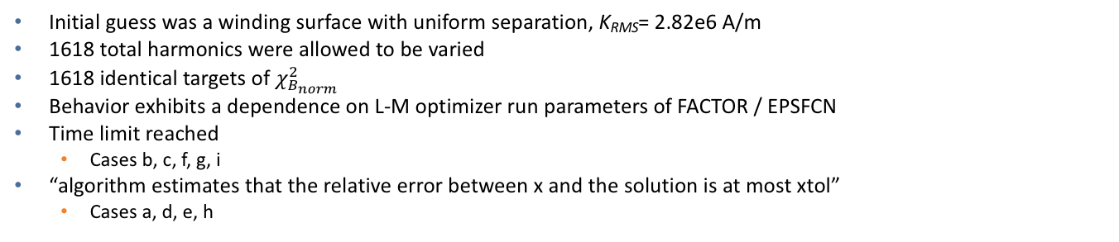
STELLOPT finds a better solutions (smaller residual error, reduced $B_{norm}$ on the target plasma surface) when manipulating the Fourier coefficients. An improvement by one order of magnitude compared to the uniform winding surface.
Initial guess was a winding surface with uniform separation, K_{RMS}= 2.82e6 A/m
1618 total harmonics were allowed to be varied
1618 identical targets of $χ_{B_{norm}}^{2}$
Behavior exhibits a dependence on L-M optimizer run parameters of FACTOR / EPSFCN
Time limit reached
  Cases b, c, f, g, i
“algorithm estimates that the relative error between x and the solution is at most xtol”
  Cases a, d, e, h

Slide 4
The next 21 slides show the evolution of the new ‘optimal’ solution during case 1b with FACTOR/EPSFCN = 25 / 1e-5
This is the case shown in red ‘+’ symbols, see arrows
The first slide will explain what is being shown in each subplot
There are 21 set of plots, one for each new solution

Slide 5
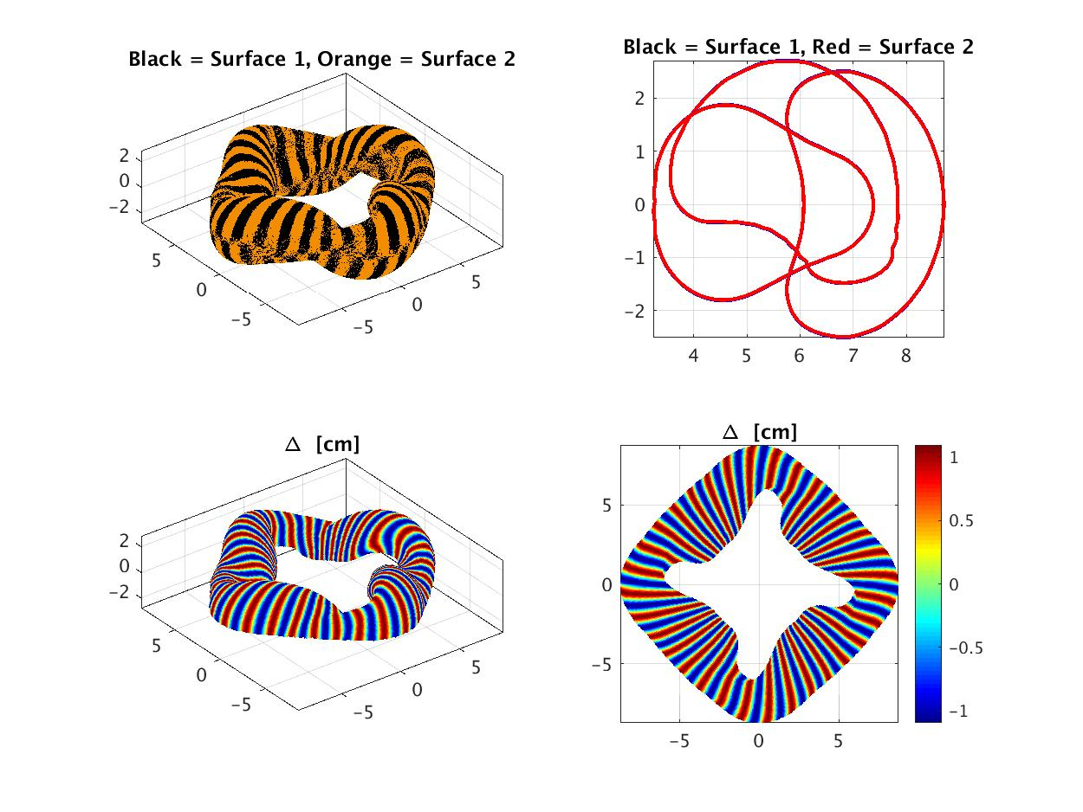
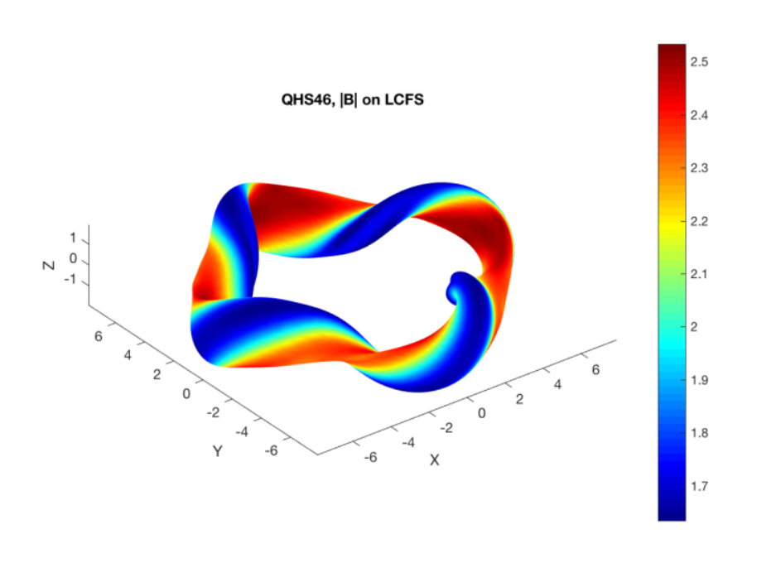
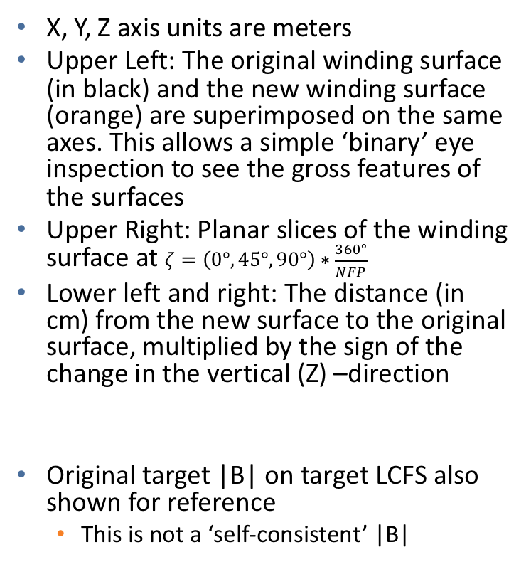
As an example, the first step (but don’t dwell on it)
X, Y, Z axis units are meters
Upper Left: The original winding surface (in black) and the new winding surface (orange) are superimposed on the same axes. This allows a simple ‘binary’ eye inspection to see the gross features of the surfaces
Upper Right: Planar slices of the winding surface at $ζ=\left(0°,45°,90°\right)∗\frac{360°}{NFP}$
Lower left and right: The distance (in cm) from the new surface to the original surface, multiplied by the sign of the change in the vertical (Z) –direction
Original target |B| on target LCFS also shown for reference
  This is not a ‘self-consistent’ |B|

Slide 6
Iterative solution #2, The first step

Slide 7
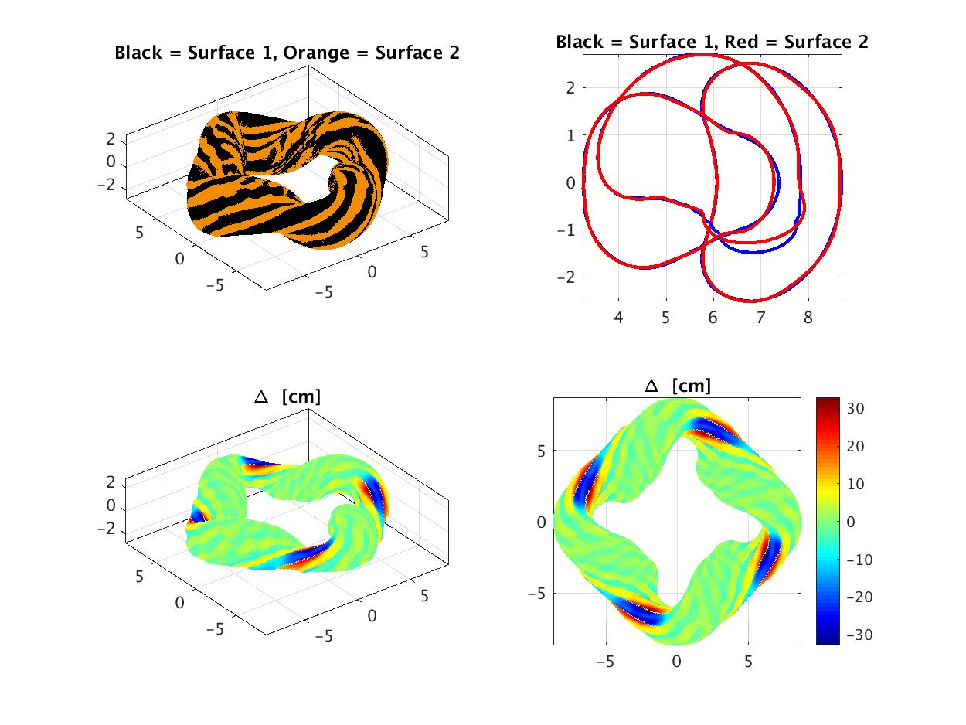
Iterative solution #3

Slide 8
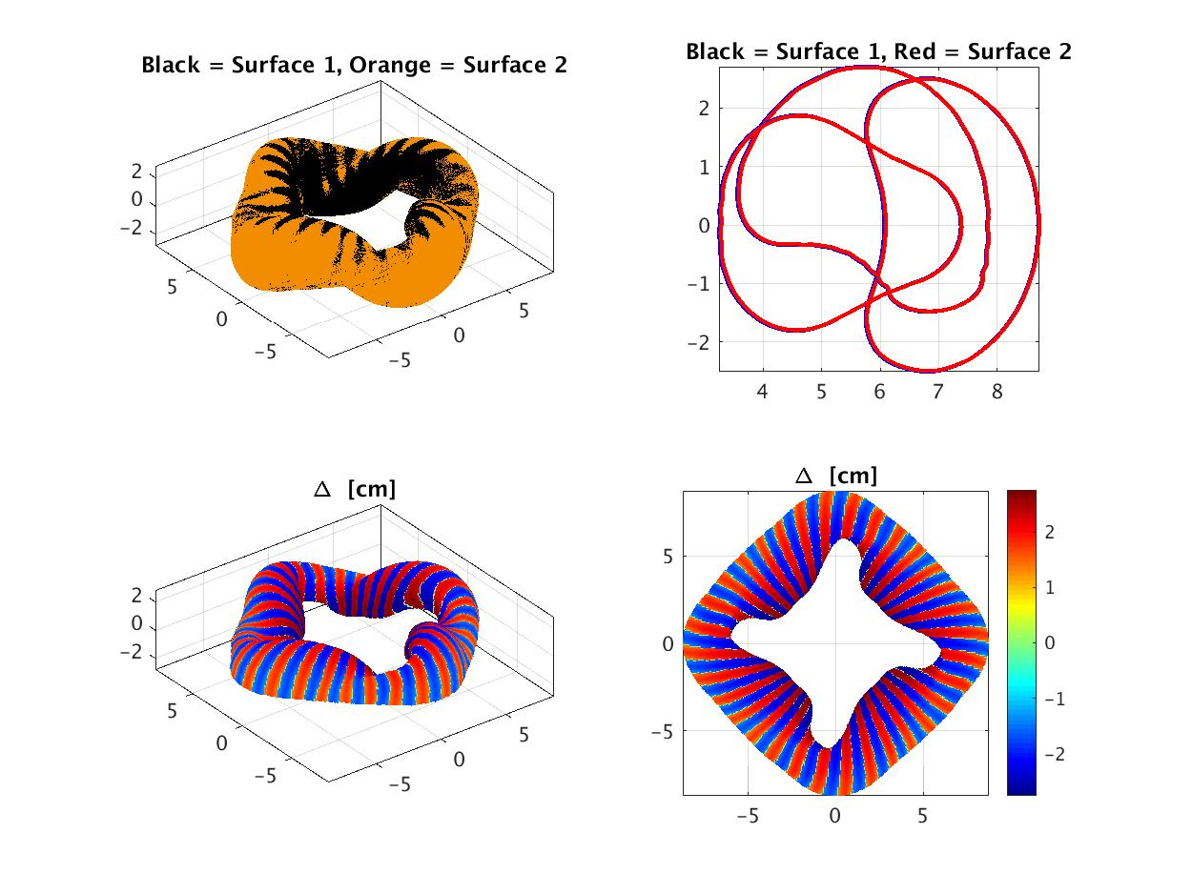
Iterative solution #4

Slide 9

Iterative solution #5

Slide 10
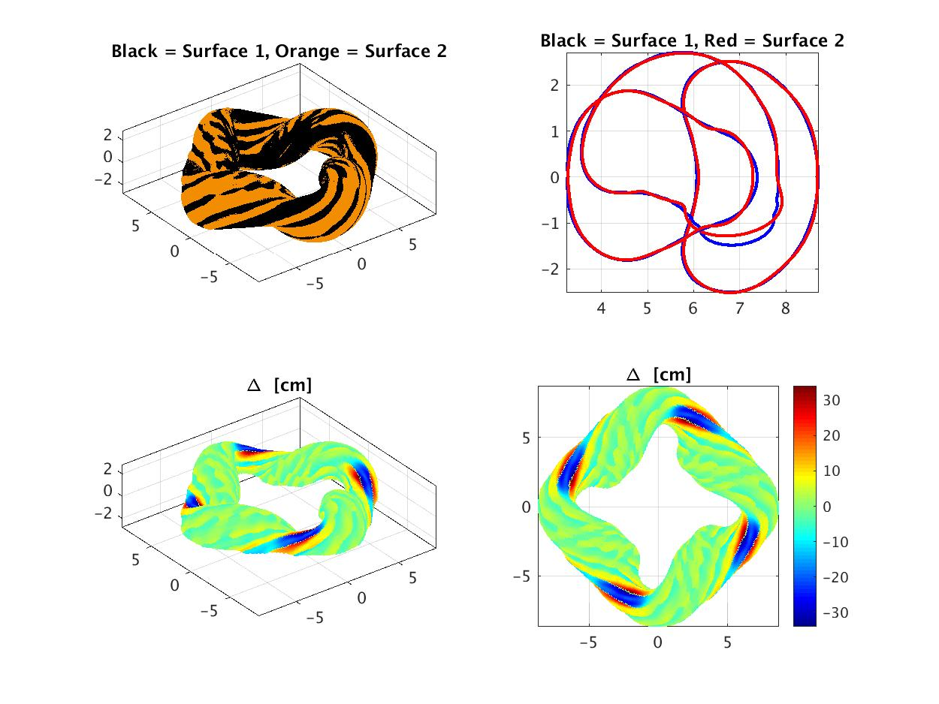
Iterative solution #6

Slide 11
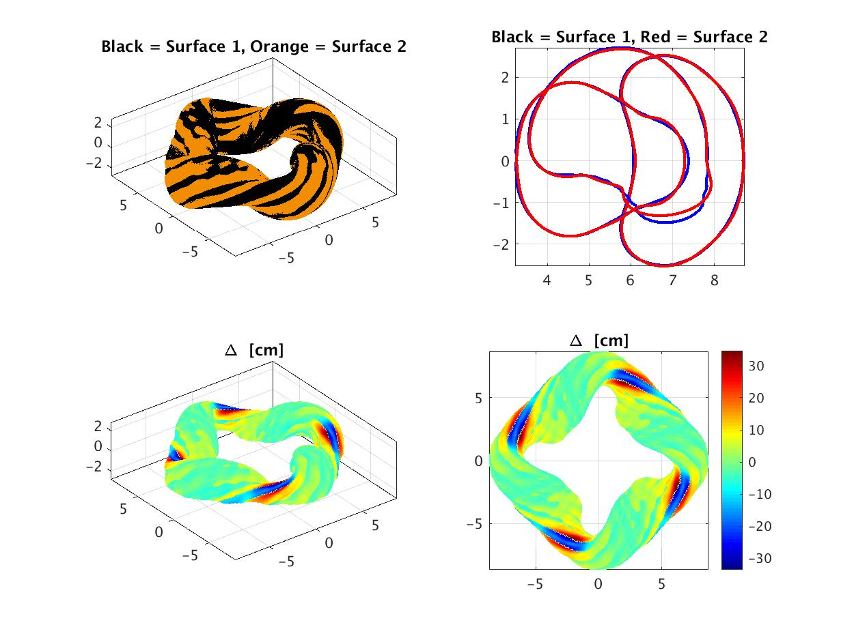
Iterative solution #7

Slide 12
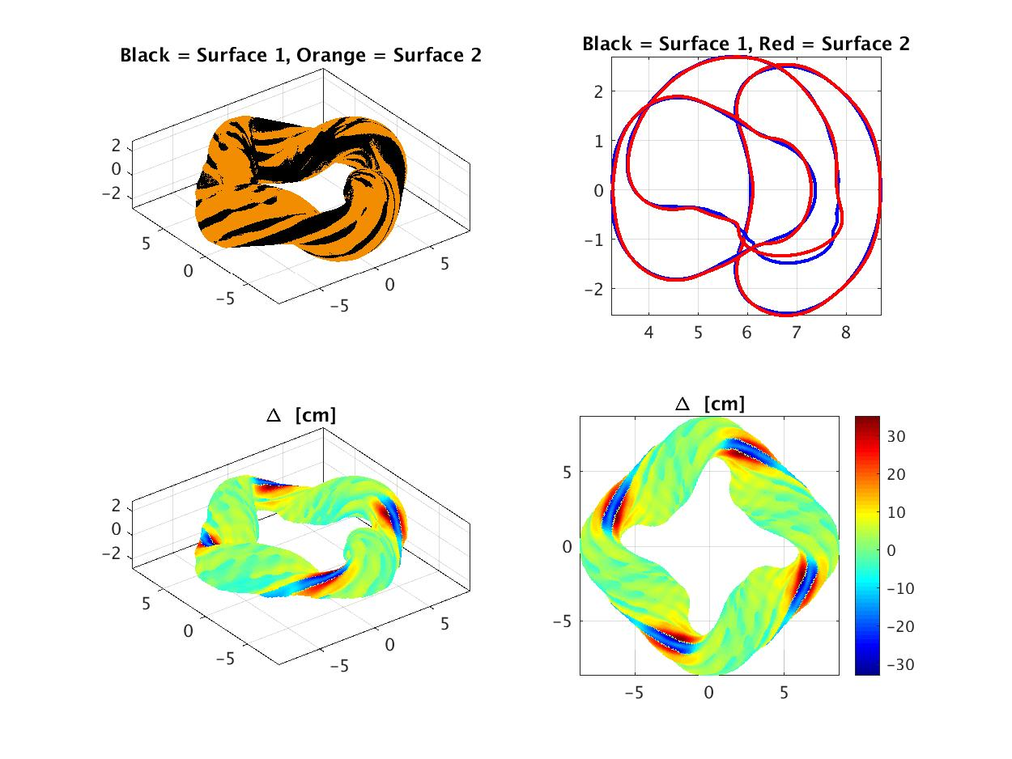
Iterative solution #8

Slide 13
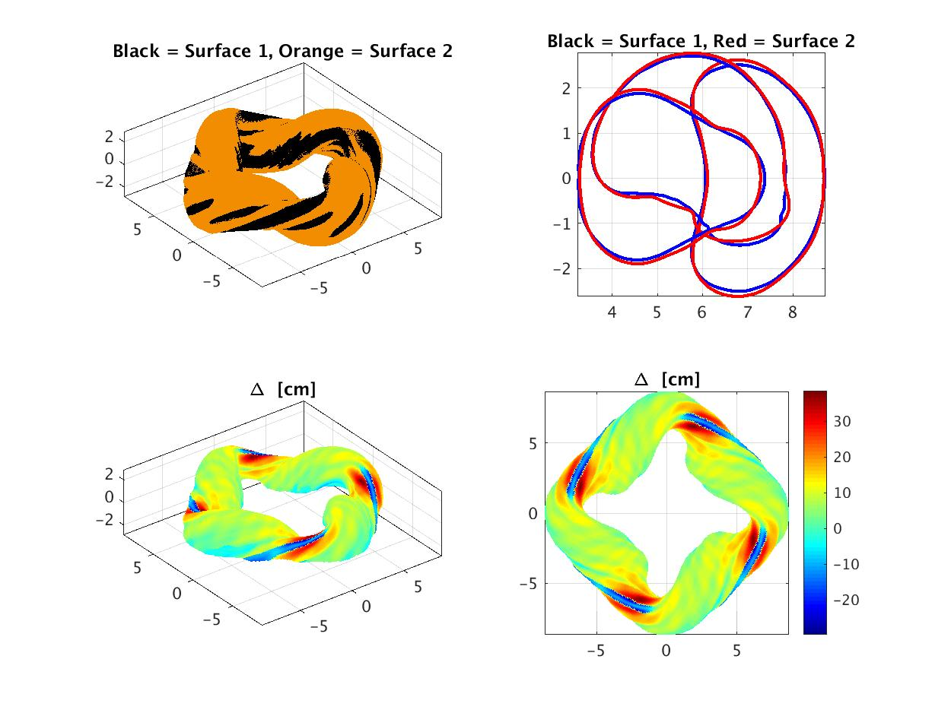
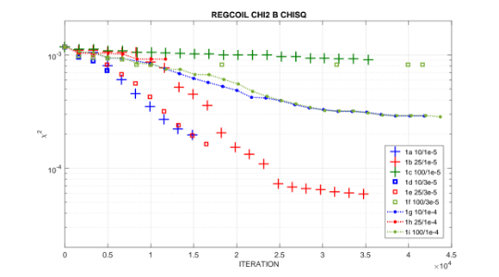
Iterative solution #9: A new rate of descent begins now; Surface will become narrower and taller.

Slide 14

Iterative solution #10

Slide 15
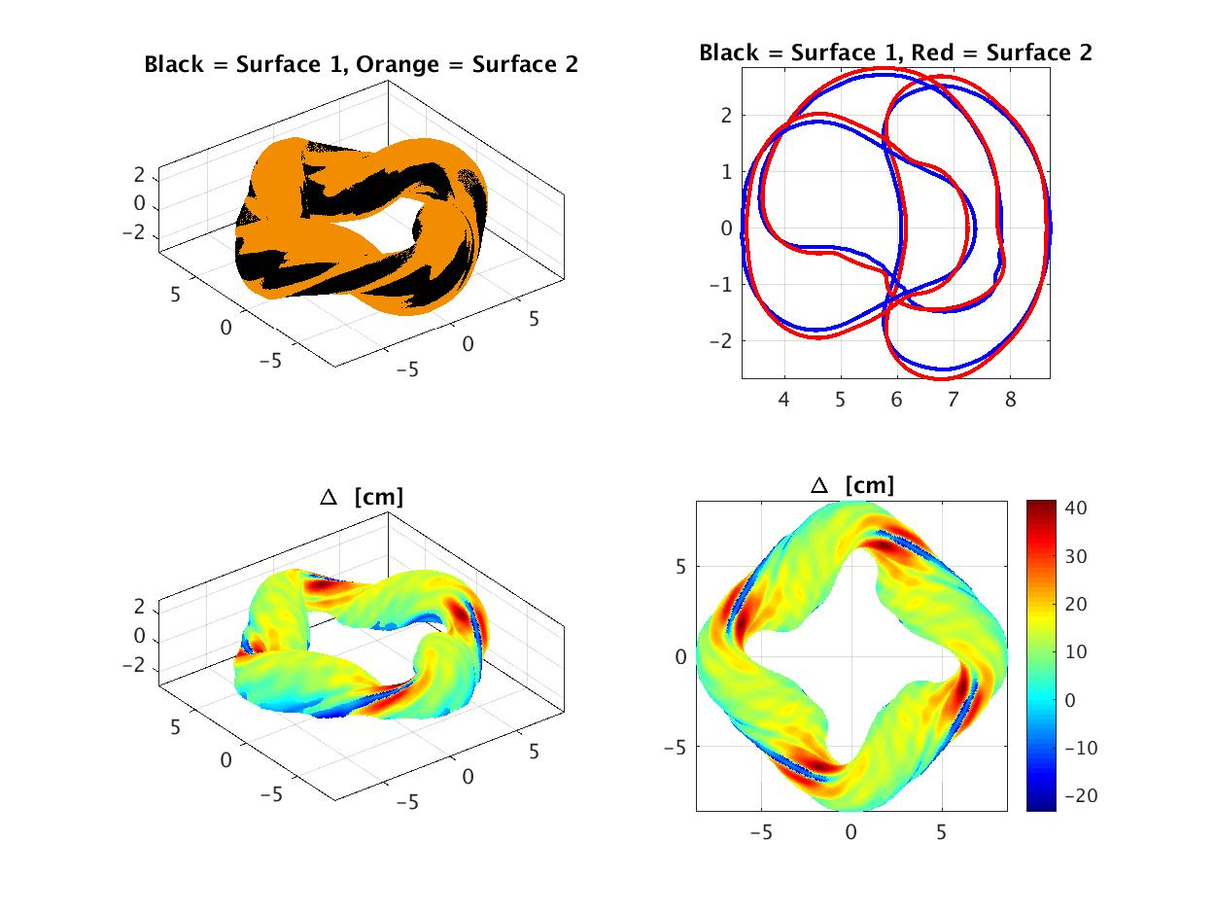
Iterative solution #11

Slide 16
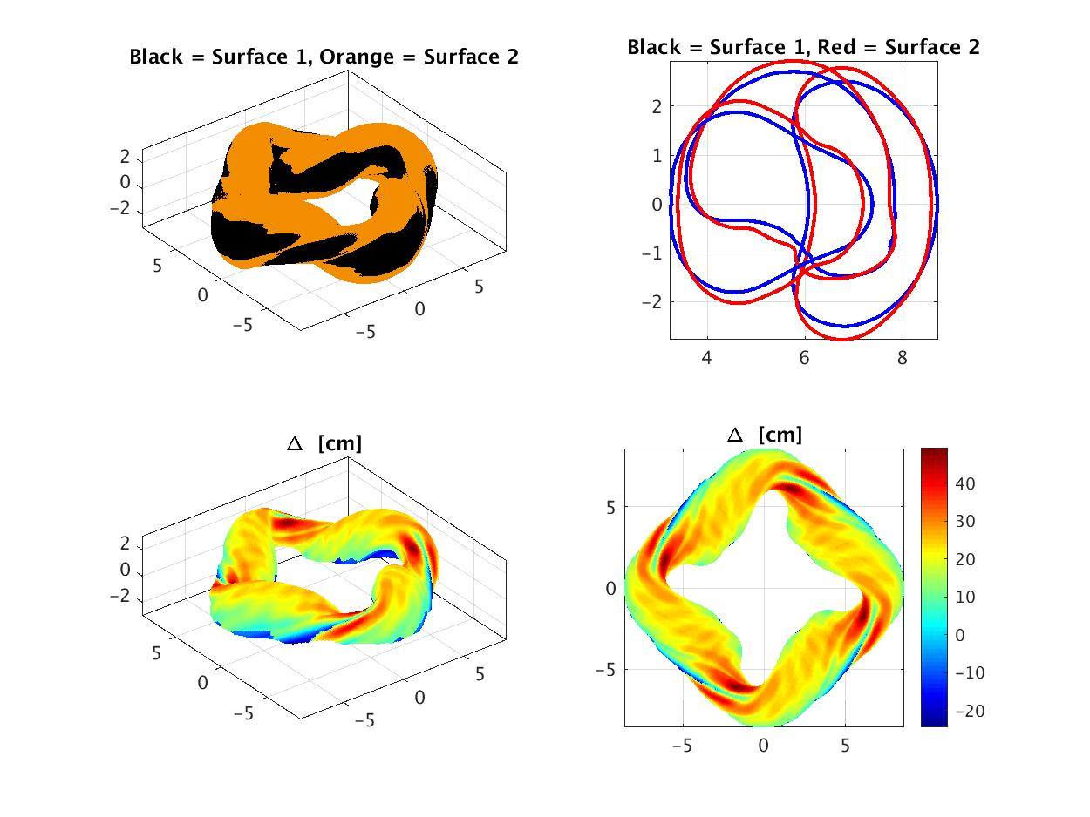
Iterative solution #12

Slide 17

Iterative solution #13

Slide 18
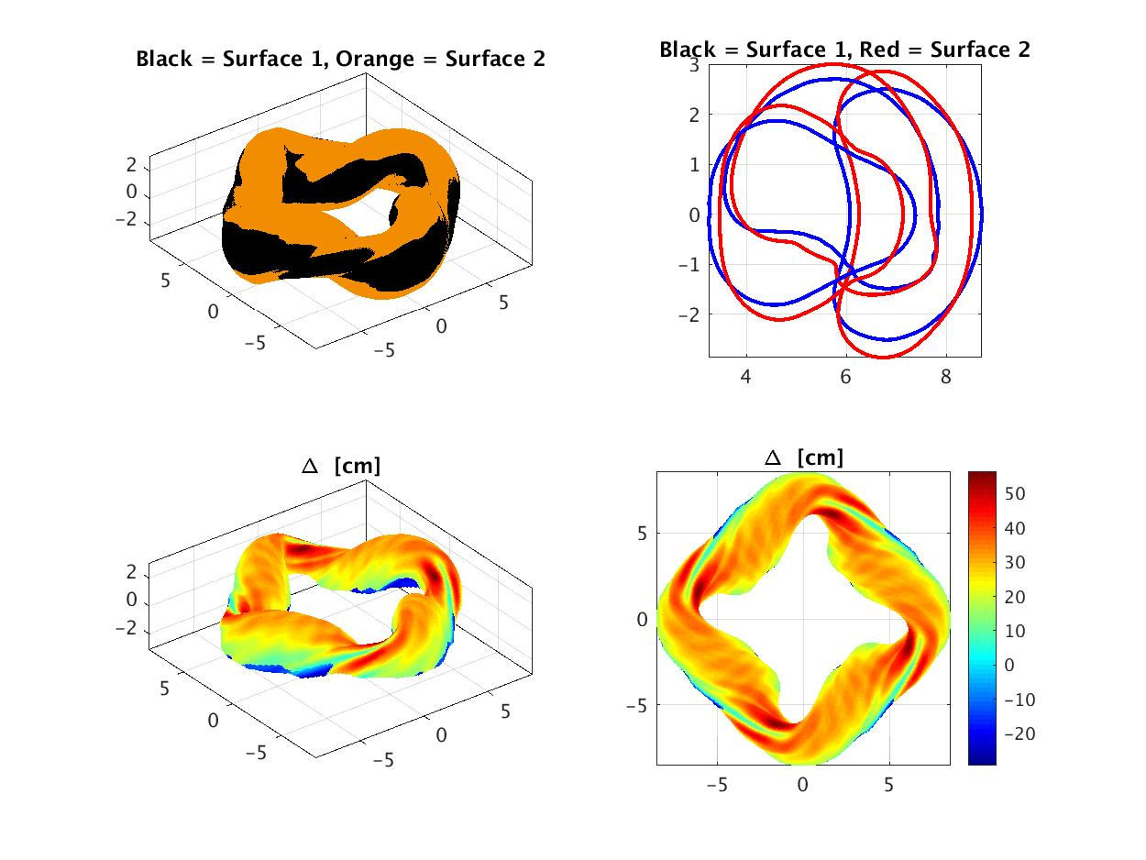
Iterative solution #14

Slide 19

Iterative solution # 15

Slide 20
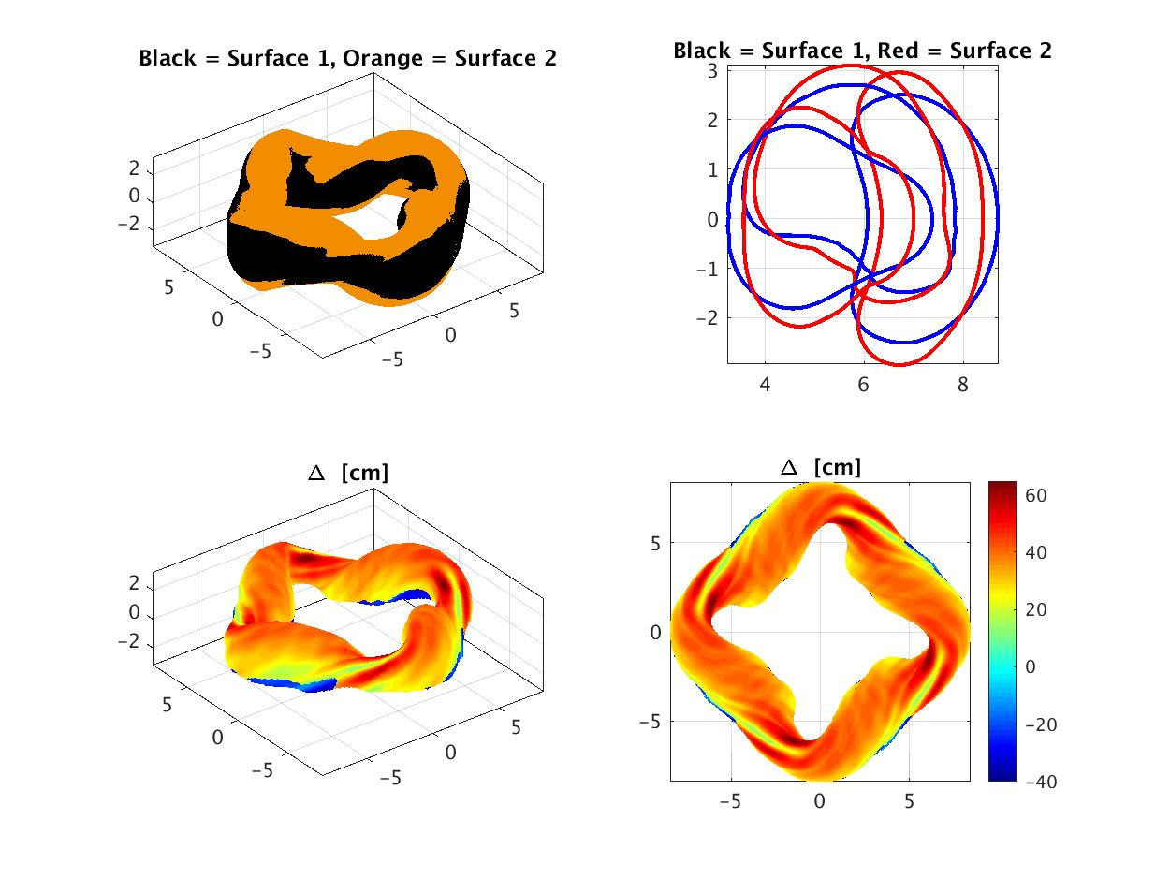
Iterative solution # 16: Descent slows down from here on to the end

Slide 21

Iterative solution #17

Slide 22

Iterative solution #18

Slide 23

Iterative solution #19

Slide 24

Iterative solution #20

Slide 25

Iterative solution #21

Slide 26

Iterative solution #22: (24x32 cpu-hour time limit)
The solution after the last iteration is teller and narrower than the starting position
Recall: The starting position was a ‘uniform distance’ away from the plasma boundary

Slide 27
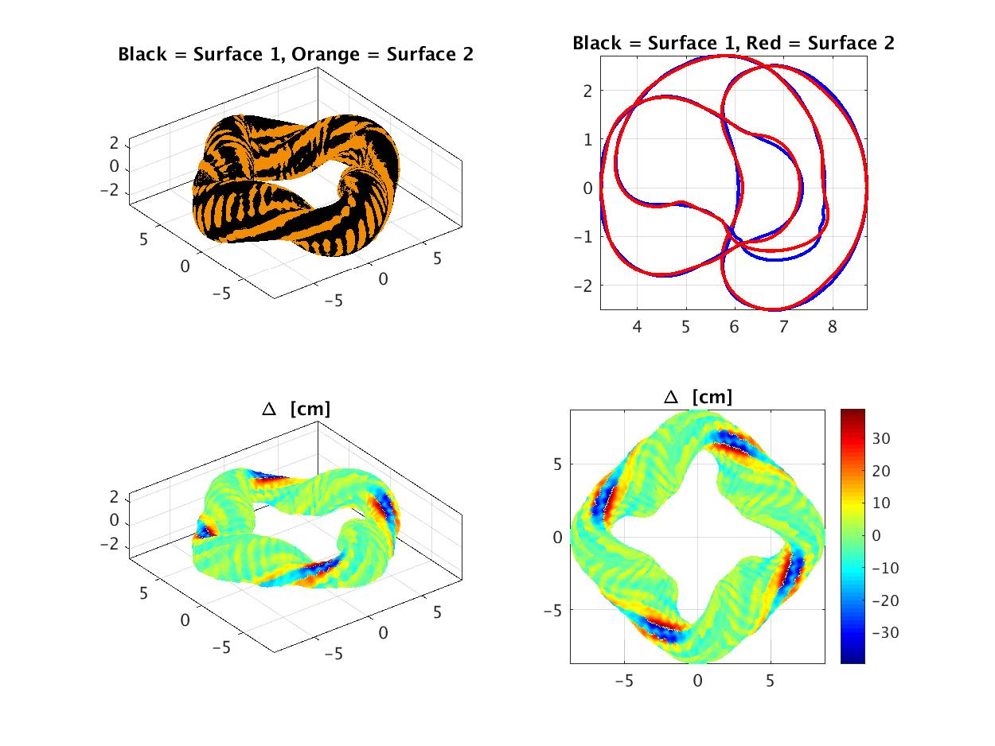


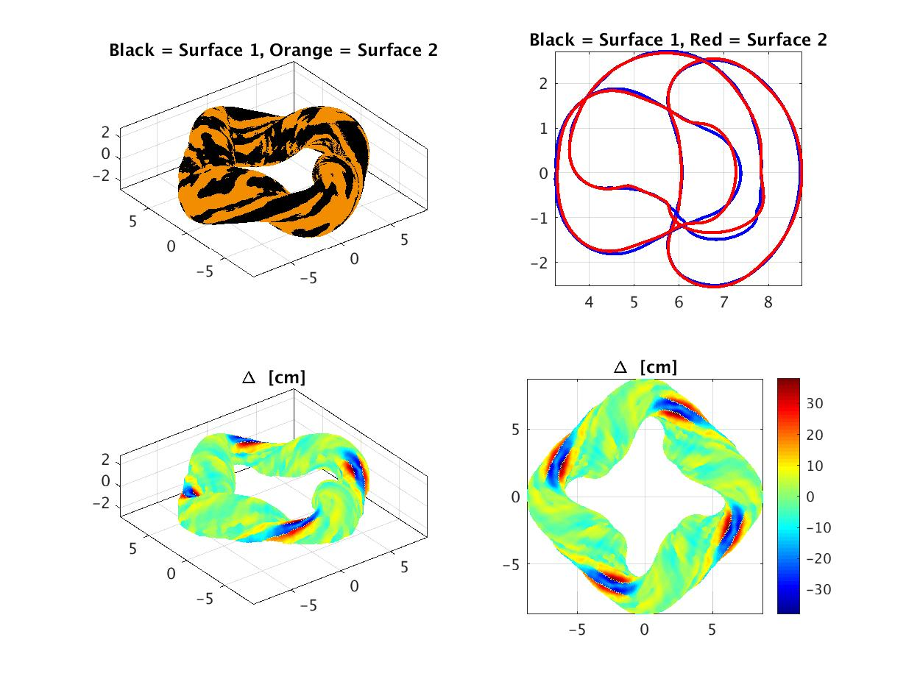
The optimizer runs that demonstrated the most rapid descent
A) look a little different, B) are still evolving, and C) terminated because the solver was in a local minimum (I think)
The surfaces of the two branches that descend more rapidly, but are truncated, look a little different
blue +’s (upper left)
red squares (lower left)
The red square descent path has one extra step – see lower right plots
The solver got stuck in a local minimum?
  “algorithm estimates that the relative error between x and the solution is at most xtol”

Slide 28
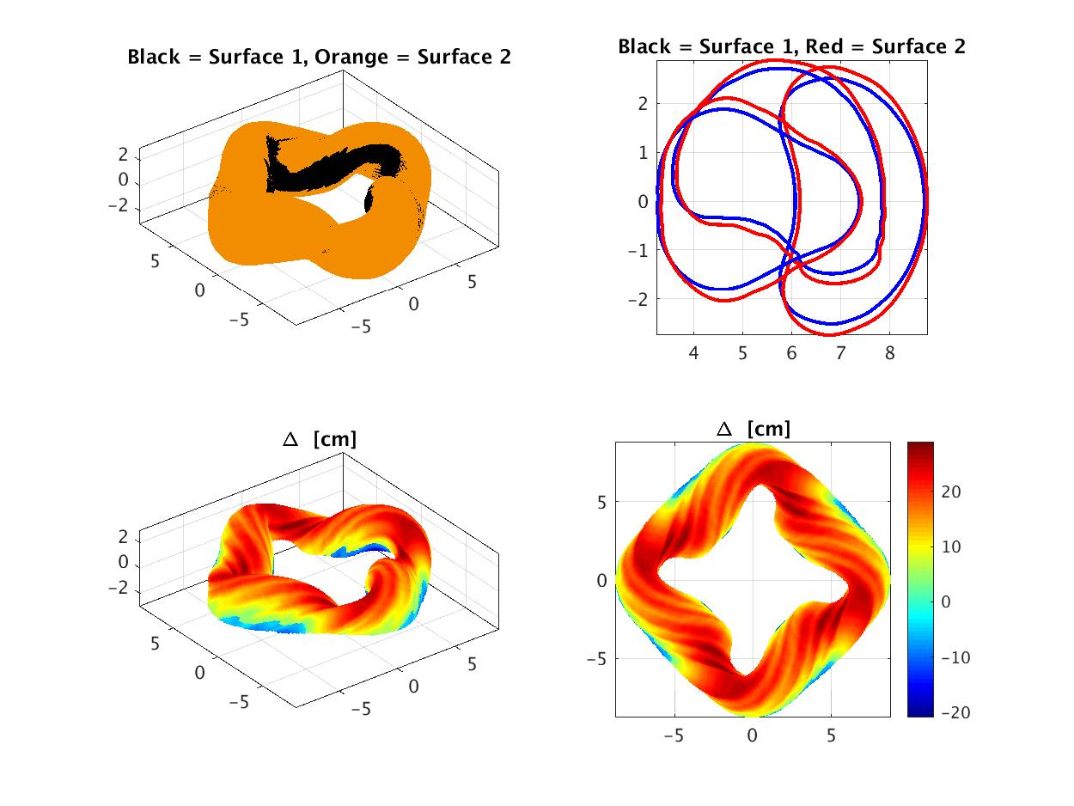
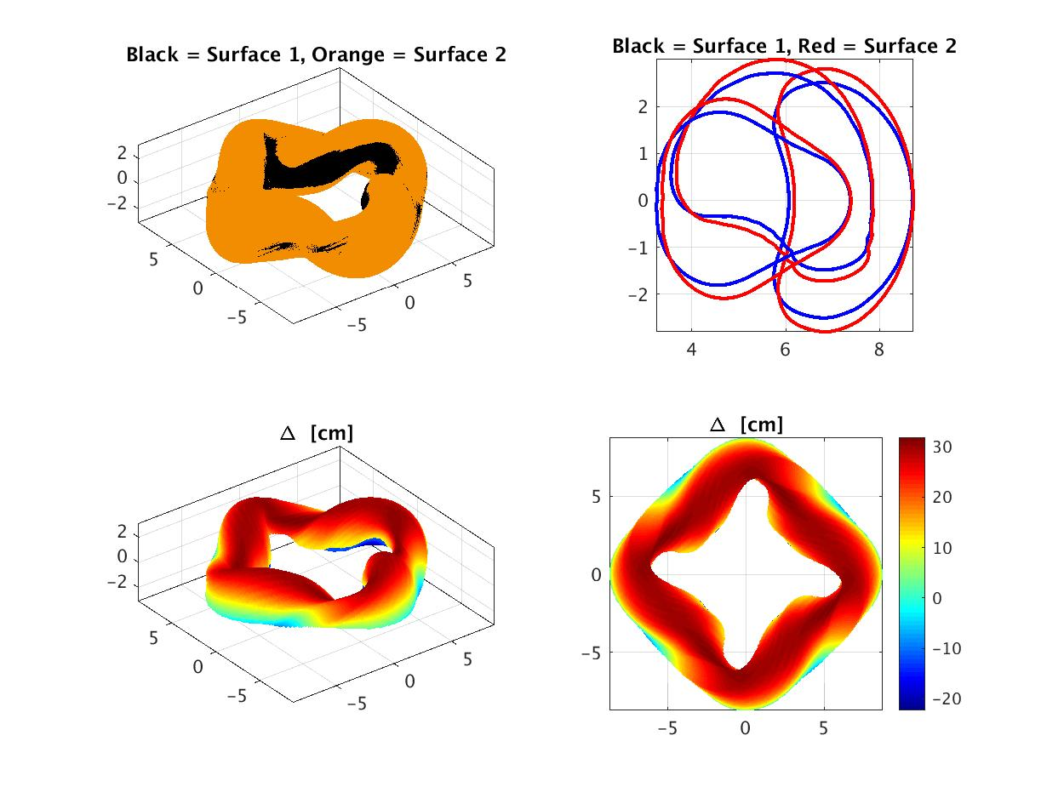

The optimizer branch that descends more slowly looks vaguely like the ‘best’ case: Taller, narrower.
*

Slide 29
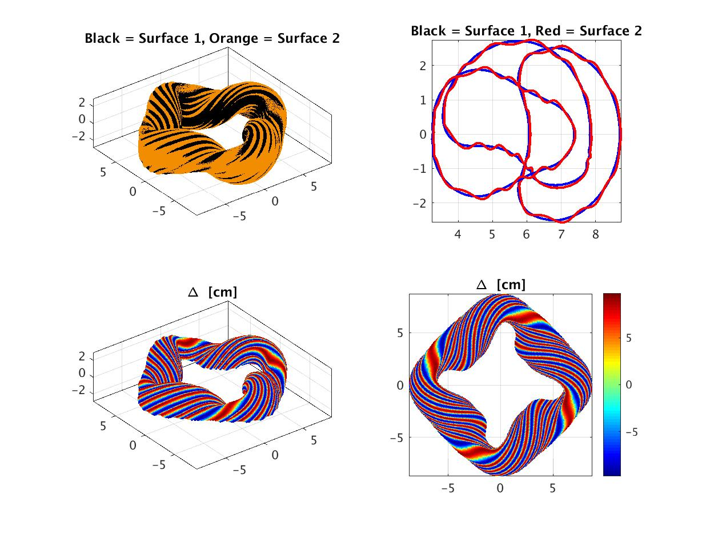
Helical Stripes: The runs that descend very slowly has very corrugated surfaces.

Slide 30
Conclusions, Part 1
It works, but the routine may not be optimized, robust, nor guaranteed to be globally relevant. Still, it’s a tool that we can tinker with, so why not try?
  Mod. L-M routine documentation is sparse; Some ‘improvements’ are self-documented; Intent/side effects of some code choices are not explained.
  Outline of routine to be done.
Perhaps a Quasi-Newton (or QN-like) step may be more robust
  When the following are true:
    A step along a variable (or several variables) shows an improvement (along a vector/direction)
    and repeated steps (2 or more) along this direction (or set of directions) continue to show improvements
  Then:
    Hypothesis: The local space is well-described by the finite-step forward-difference calculation of the 1st derivative and an estimate of the 2nd derivative is reasonable (along the search vector)
    These steps or directions should be rewarded/trusted and the search and/or step distance along this direction may be accelerated – via a Taylor expansion including 1st and 2nd derivatives
  Additional ‘history’ of the function evaluations needs to be maintained

Slide 31
Part 2: Discrete coils and the subsequent Boozer spectrum

Slide 32
Coils, MHD equilibrium and Boozer spectrum for two different winding surfaces: ‘Uniform distance’ and ‘Fourier/Optimized’
Cutting coils, calculating the vacuum VMEC MHD solution and Boozer spectrum
Generate coilsets for two different winding surfaces
  The 1st winding surface is ‘uniformly displaced’ from the plasma
    Shown in a previous Group Meeting: March 23, 2018 @ https://wistell.engr.wisc.edu/?page_id=156
  The 2nd winding surface is the one found by STELLOPT with Fourier Series variations
    shown in detail on slides 4-26 on this presentation
  Coilsets explored consist of a discrete number of unique coils
    Uniform winding surface: 4, 5, 6 (Surfaces are not great)
    Fourier/Optimized winding surface: 3, 4, 5, 6 (VMEC converged with even only 3 coils/FP)
VMEC(+post) are run for each of the cases
  Free-boundary VMEC (using the coils via an ‘mgrid’)
  Boozer spectrum (xbooz_xform)
FOR NOW, I only show the case with 6 coils
Other cases are interesting, but the ‘best Boozer spectrum’ results to date have been found with 6 coils per field period

Slide 33
Slide labels
Slide 34
  Mod B on LCFS for: QHS46 and Coil set with {4, 5, or 6} coils on uniformly displaced surface
  Lots of tight twists, closely-fitted high-curvature sections. Not great results
Slide 35
  Mod B on LCFS for: QHS46 and with 6 Coils / field period on the Fourier/Optimized surface
  Also see the interactive Matlab figure
Slide 36: Different views of the coils
Slide 37:|B| near LCFS from Boozer spectrum for QHS46 (target) and with 6 coils / field period
Slide 38-39: Boozer spectrum comparison QHS46 (target) and with 6 coils / field period
Slide 40: Boozer spectrum comparison QHS46 (target) and with 3, 4, and 5 coils / field period

Slide 34
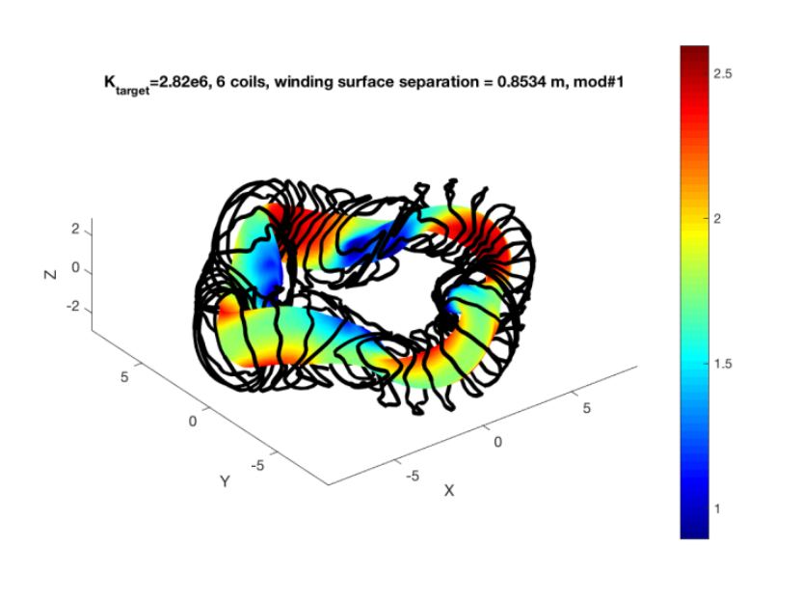
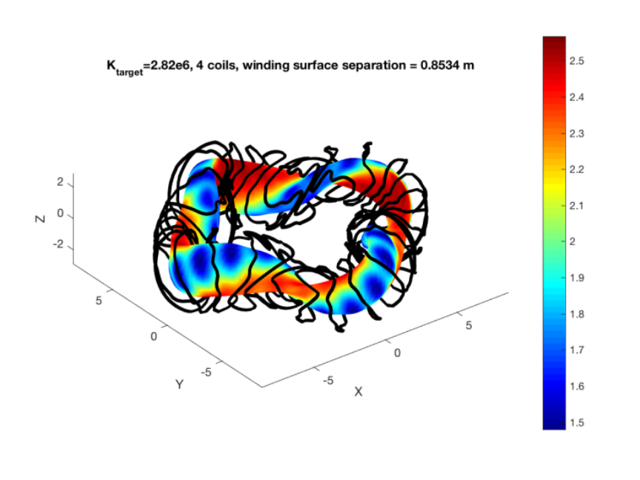
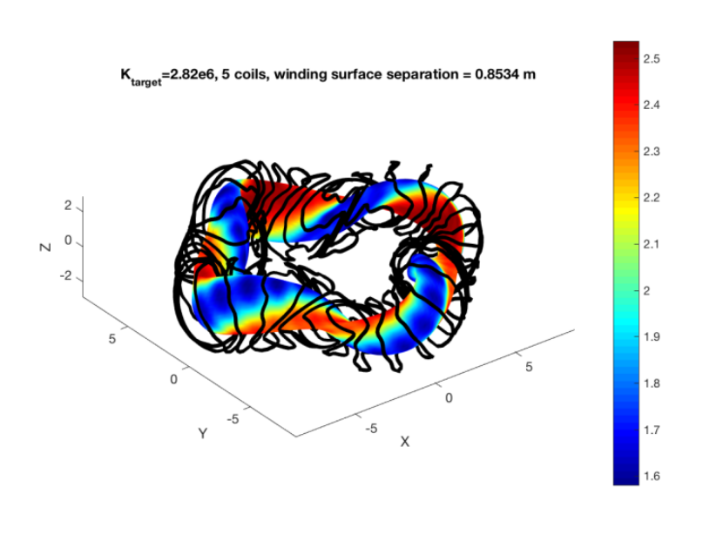
4, 5, or 6 Coils / field period
Uniform winding surface, 2.82e6 A/m

Slide 35
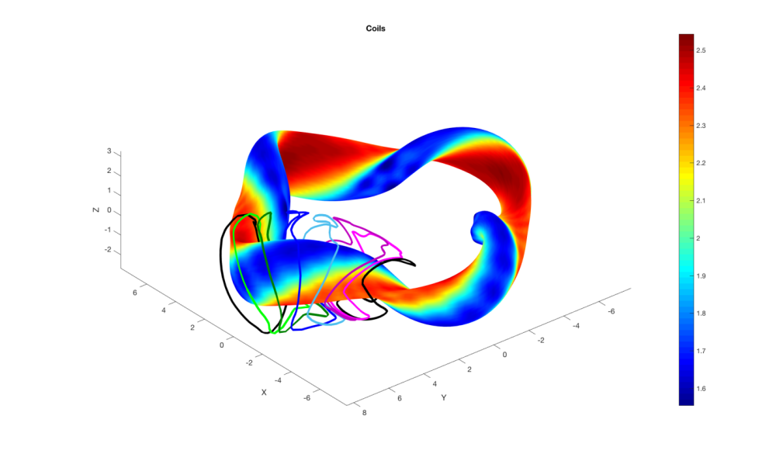
6 Coils / field period
Fourier/Optimized winding surface
2.82e6 A/m on winding surface; 1.5 MA in each coil
Also see the interactive matlab figure:

Slide 36
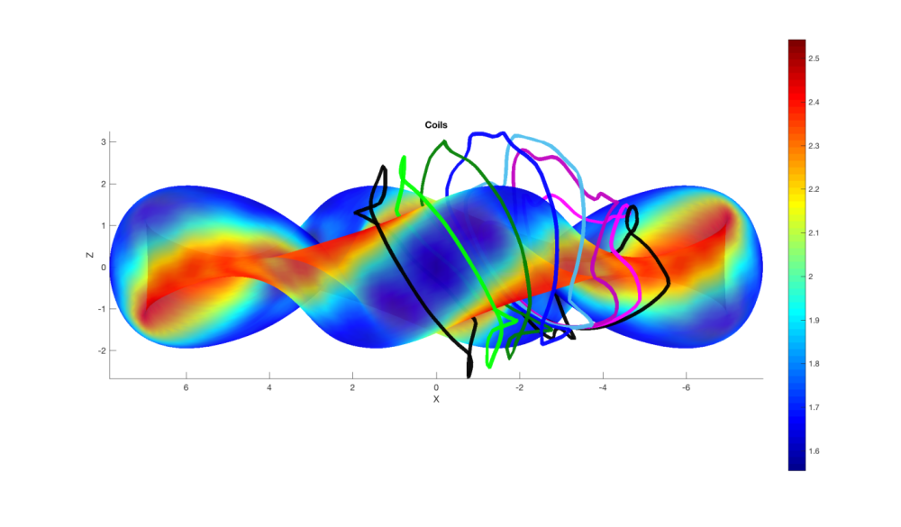
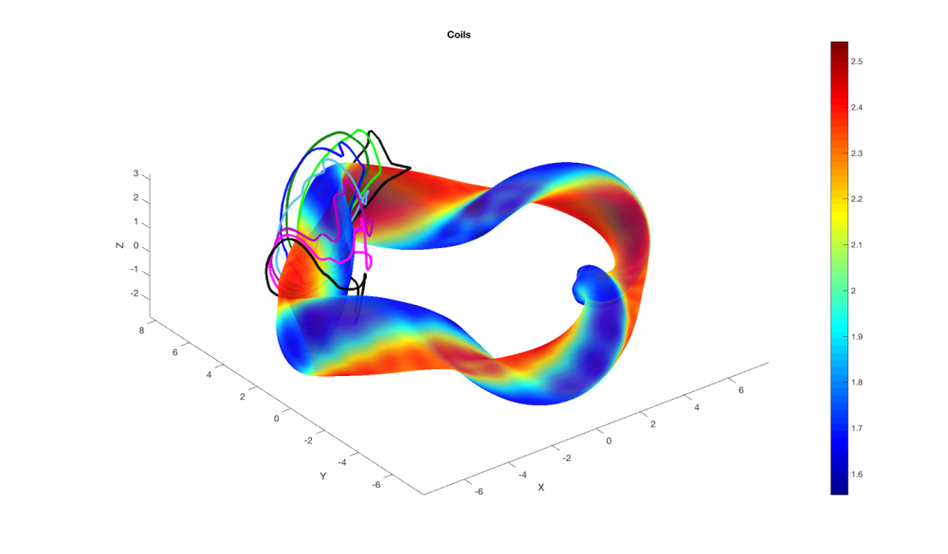
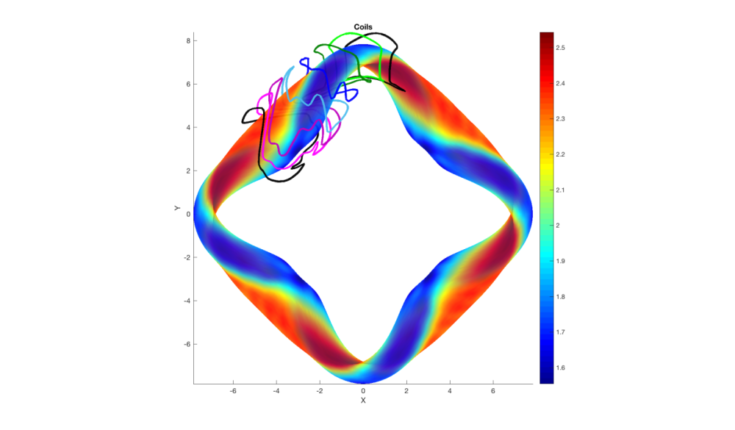
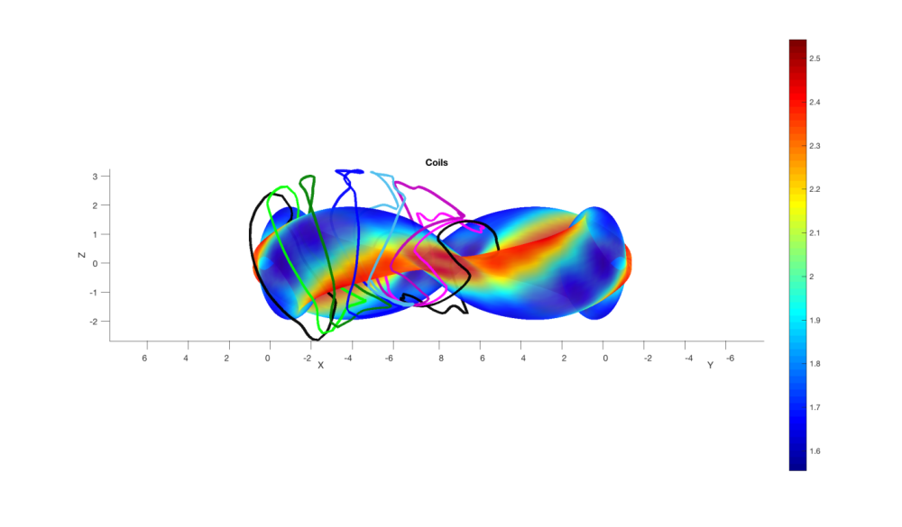
6 Coils / field period
Fourier/Optimized winding surface

Slide 37
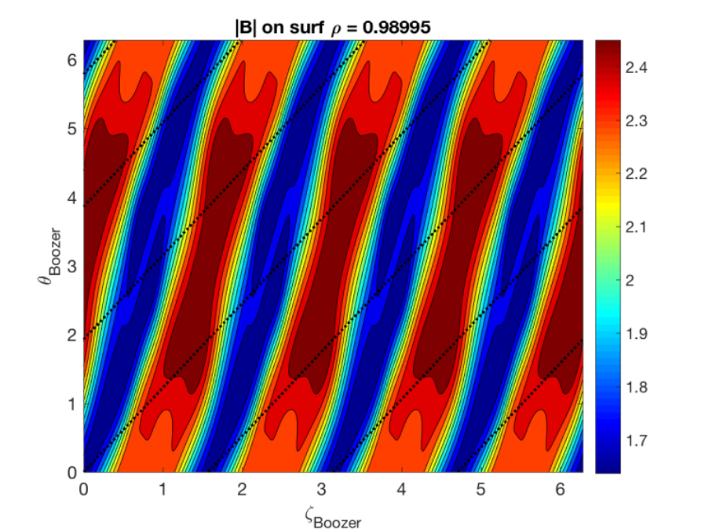
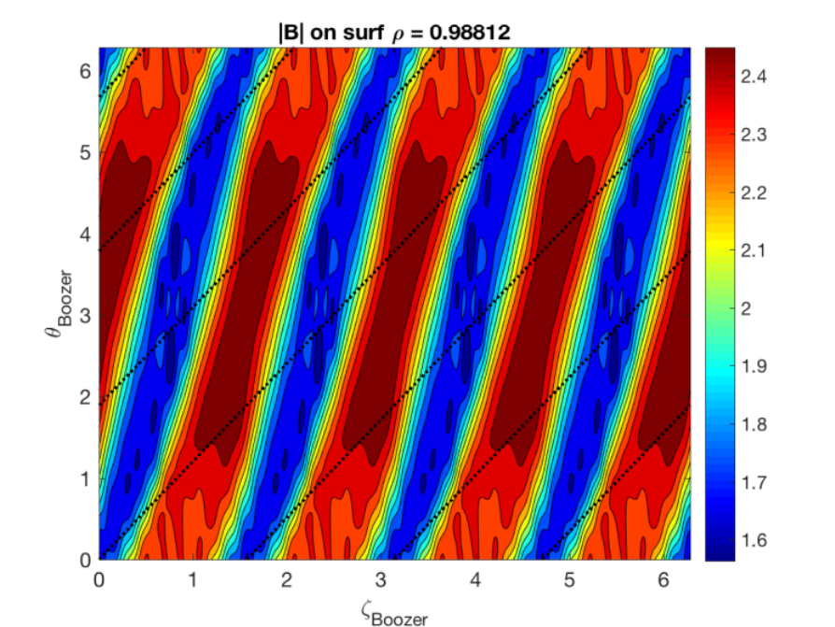
6 Coils / field period
Fourier/Optimized winding surface
|B| near target surface looks qualitatively good
|B| as calculated from Boozer spectrum
  Left: QHS46 (the target) Right: 6 coils on optimal winding surface

Slide 38
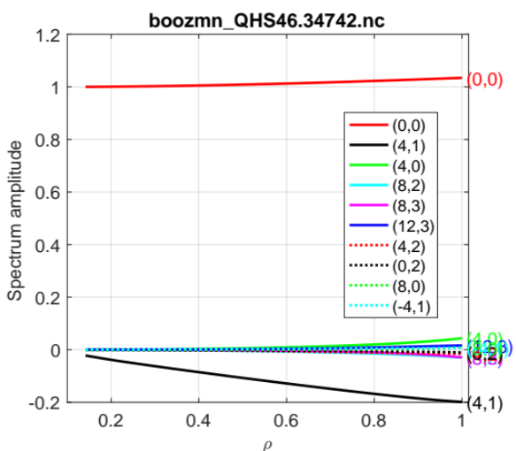
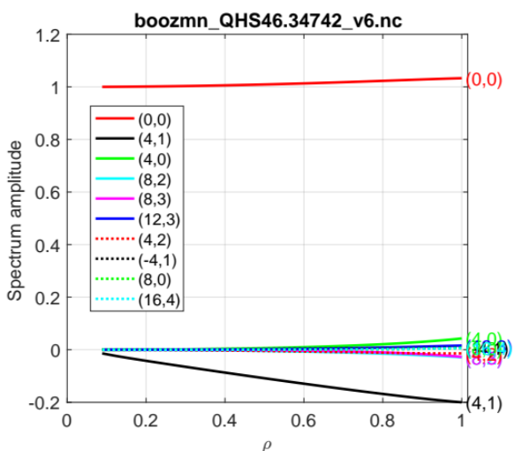
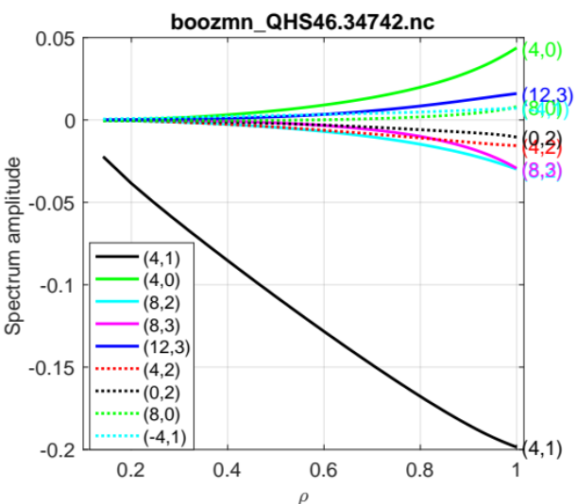
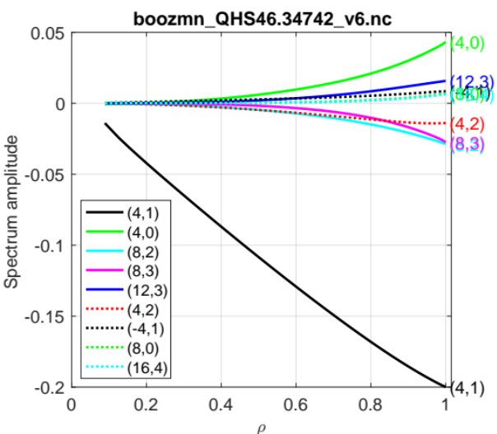
6 Coils / field period
Fourier/Optimized winding surface
Boozer spectrum is matched well
QHS46 Target
6-coil on Opt. W.S.
QHS46 Target
6-coil on Opt. W.S.

Slide 39
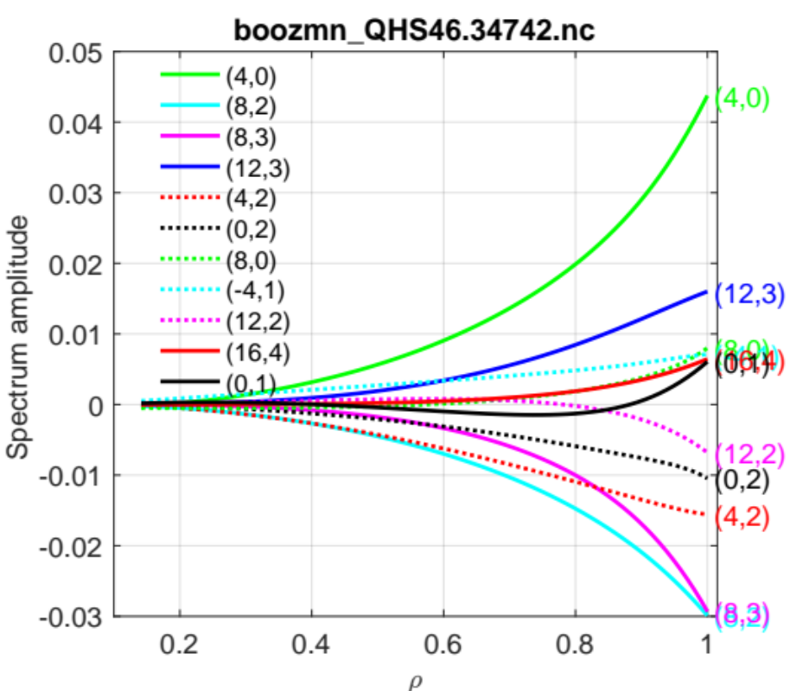
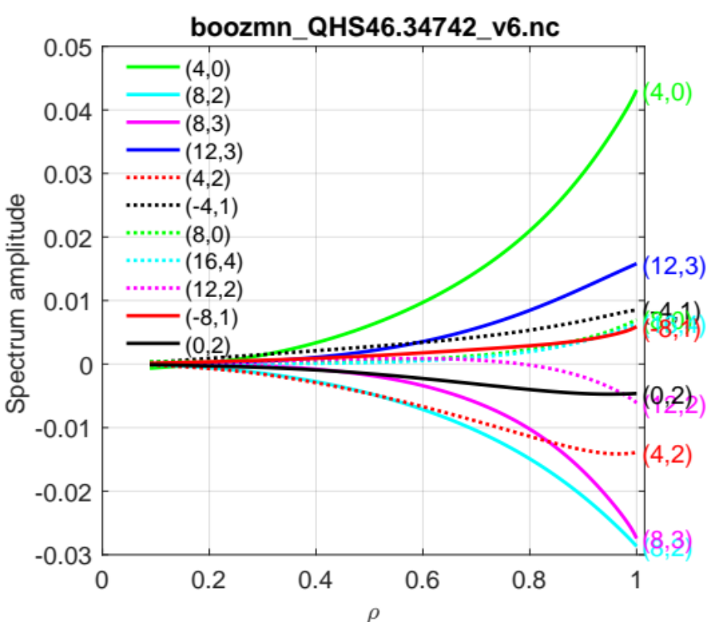
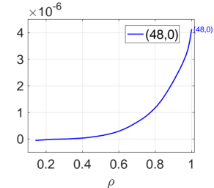
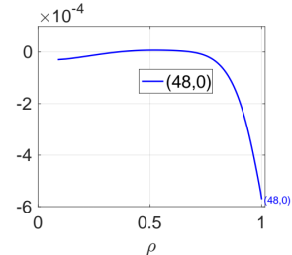
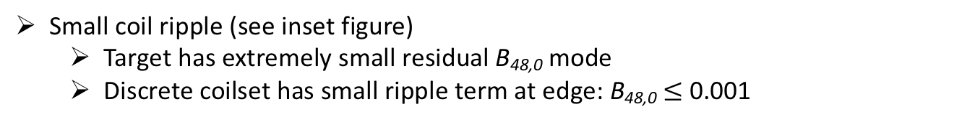
6 Coils / field period
Fourier/Optimized winding surface
Top 5 Boozer modes (after B₀₀, B₄₁) are well-matched
Small coil ripple (see inset figure)
  Target has extremely small residual B_{48,0} mode
  Discrete coilset has small ripple term at edge: B_{48,0}$≤$ 0.001
QHS46 Target
6-coil on Opt. W.S.

Slide 40
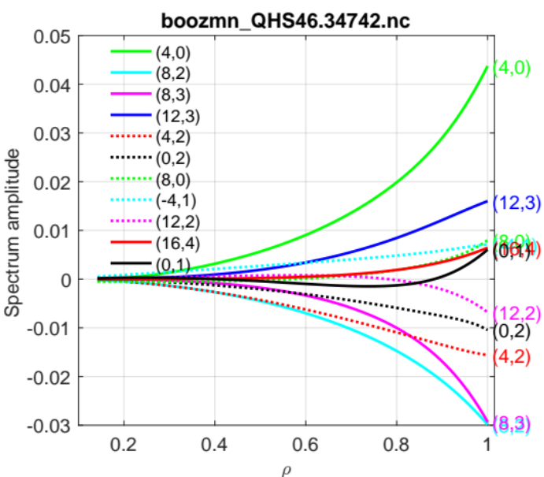
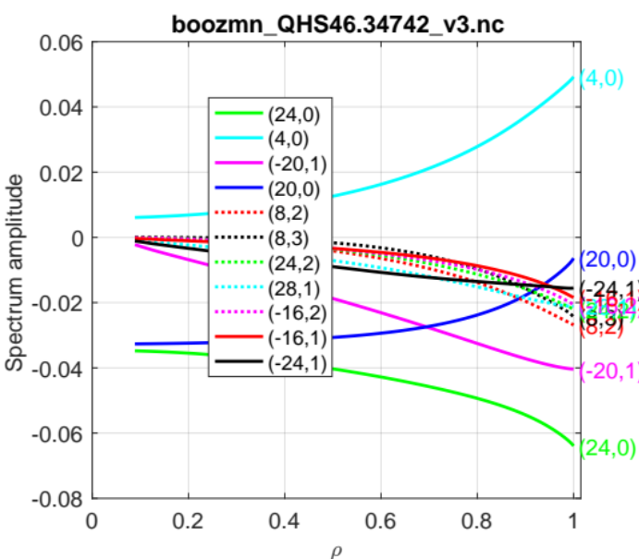
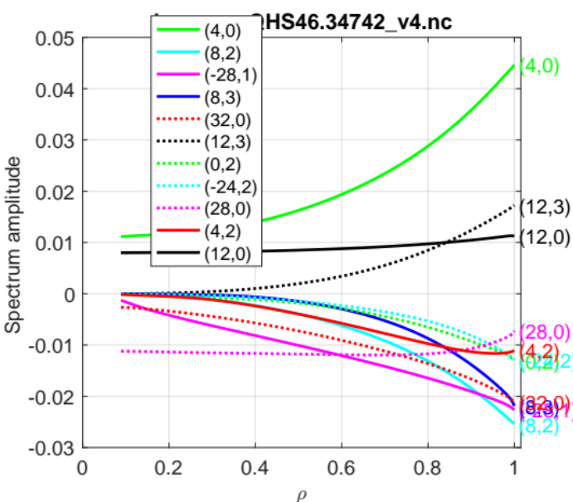
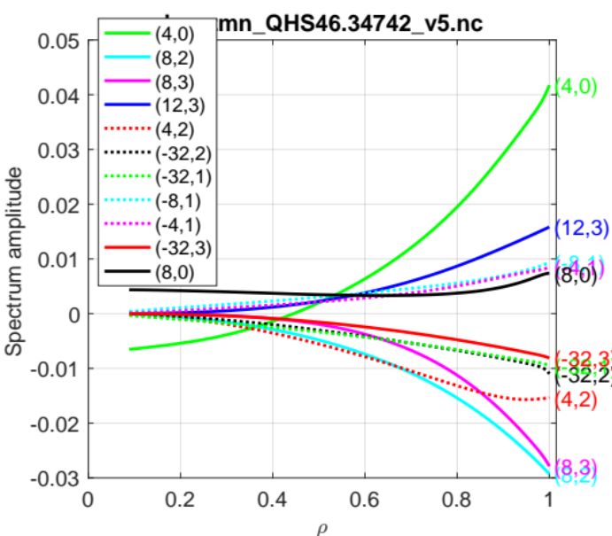
3-coil on Opt. W.S.
QHS46 Target
4-coil on Opt. W.S.
5-coil on Opt. W.S.

Slide 41
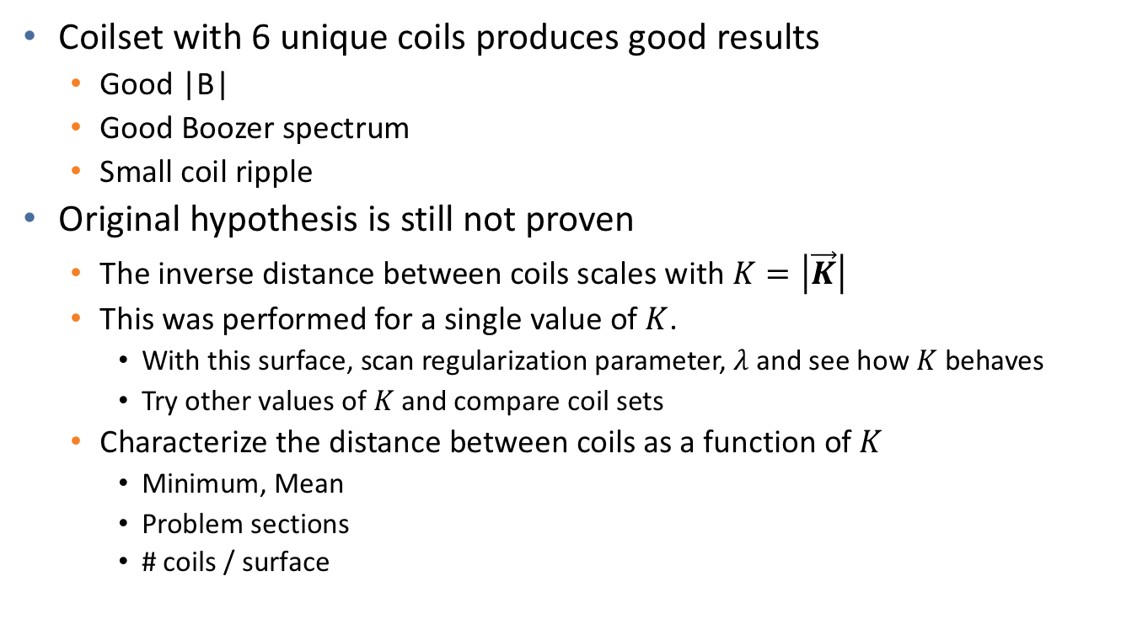
Conclusions, Part 2
Coilset with 6 unique coils produces good results
  Good |B|
  Good Boozer spectrum
  Small coil ripple
Original hypothesis is still not proven
  The inverse distance between coils scales with $K=\left|\vec{K}\right|$
  This was performed for a single value of $K$.
    With this surface, scan regularization parameter, $λ$ and see how $K$ behaves
    Try other values of $K$and compare coil sets
  Characterize the distance between coils as a function of $K$
    Minimum, Mean
    Problem sections
    # coils / surface

Slide 42

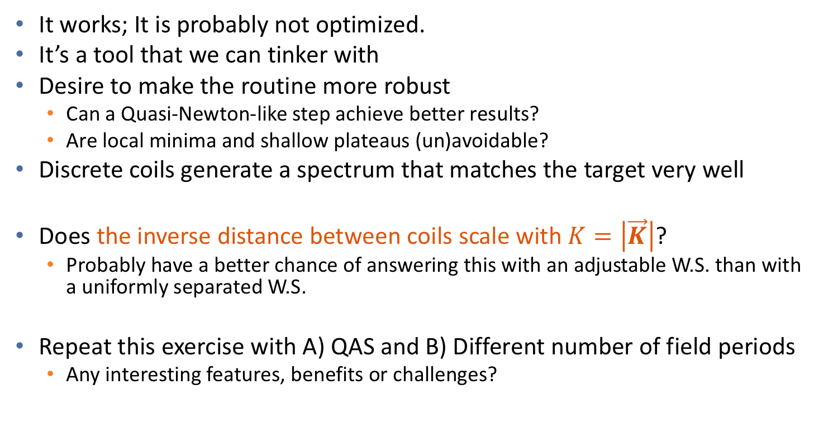
STELLOPT finds better winding surfaces when manipulating the Fourier coefficients.
Discrete coils have favorable features: Good spacing and desired magnetic spectrum.
It works; It is probably not optimized.
It’s a tool that we can tinker with
Desire to make the routine more robust
  Can a Quasi-Newton-like step achieve better results?
  Are local minima and shallow plateaus (un)avoidable?
Discrete coils generate a spectrum that matches the target very well
Does the inverse distance between coils scale with $K=\left|\vec{K}\right|$?
  Probably have a better chance of answering this with an adjustable W.S. than with a uniformly separated W.S.
Repeat this exercise with A) QAS and B) Different number of field periods
  Any interesting features, benefits or challenges?

Slide 43
Extra

Slide 44
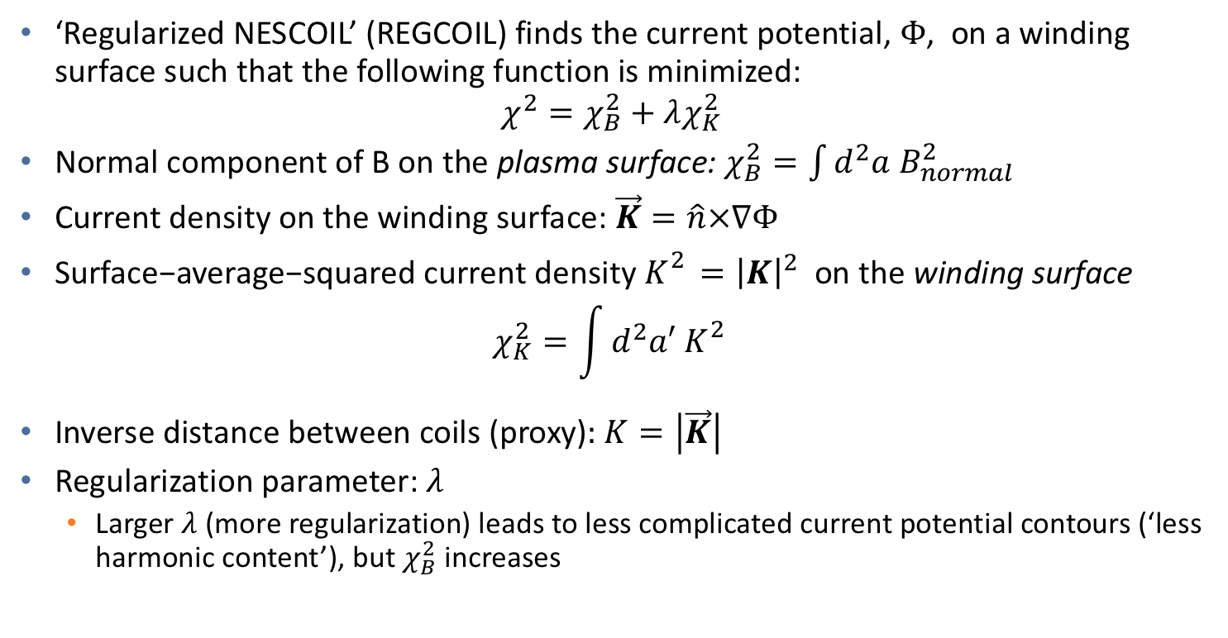
Background about REGCOIL^{1,2}, 1
‘Regularized NESCOIL’ (REGCOIL) finds the current potential, $Φ$, on a winding surface such that the following function is minimized:
$$χ^{2}=χ_{B}^{2}+λχ_{K}^{2}$$
Normal component of B on the plasma surface: $χ_{B}^{2}=\int{d^{2}a B_{normal}^{2}}$
Current density on the winding surface: $\vec{K}=\hat{n}×∇Φ$
$\text{Surface}\text{−}\text{average}\text{−}\text{squared} \text{current} \text{density}{ K}_{}^{2}={\left|K\right|}^{2} \text{on} \text{the} \text{winding} \text{surface}$
$$χ_{K}^{2}=\int{d^{2}a′ K_{}^{2}}$$
Inverse distance between coils (proxy): $K=\left|\vec{K}\right|$
Regularization parameter: $λ$
  Larger $λ$ (more regularization) leads to less complicated current potential contours (‘less harmonic content’), but $χ_{B}^{2}$ increases
(Check Normalization)
¹ M. Landreman, Nuclear Fusion 57, 046003 (2017).
² https://github.com/landreman/regcoil

