Slide 1
Alpha particle lifetimes
A.S. Ware

Slide 2
Particle following code to determine alpha confinement
Obtained a code from Sergei Kasilov that was originally developed by Viktor Nemov to calculate alpha particle confinement
Have compiled the code on Cori at NERSC and have begun coupling it into the latest StelloptV2/VMEC structure

Slide 3
Tracing alpha particle orbits
The code traces the guiding center orbits of mono-energetic particles (defaults for alpha particles at 3.5 MeV)
  Can choose to assume passing particles are confined
  Particles that reach the next to last closed flux surface are assumed lost
  Code calculates the fraction of trapped particles remaining as a function of time
See Nemov, Kasilov, & Kernbichler,
Phys. Plasmas 21, 062501 (2014) for more details

Slide 4
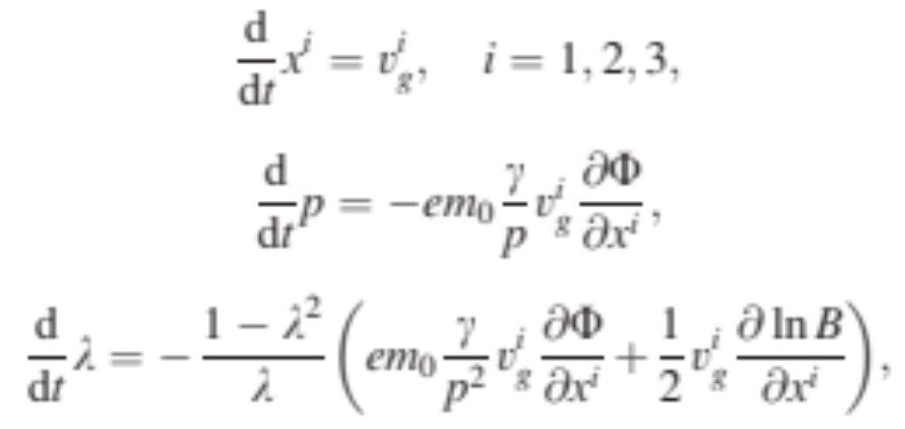

Tracing alpha particle orbits (cont.)
Code follows:
  Momentum magnitude:
  Pitch angle:
  Electrostatic potential: Φ

Slide 5
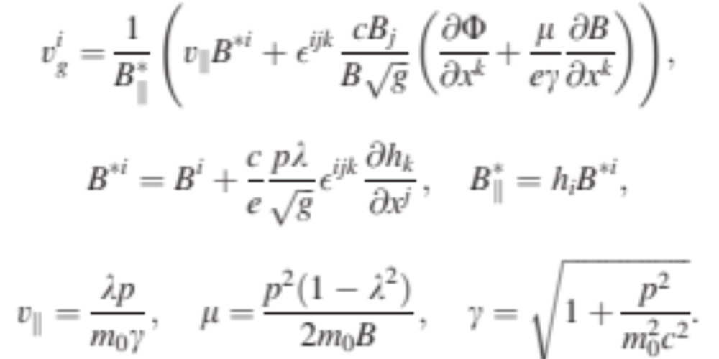
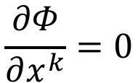
Tracing alpha particle orbits (cont.)
Drift velocity:
  With:
  Note: Code currently assumes no electric field,
$$\frac{∂Φ}{∂x^{k}}=0$$

Slide 6
Tracing alpha particle orbits (cont.)
Some of the user inputs:
  notrace_passing = 0 or 1 (assume passing confined)
  ntestpart = # of particles
  nper = # of toroidal field periods covered by a starting
  field line representing the starting surface
  npoiper = # of points per field period on starting line
  ntimstep = # of time steps per slowing down time
  (how often to write # of particles remaining)
  trace_time = maximum time test particles are traced
  sbeg = flux label for the starting magnetic surface

Slide 7
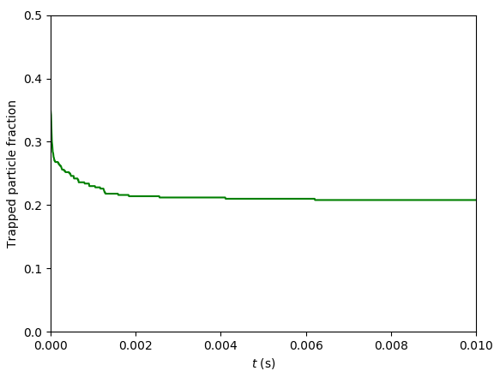
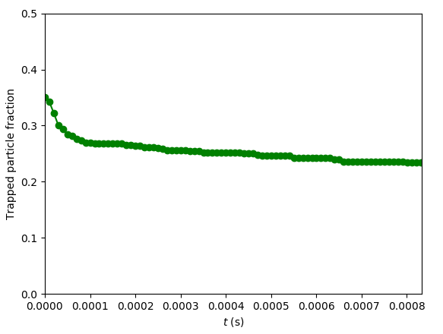
Initial results for a test case
Starting surface: S = 0.4 surface, a new HSX case with I_{BS}, following 500 particles

Slide 8
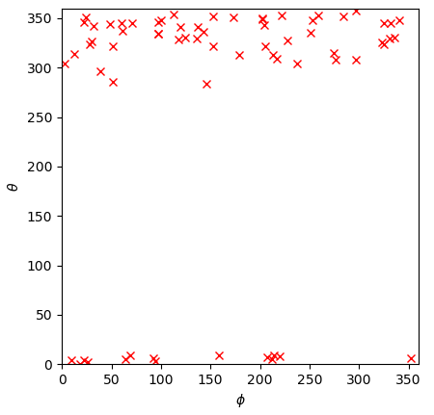
Initial results for a test case (cont.)
Position (θ,φ) of the
exit point for trapped
particles leaving the
confinement region
  500 particles traced
  (71 lost)

Slide 9
Next steps
Test the code and do comparisons with other configurations
Test the impact of sacrificing some quasi-symmetry to obtain different rotational transform profiles
Can we implement this in an optimization run?

