Slide 1
Initial optimization study of
QH configuration
Yasuhiro Suzuki
suzuki.yasuhiro@nifs.ac.jp
National Institute for Fusion Science
SOKENDAI, The Graduate University for Advanced Studies

Slide 2
Target of optimization studies in NIFS
Goal: current-free, high-beta, steady-state stellarator
From this target, the QI/QP is strong option.
In QH, the bootstrap current decreases the rotational transform. The QA is tokamak!
Some remaining issues…
A path to the target beta was not considered.
Confirmation of the divertor configuration to extrapolate the reactor.
Turbulence transport
Fast ion confinement
Build in divertor configuration like helical divertor
Buildable coil configuration

Slide 3
A path to high-beta QI/QP configuration
Referring W7-X, to achieve the QI, the plasma beta must be high because the strong diamagnetic effect helps to make closed B_{min} contours.
This suggests the W7-X configuration for the vacuum an low-beta is not highly optimized.
This is a limitation of the present optimization model. => fixed the target beta!
Question: Is it possible to connect dynamically from an optimized configuration for the low-beta to another optimized configuration for the high-beta?

Slide 4
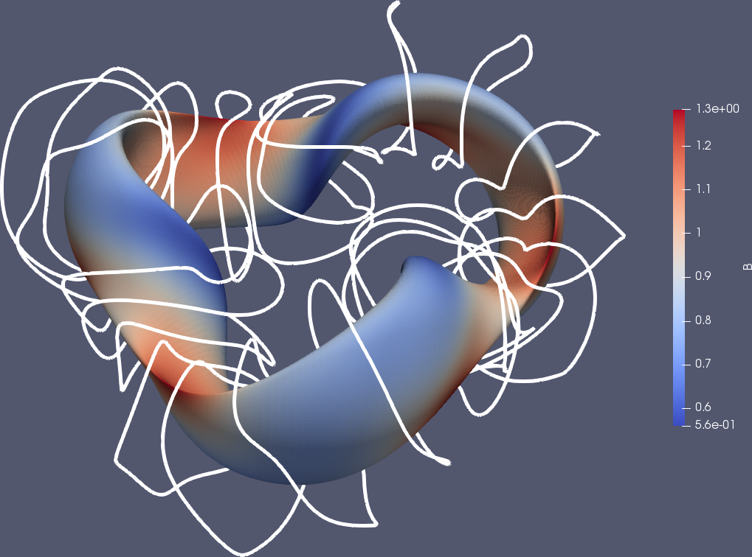
Kaleidoscopic configuration (© M. Nakata 2018)
Goal: current-free, high-beta, steady-state stellarator
But, the configuration properties of QI/QP is not good for the low beta.
=> The plasma starts up from the QH and the configuration dynamically changes to the QI/QP by the sweeping of the magnetic field.
Initial QH (N=3, Ap=6)
Initial QH configuration is calculated from STELLOPT.
Coil design is calculated from FOCUS.
Next step is free-boundary optimization to realize the QI/QP in this coil configuration.
Design additional coil set.

Slide 5
Present status of optimization studies in NIFS
Codes developing in NIFS are applying to optimized stellarators (W7-X, HSX, CFQS).
Neoclassical and turbulent transport codes work well in those stellarators.
Optimization code is updated to STELLOPT2.
QH configuration studies have been started.
Developments of new optimizer have been started.
FOCUS runs routinely but further improvements are needed.

Slide 6
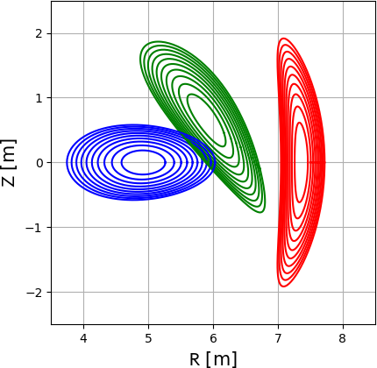
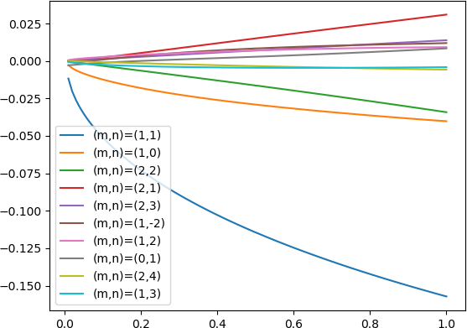
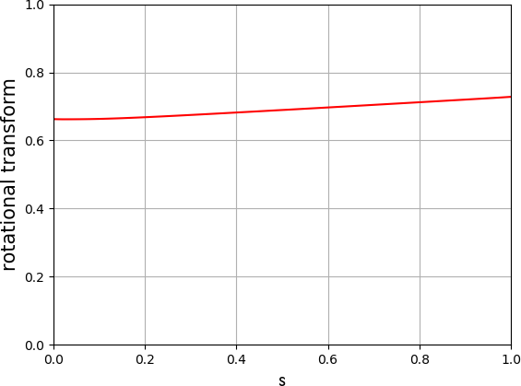
QH configuration studies for N = 3 (vacuum)
VMEC surfaces
Iota profile
Boozer spectra
(m,n) = (0,0) and (1,0) are fixed in optimization.
Boozer spectra, effective ripple, neoclassical transport are switched on.
Boozer spectra are optimized at ρ = 0.5.

Slide 7
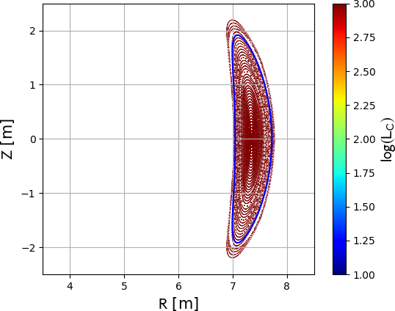
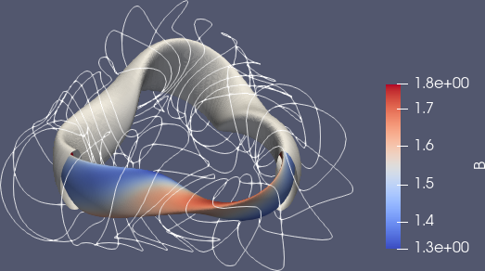
FOCUS well reproduce vacuum flux surfaces
Coils and modeled vessel
Comparison of VMEC boundary and vacuum flux surfaces
Clearance of bean shape cross section is ok.

Slide 8
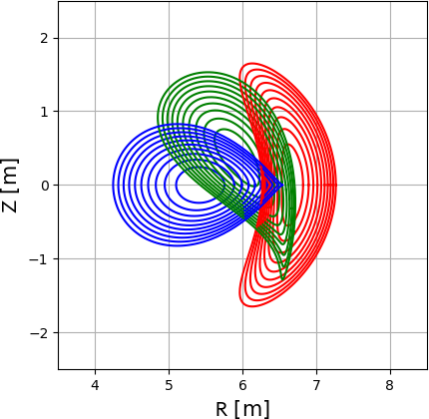
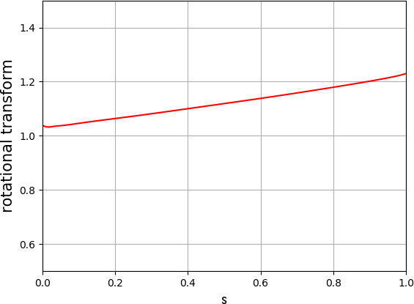
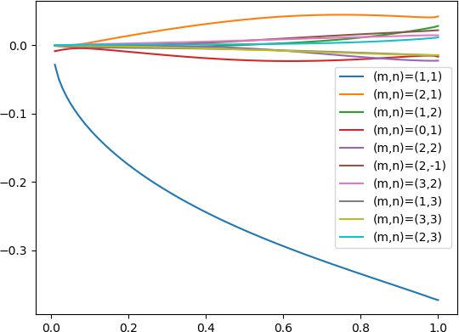
QH configuration studies for N = 6 (vacuum)
VMEC surfaces
Iota profile
Boozer spectra
(m,n) = (0,0) and (1,0) are fixed in optimization.
Boozer spectra, effective ripple, neoclassical transport are switched on.
Boozer spectra are optimized at ρ = 0.5.

Slide 9
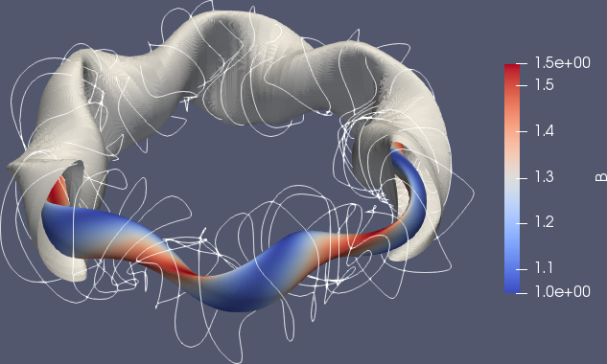
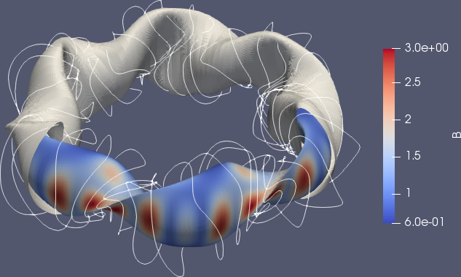
FOCUS calculations are on going
S = 0.3
S = 1.0
Fourier mode number should be optimized.

Slide 10
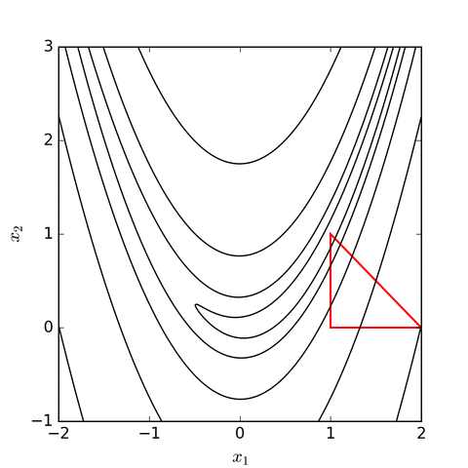
On going tasks for Optimizer developing
Developments of new optimizer will start soon.
We are planning to use “Nelder–Mead method”.
Advantage of N-M method:
N-M method does not use “gradient”
Disadvantage:
Time consuming!
We had already applied N-M method to transport simulations and equilibrium reconstructions. Based on those code, we will compile physics modules to new optimizer.

