Slide 1
Next Generation Stellarator Creation Research Activity in NIFS
Motoki NAKATA
Meeting at UWM, Sep. 2018

Slide 2
Background and Motivation
Budget for ”Big Science” in JAPAN MEXT (Ministry of Science and Education)
- MEXT selects 10 big science projects (10 years duration), based on “Master plan” and “Road map” produced by “Science Council of Japan” every 3 years.
- e.g., Super-Kamiokande neutrino detecter, ALMA telescope, TMT telescope,
KAGRA gravitation wave detecter, Large Helical Device for steady plasma confinement, etc.
- Scientific budget for LHD project is ensured for 2012-2022. (But the LHD-DD Exp. plan is for 2025.)
- We need this budget again for our future plan after LHD, then the plan should be selected as a high priority plan in “Master plan” & “Road map” of Science Council of Japan. (2020, 2023, …)
- We should compete with the other physics fields like the particle physics and astrophysics, not tokamak & LASER fusion community!
- Also, highly organized domestic and international collaborations are extremely encouraged.
( cf. NIFS is an inter-university research institute )

Slide 3
A policy of NIFS for the future plans after LHD
A policy decided by Director General Takeiri
— For now, we are going to consider our future plan along the two directions, simultaneously and complementary: “Engineering based research by Heliotron-type new device with high-temperature-superconductor (HTS) helical coils” and “Physics-based research by Next-generation device with advanced optimization concept”. —
Upgrading LHD is quite limited (i.e., it runs for more than 20 years), so we should set the best strategy to maximize the scientific outcome and for connecting to the future plan.
In any plans, they must be discussed and endorsed by the plasma and fusion community, in order to compete the other physics fields.

Slide 4
New activity for the future plans
Steering committee for the future plans (∈ NIFS advisory committee) is organized.
Future plan promotion office is organized to manage and unify the two teams.
NIFS Advisory Committee
Future Plan Steering Committee
HTS new Heliotron Team
Future Plan promo. office
Team members
K. Takahata, etc
Director: R. Sakamoto
M. Nakata, K. Nagaoka, M. Yokoyama
R. Sakamoto, S. Satake, G. Kawamura, M. Nunami, Y. Yamaguchi, K. Ogawa,
T. Kobayashi, R. Seki, Y. Suzuki, M. Isobe, A. Shimizu, K. Nagasaki, A. Fujisawa, etc
Next Generation Stellarator Creation Research Team

Slide 5
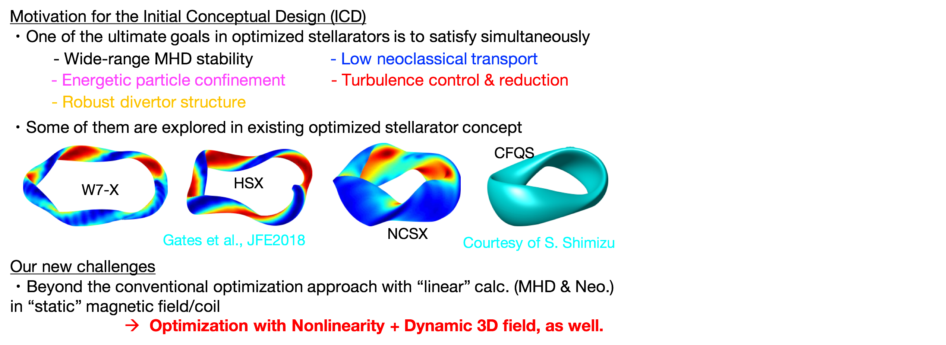
Next Generation Stellarator Design Research Team

Slide 6
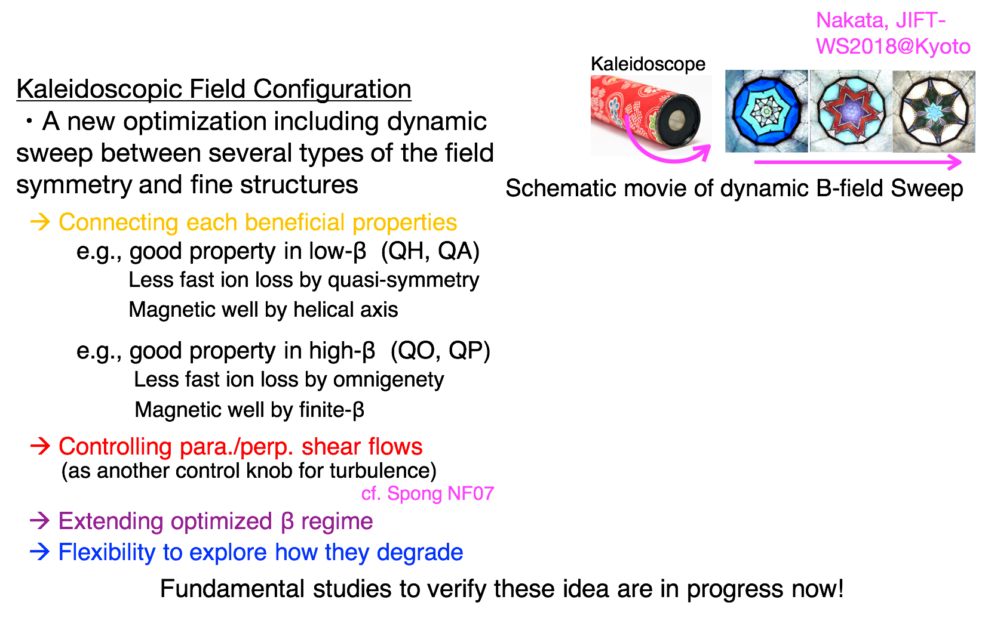
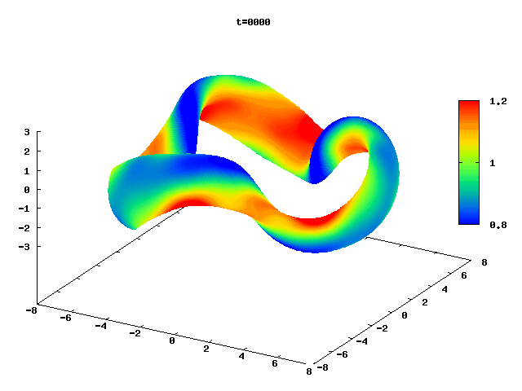
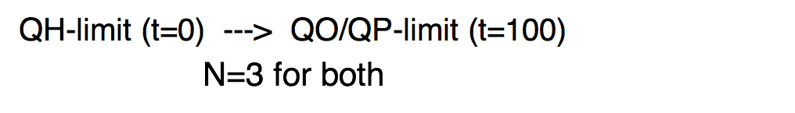
Dynamic control of 3D field structure

Slide 7
Time schedule for fundamental studies & design works
2018-2019
・Fundamental studies of Kaleidoscopic fields by FOCUS/STELLOPT, etc.
・MHD stability, core transport (neo&turb.), enegertic particle for ICD.
・Edge physics and Divertor analysis for ICD, including new physics design of divertor.
・Engineering design of Modular Coils and Vacuum Vessels.
・Heating, Power supply, fundamental & advanced measurement systems.
2019 -
・Detailed design by using Optimizer.
・Experimental verification of Kaleidoscopic field coils.
・Engineering design, etc.
Int’l Stellarator Collaboration among NIFS, UWM, IPP, PPPL, etc becomes critical, more than ever before.
Master Plan
Master Plan
Master Plan
 | 2017 | 2018 | 2019 | 2020 | 2021 | 2022 | 2023 | 2024 | 2025 | 2026
NGS team
LHD
Fundamental studies
Phys. & Eng. design
Eng. design & Construction?
Current Budget
LHD-DD Exp. plan
CFQS(QA-device) operation

