Slide 1

11/30/2018
Aten Coils

Slide 2
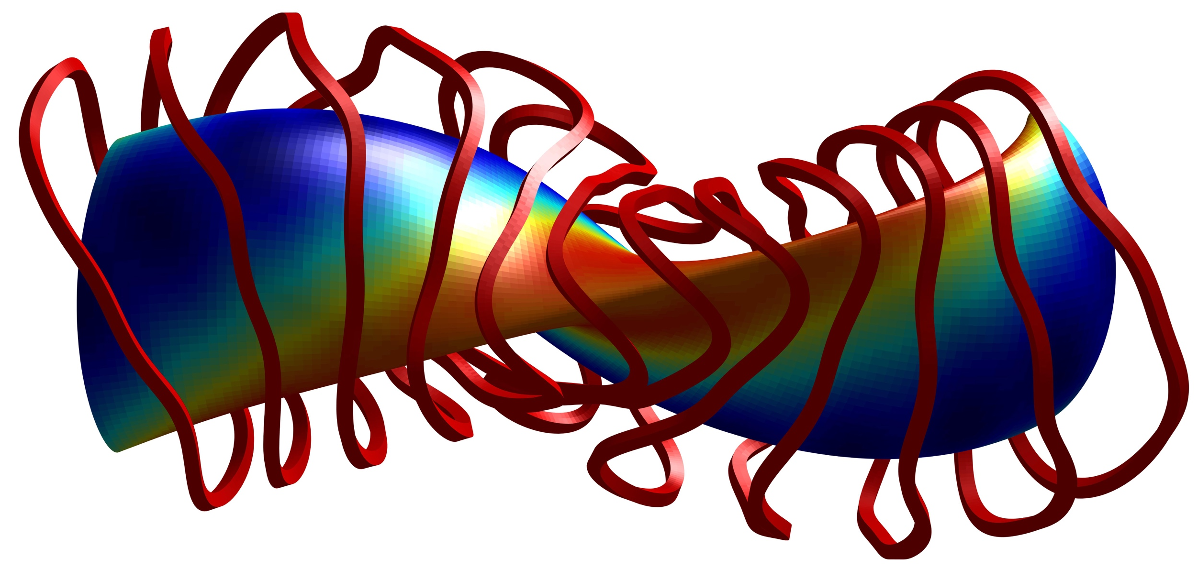
FOCUS Initialized with REGCOIL 22cm Offset
Minimum Coil to Coil Separation | Minimum Coil to Boundary Separation | Minimum Radius of Curvature
11.9 cm | 19.0 cm | 8.0 cm

Slide 3
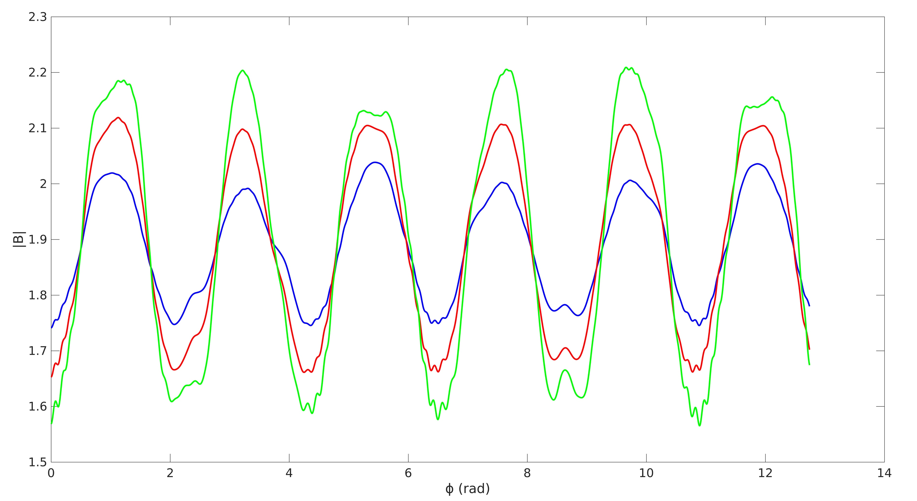
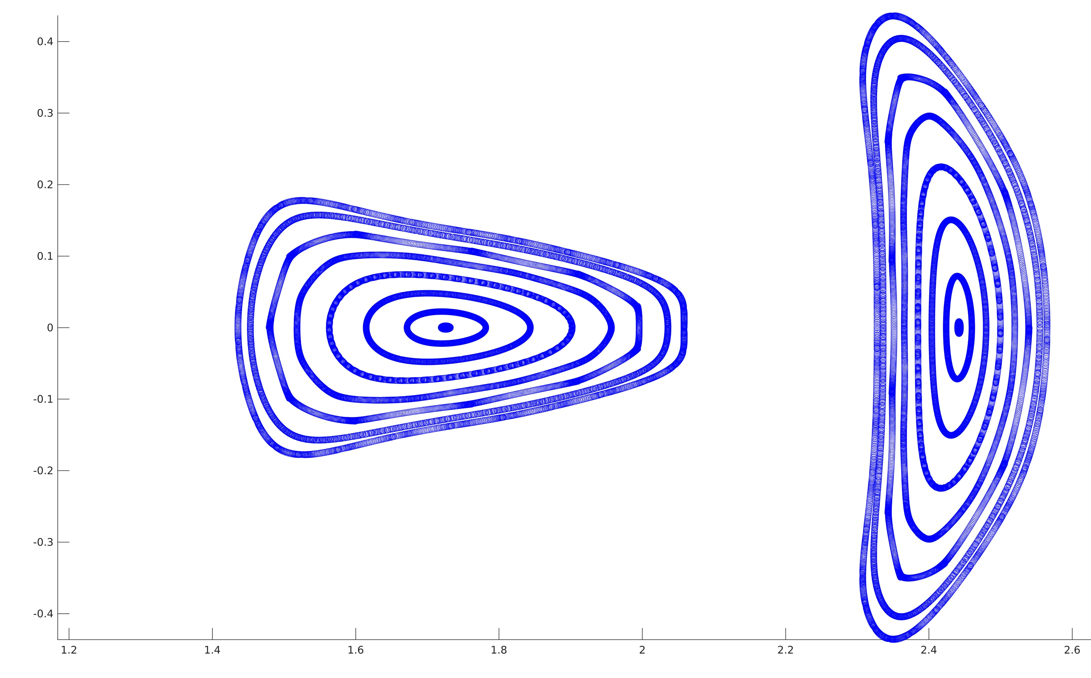
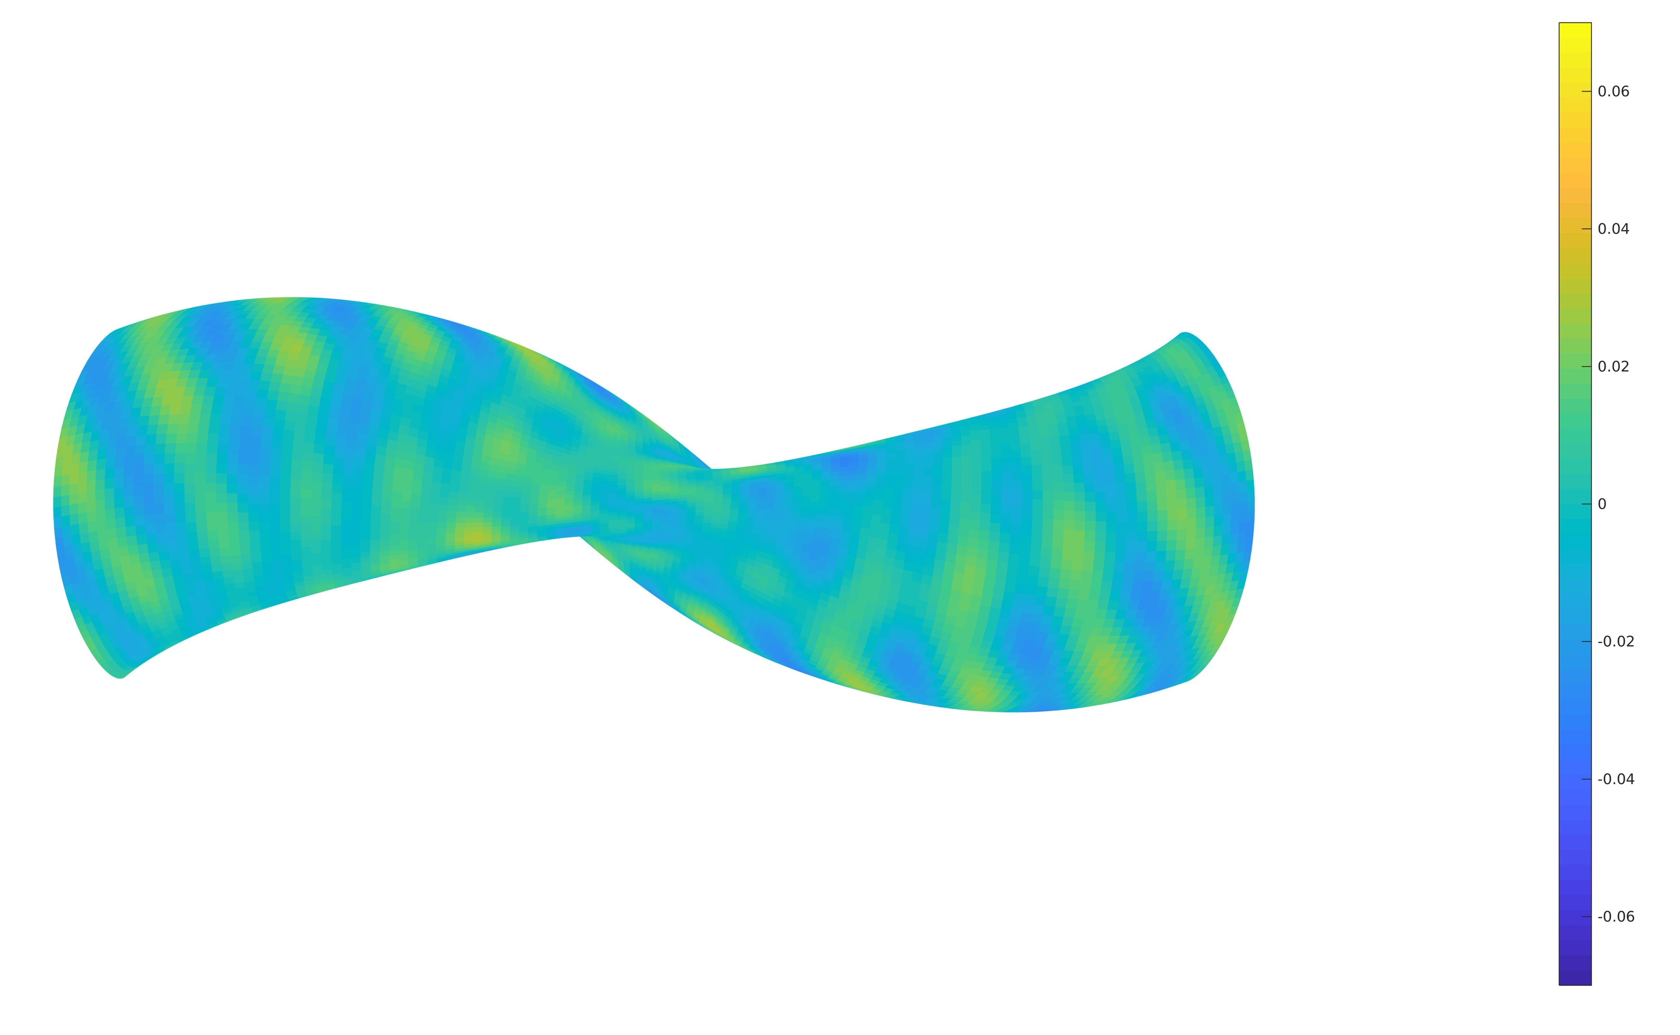
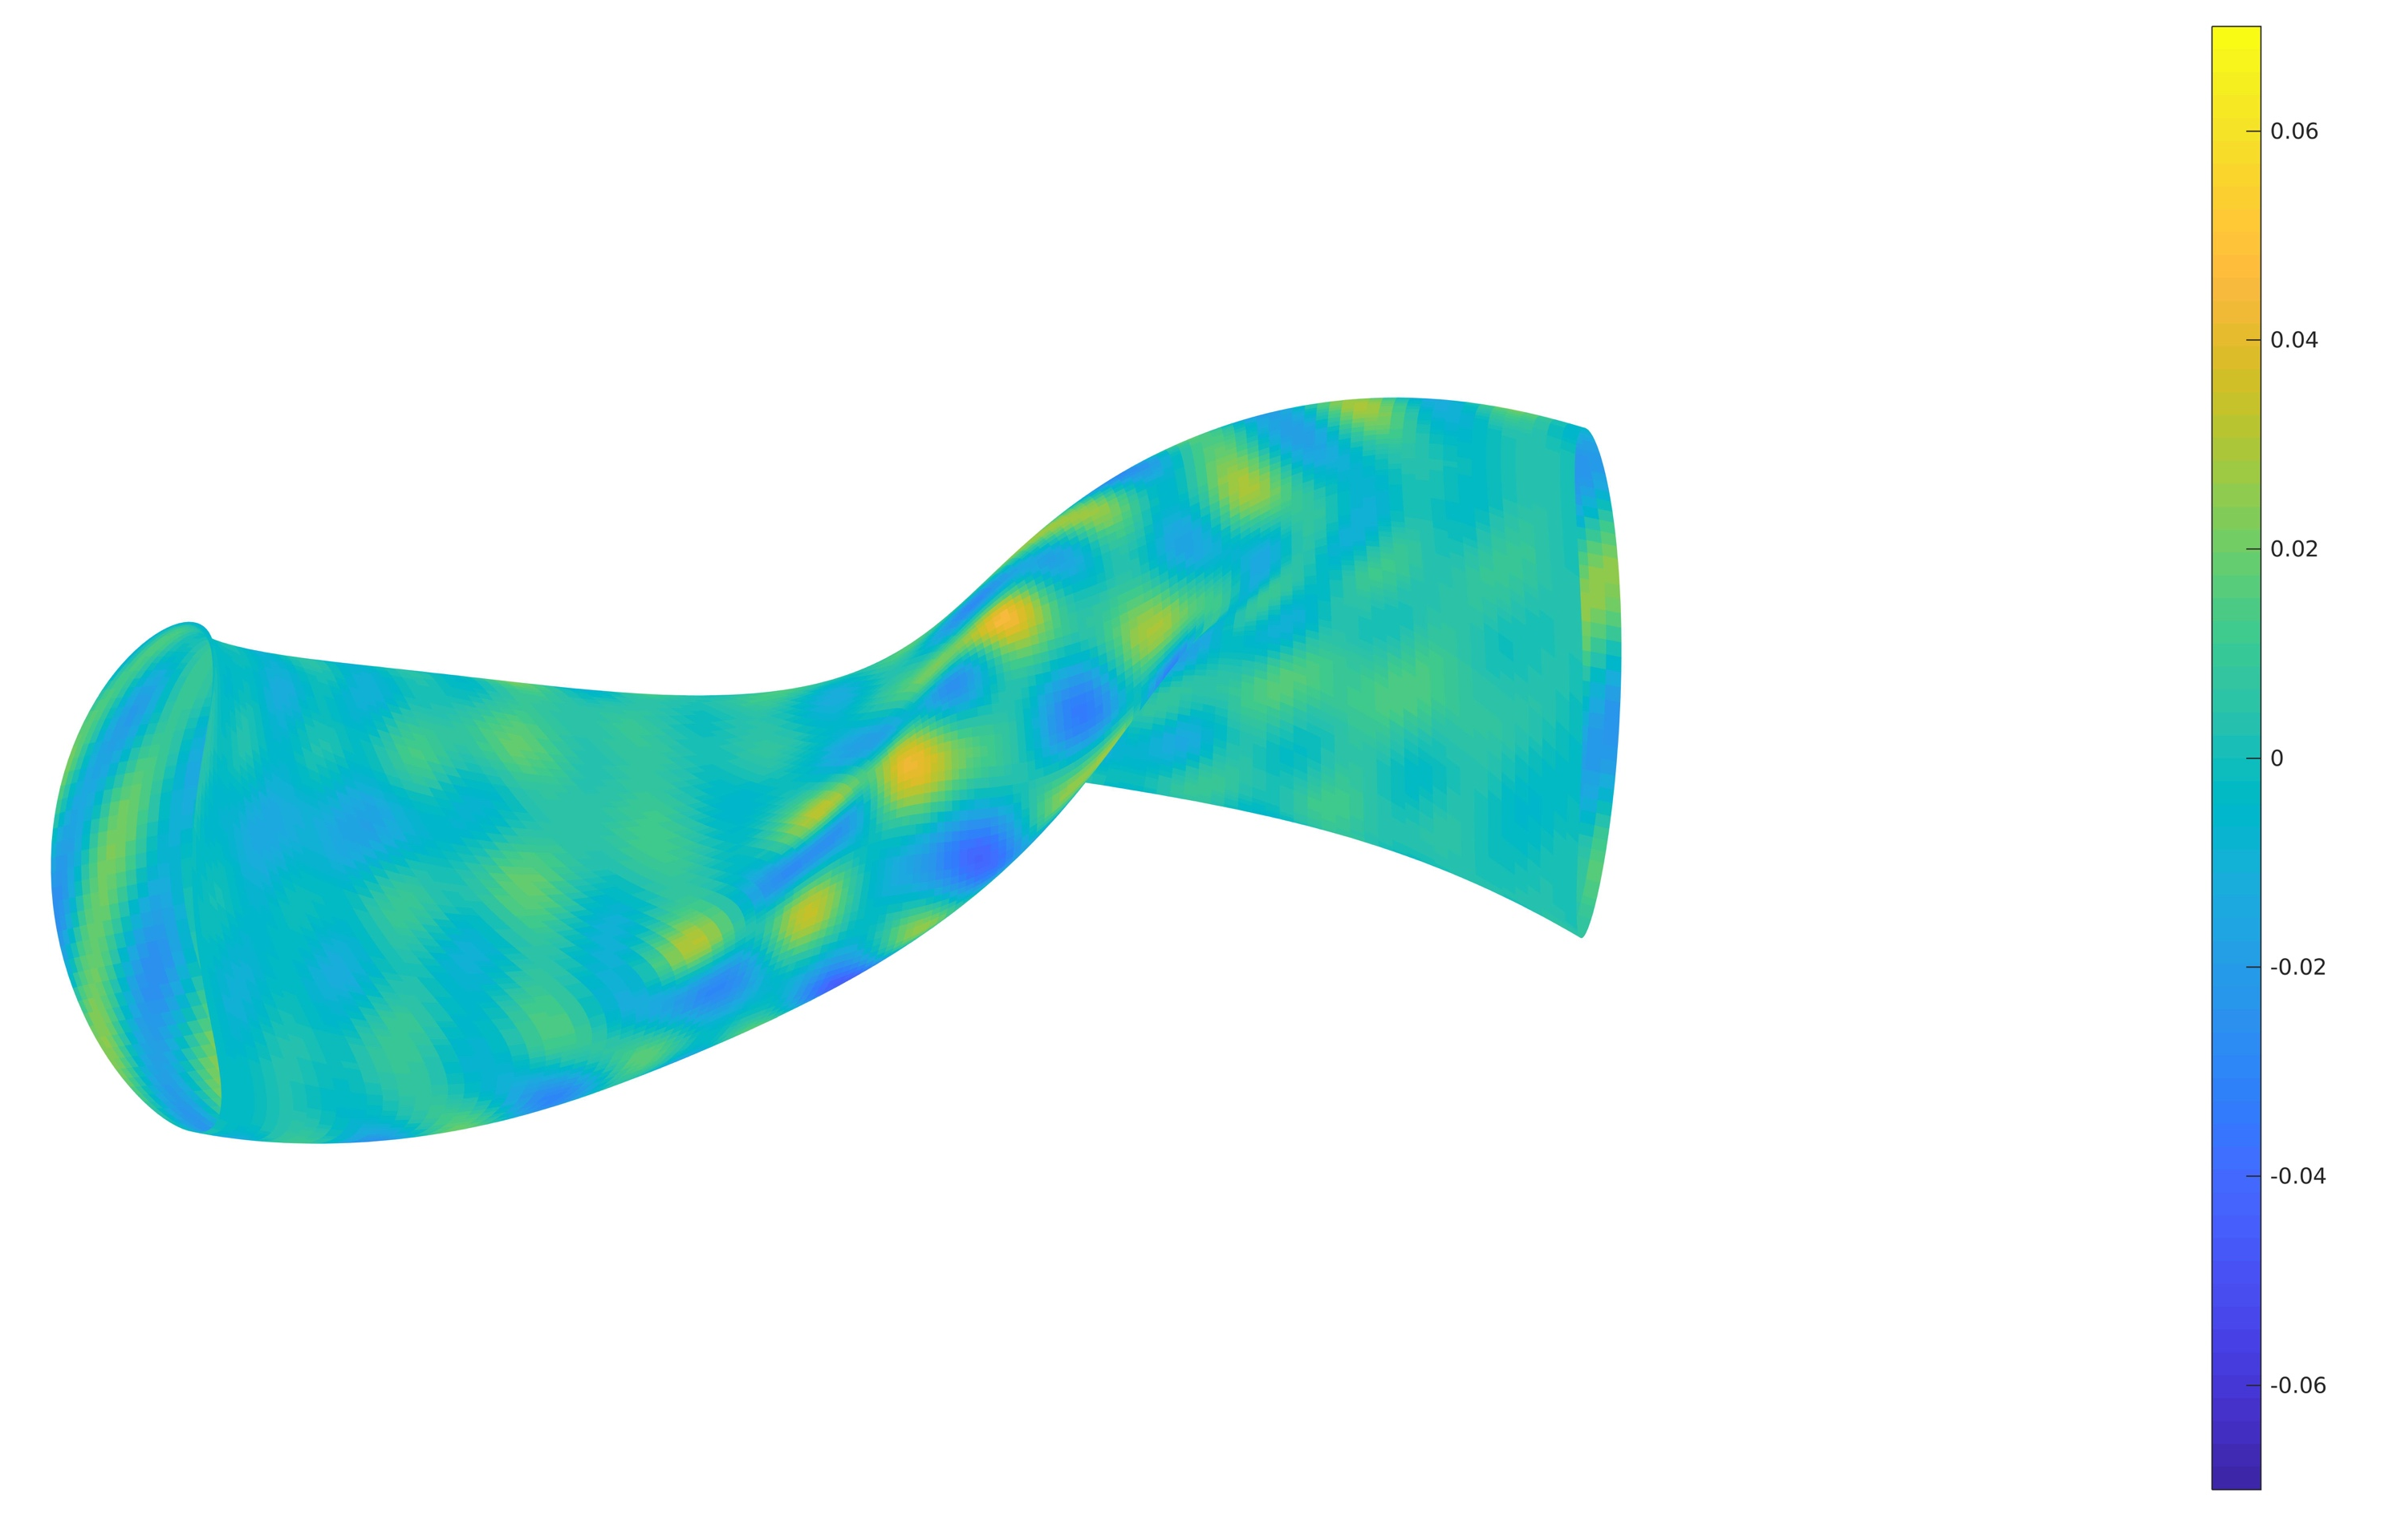

Slide 4
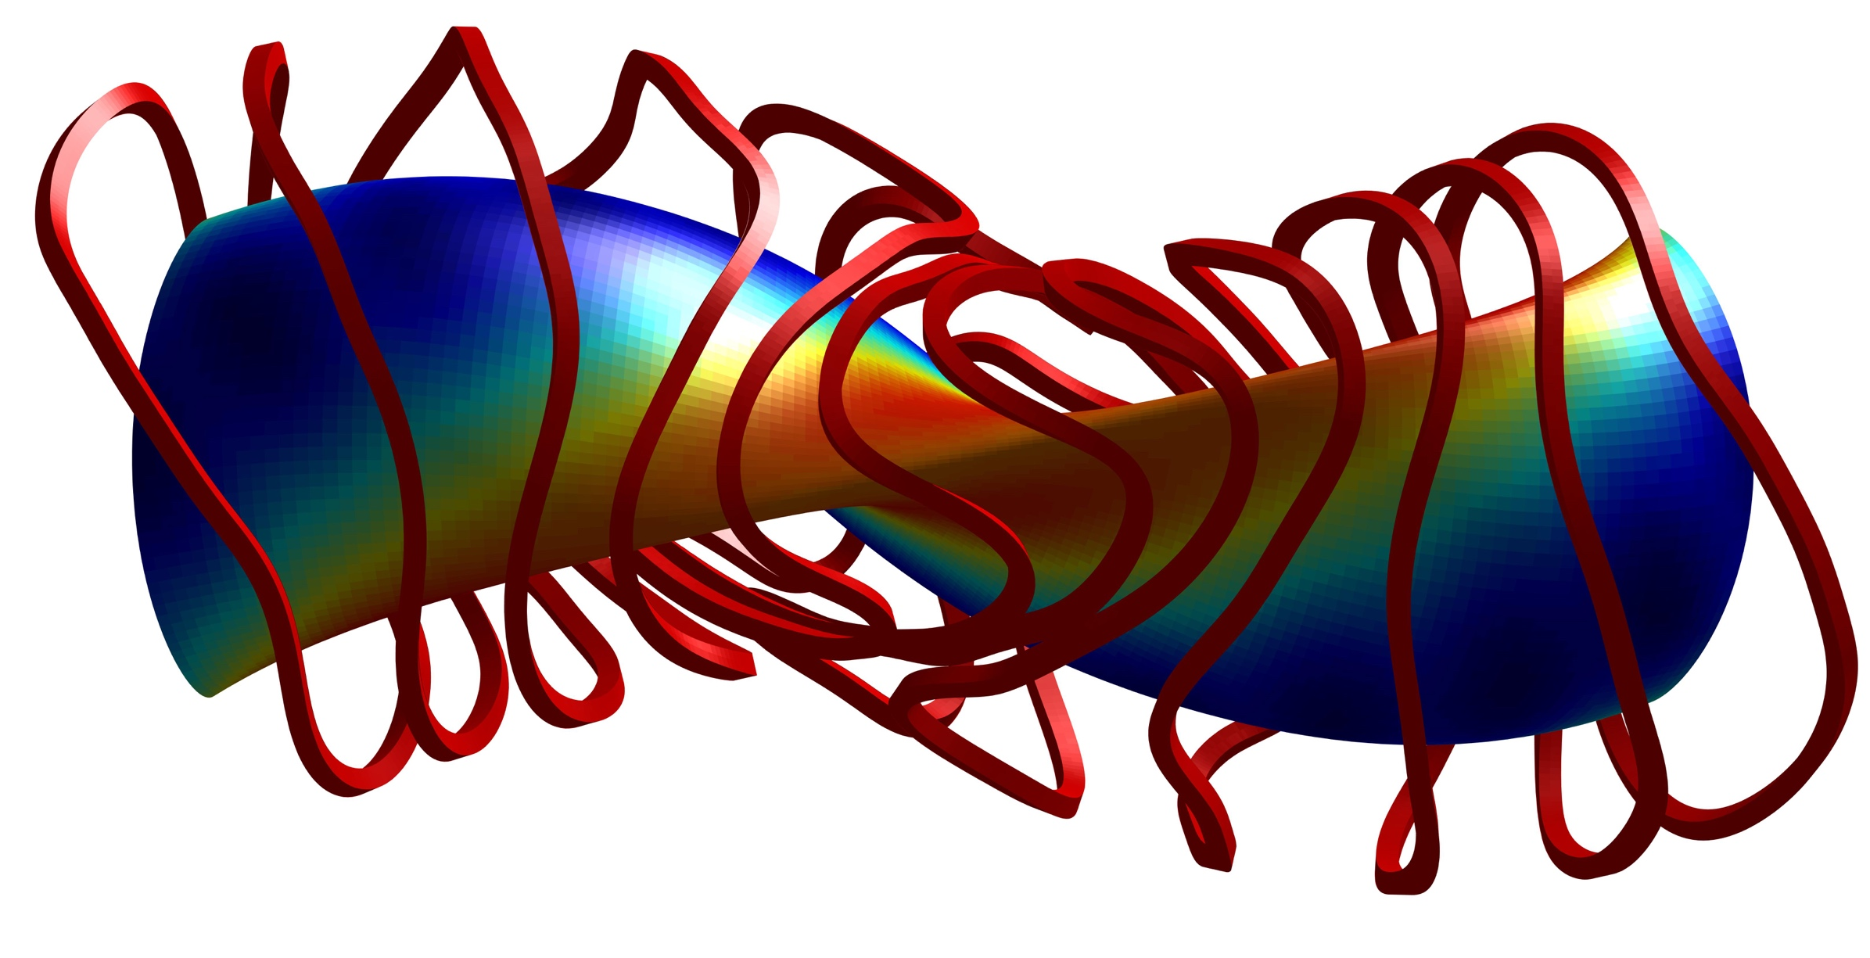
FOCUS Initialized with REGCOIL 30cm Offset
Minimum Coil to Coil Separation | Minimum Coil to Boundary Separation | Minimum Radius of Curvature
8.7 cm | 25.5 cm | 8.1 cm

Slide 5
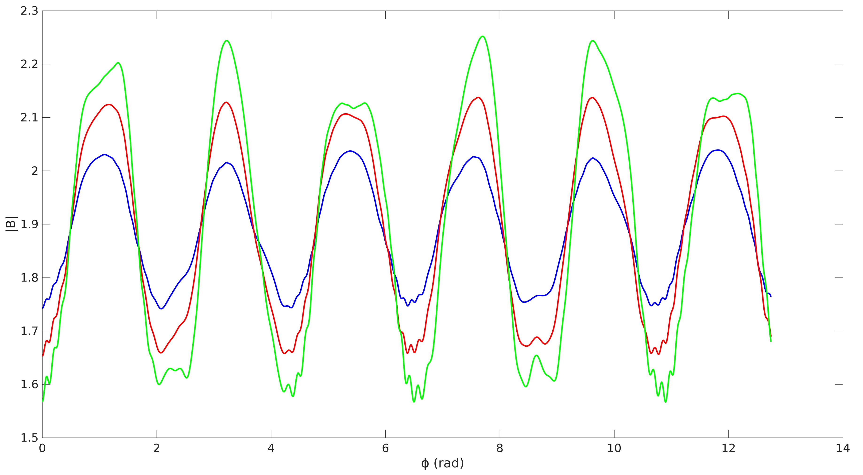
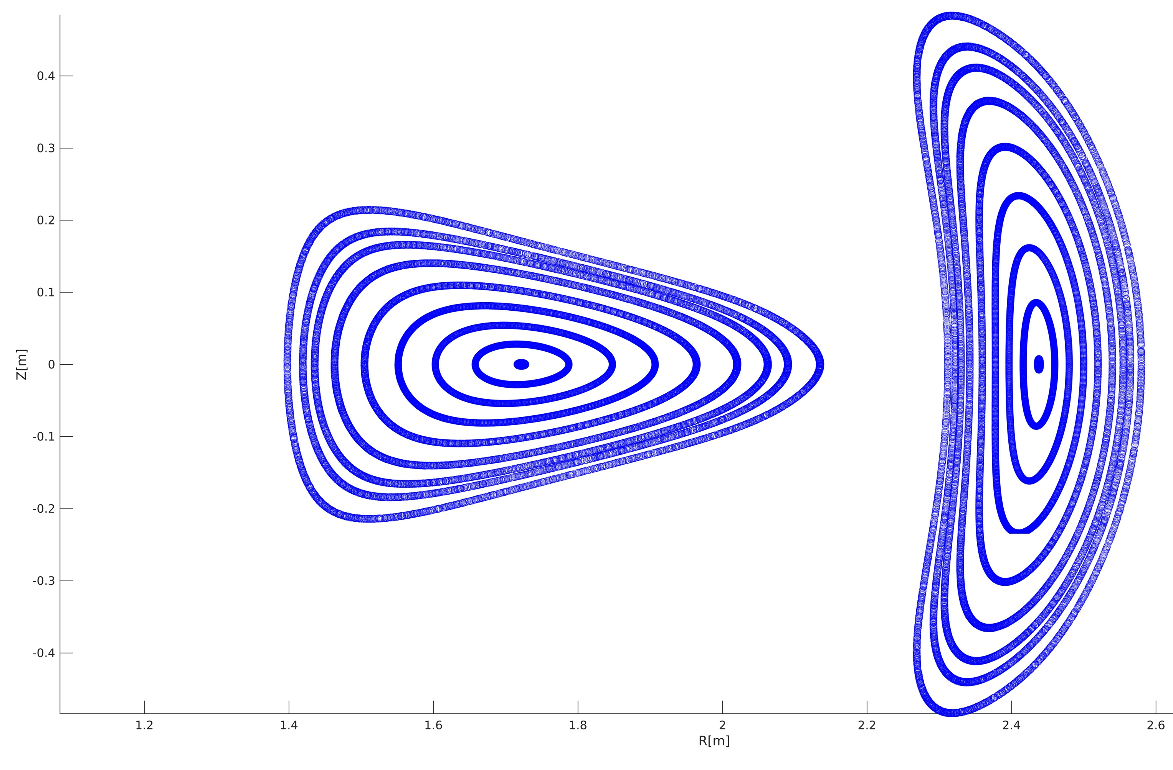
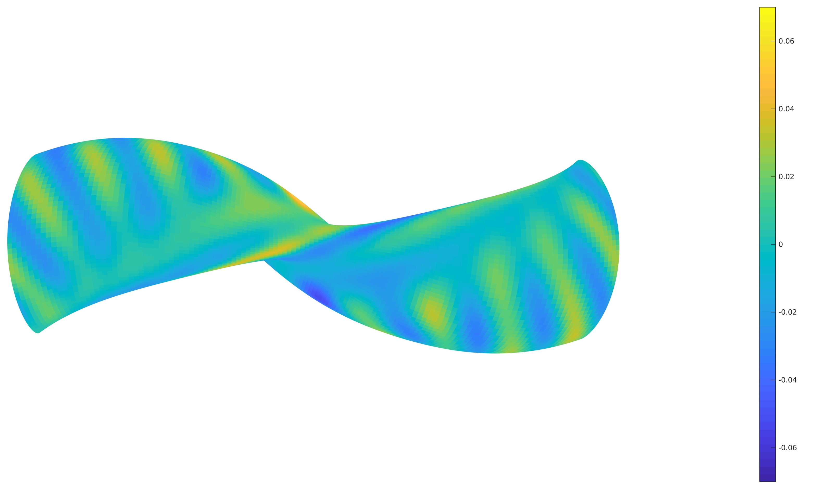
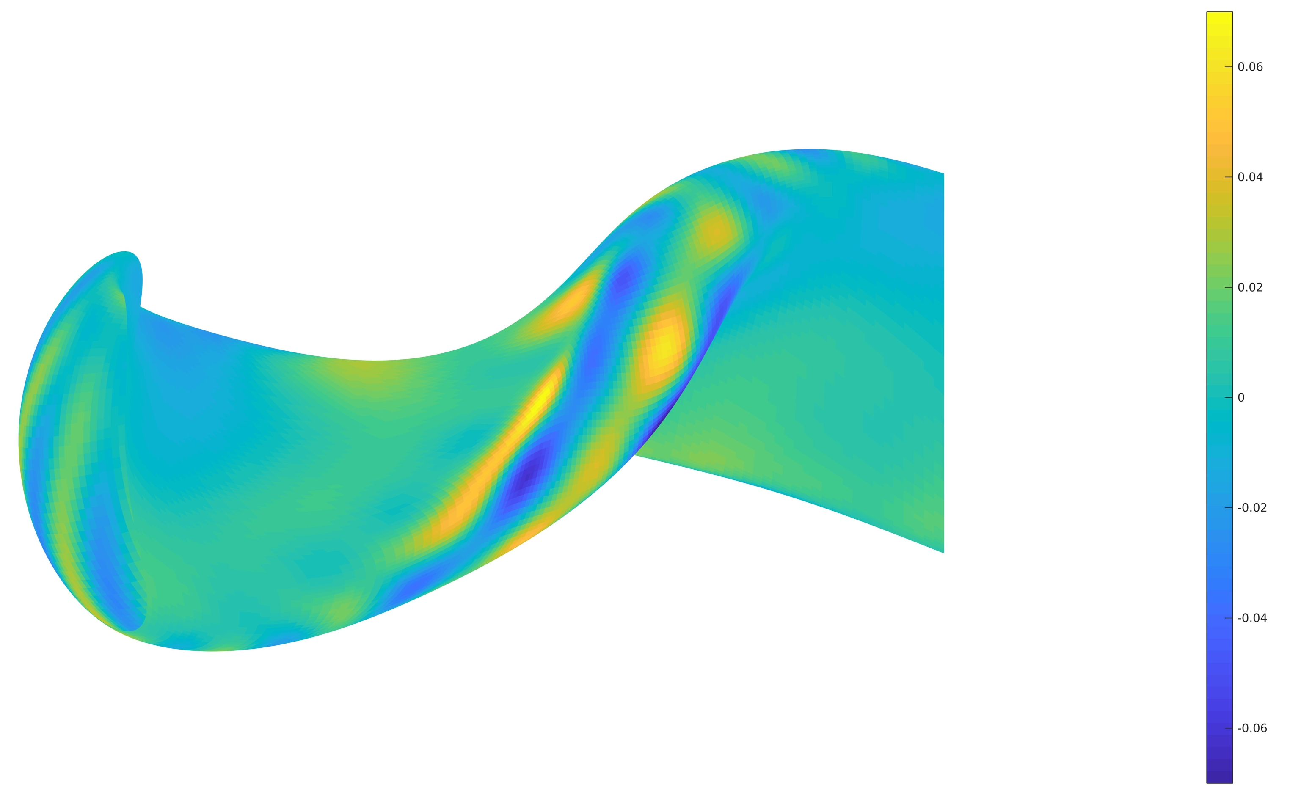

Slide 6
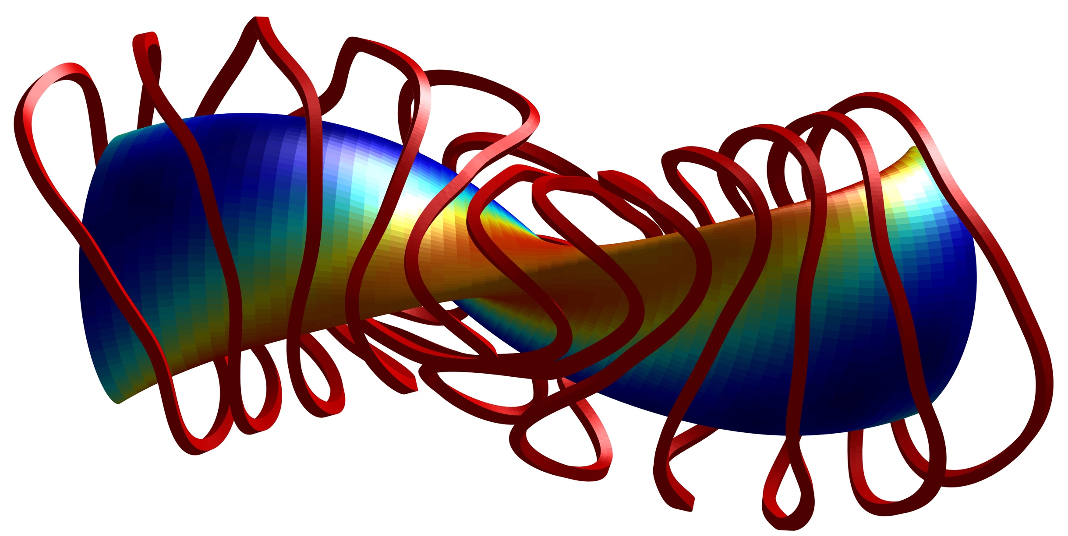
FOCUS with Coil to Plasma Spacing
Minimum Coil to Coil Separation | Minimum Coil to Boundary Separation | Minimum Radius of Curvature
10.8 cm | 19.0 cm | 8.0 cm

Slide 7
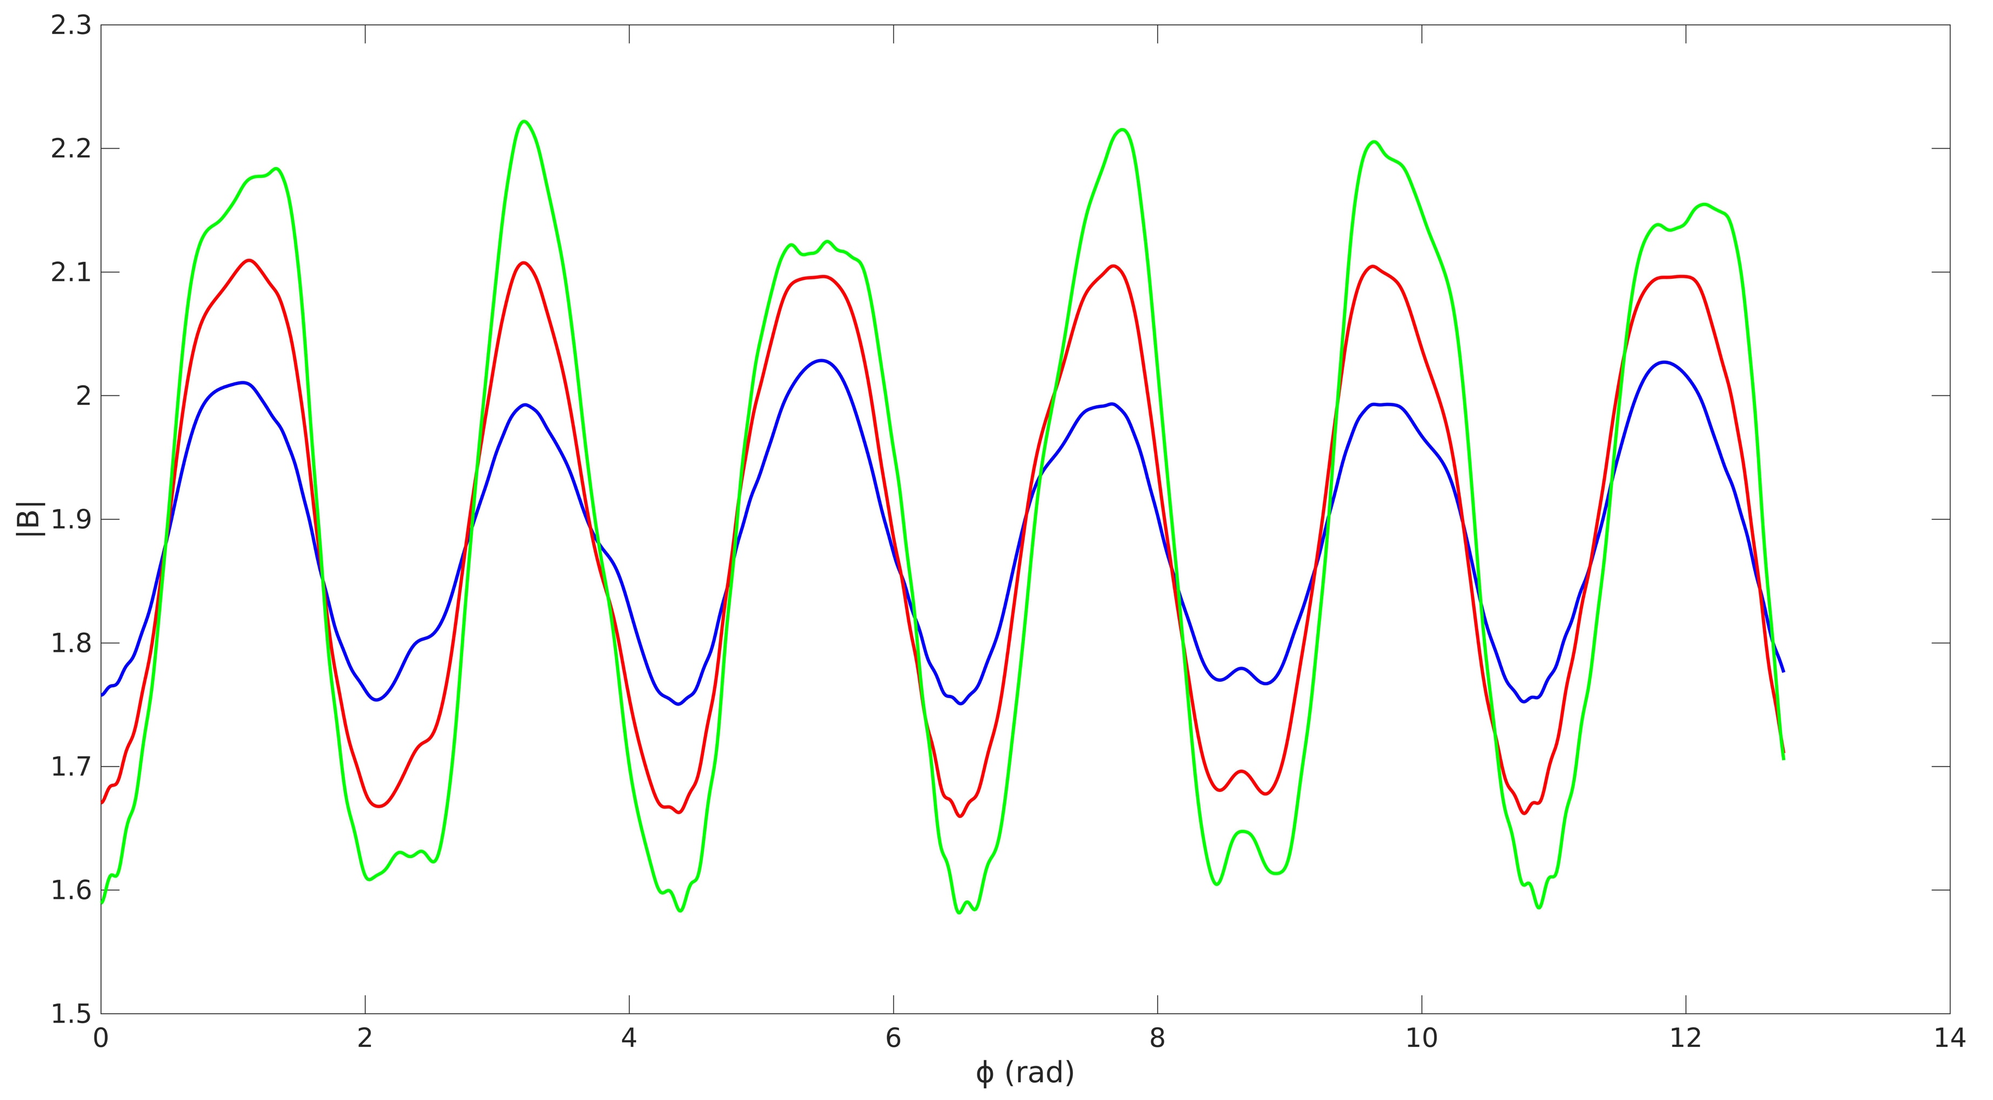
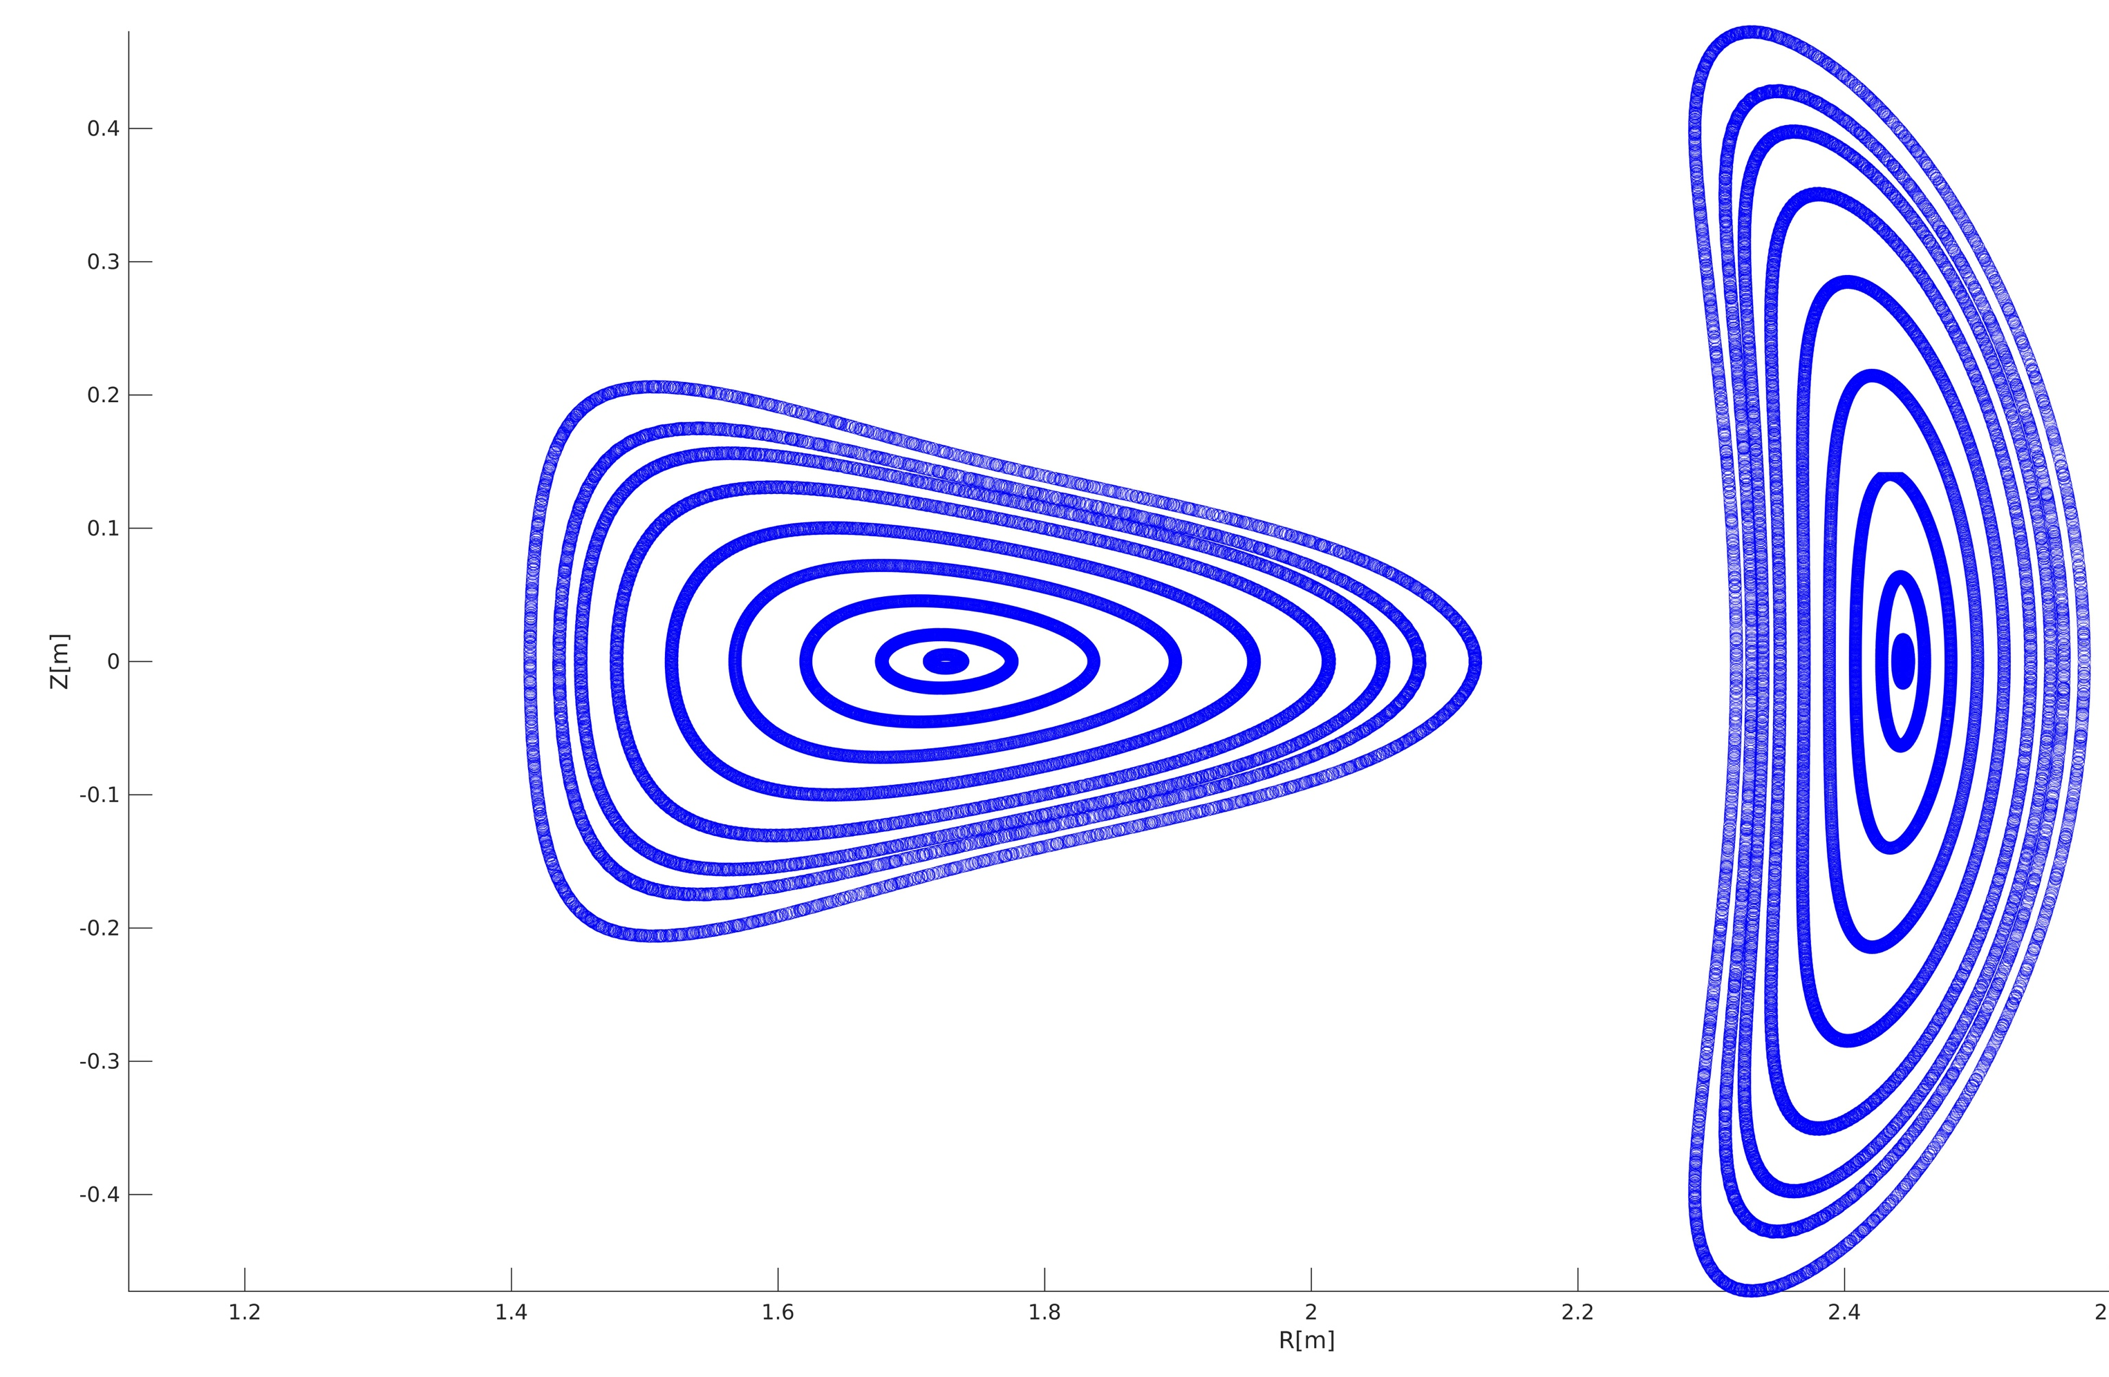
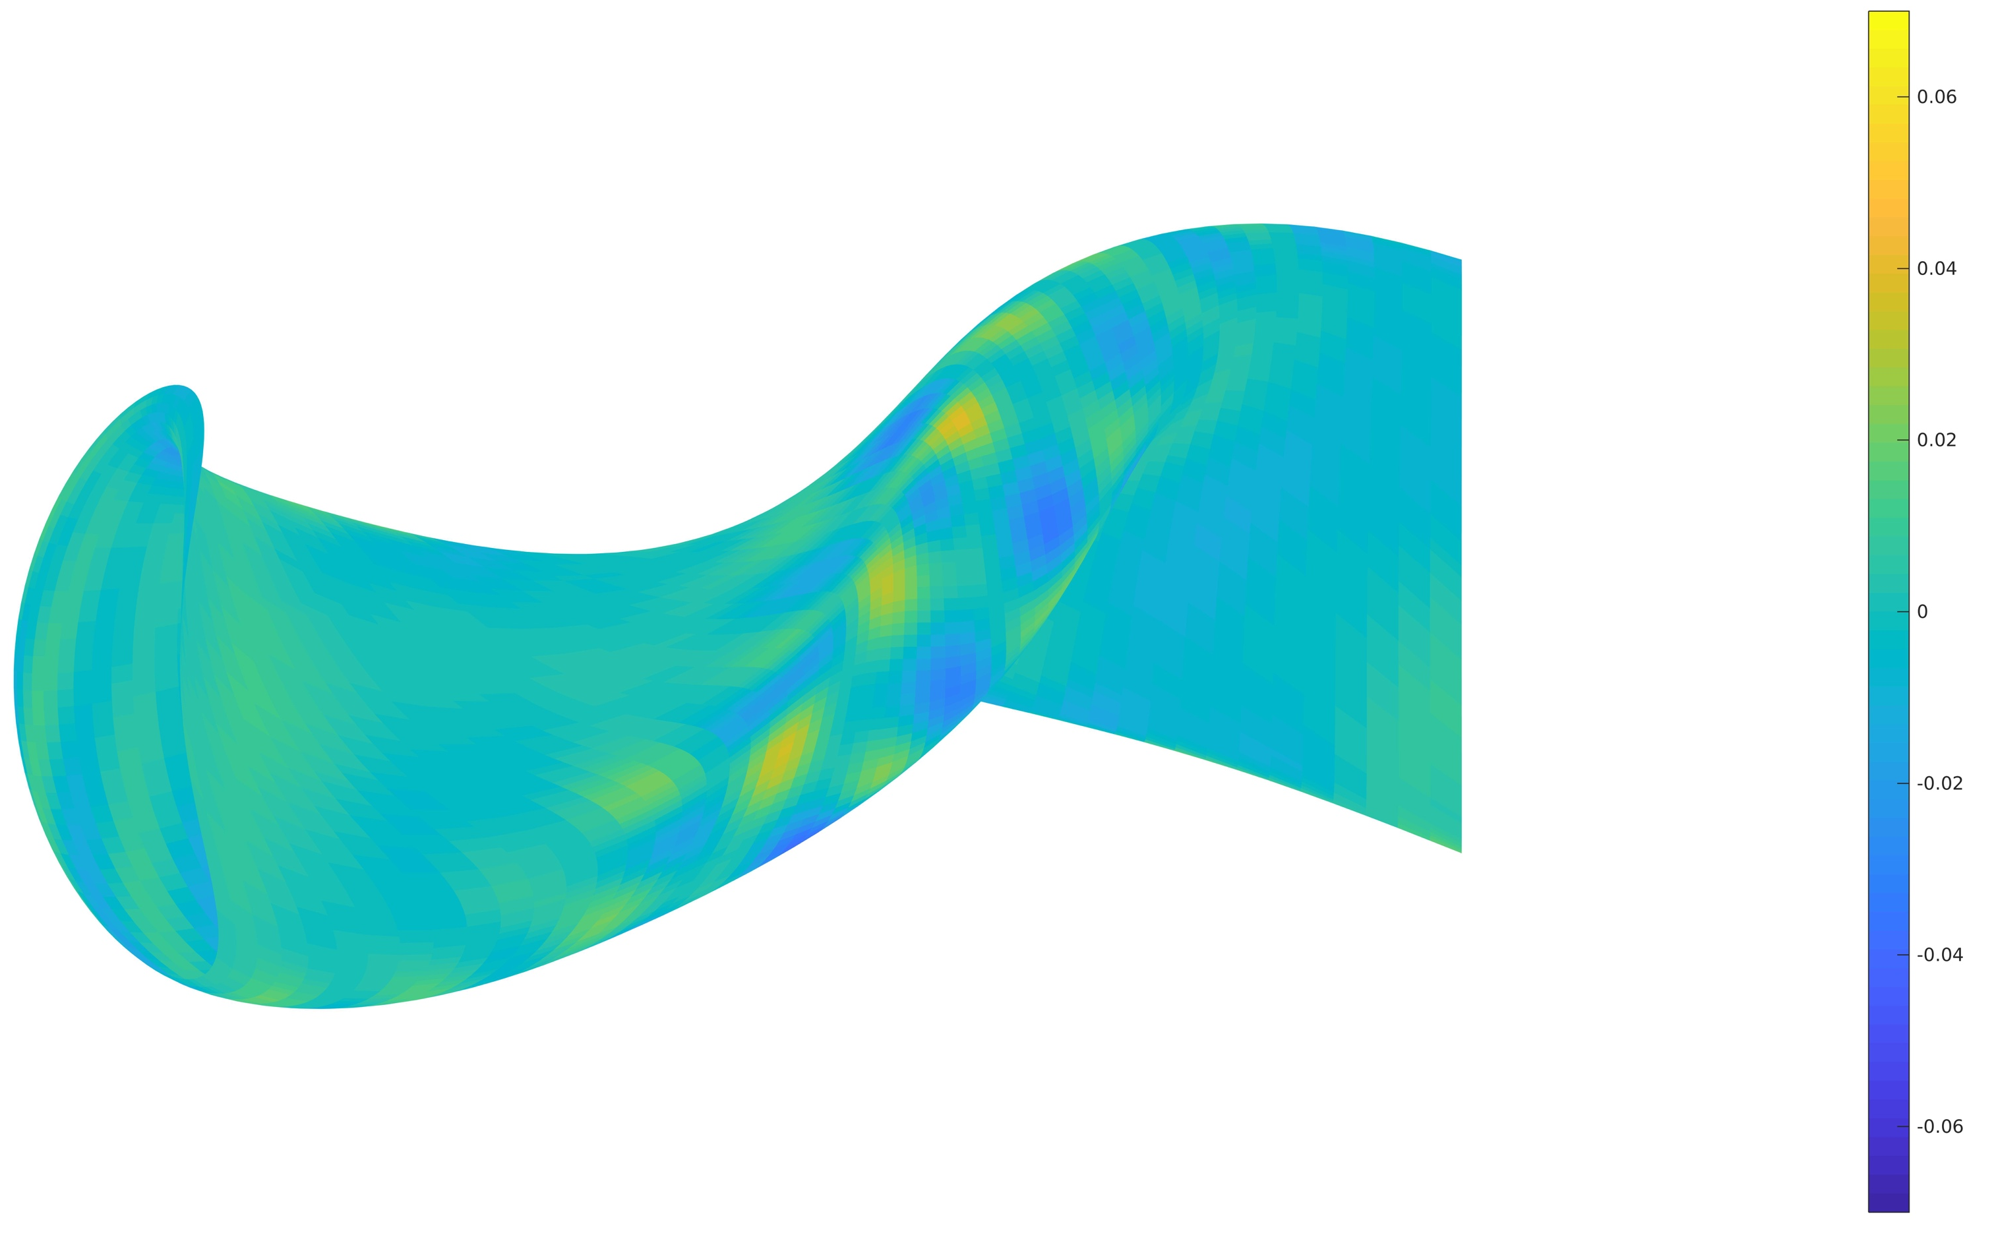
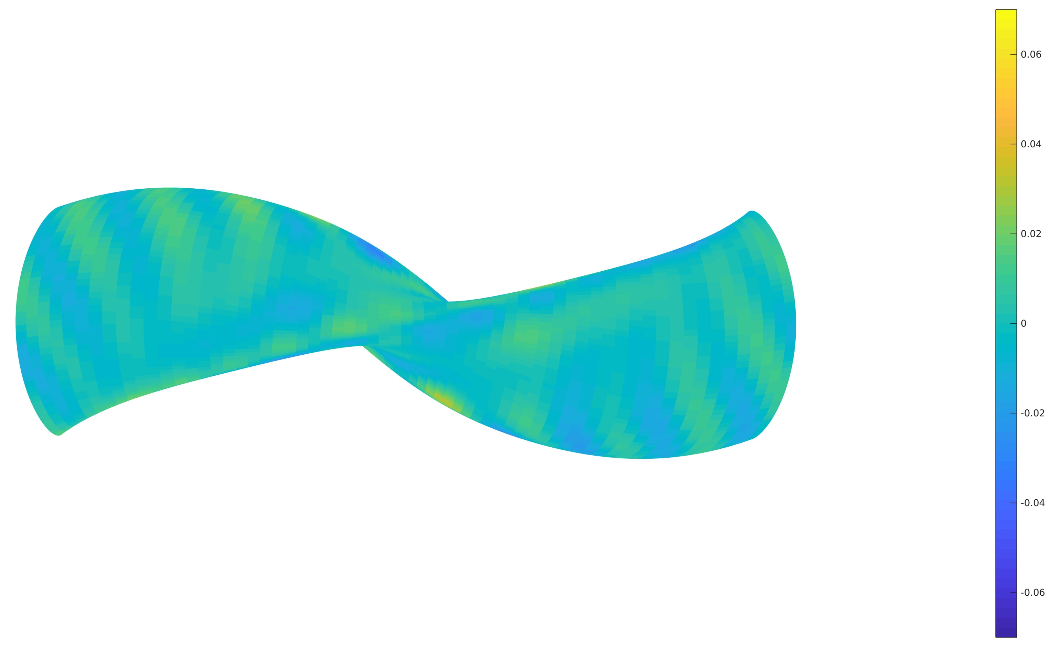

Slide 8
Conclusions
Why is it hard to fit the boundary?
  Sharp curvature
  Concavity of the boundary?
  Sharp curvature on the low field side
  Aspect ratio leading to higher coil ripple on boundary?
Going forwards
  Different number of coils
  Further optimize with current tools
  Different coil geometries, helical+modular
  Double winding surface optimization
  Coil complexity optimization of the boundary

