Slide 1
A five-field period configuration
Andrew Ware

Slide 2
Quasi-helically symmetric 5- field period configuration
Vacuum equilibrium:

Slide 3
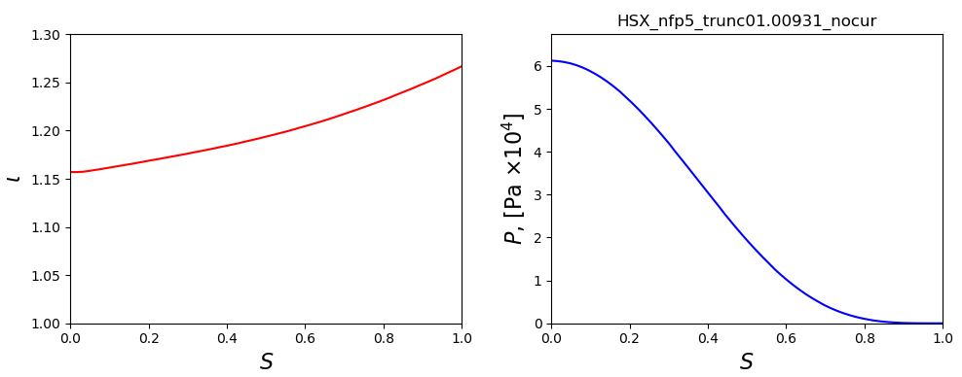
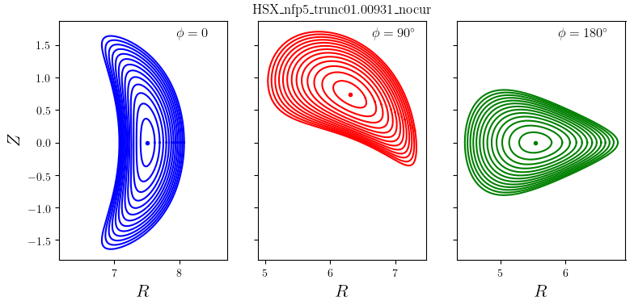
Quasi-helically symmetric 5- field period configuration (cont.)
No current but finite β equilibrium:
R = 6.34
a = 0.95
A = 6.68
β = 0.84%
ns = 64
ntor = 6
mpol = 4

Slide 4
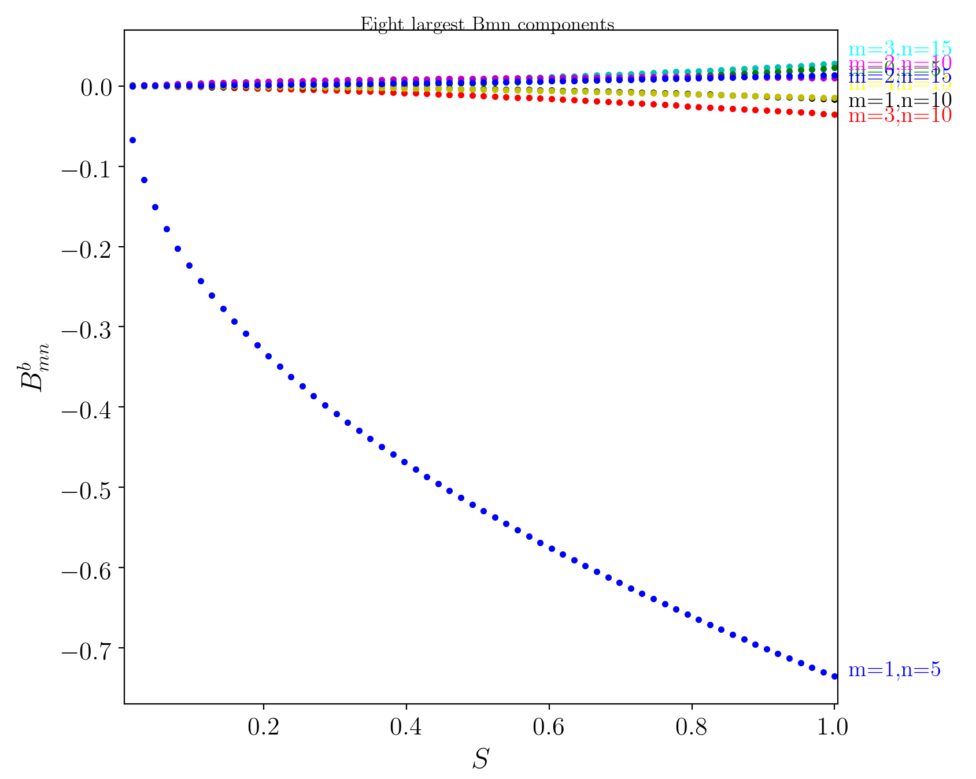
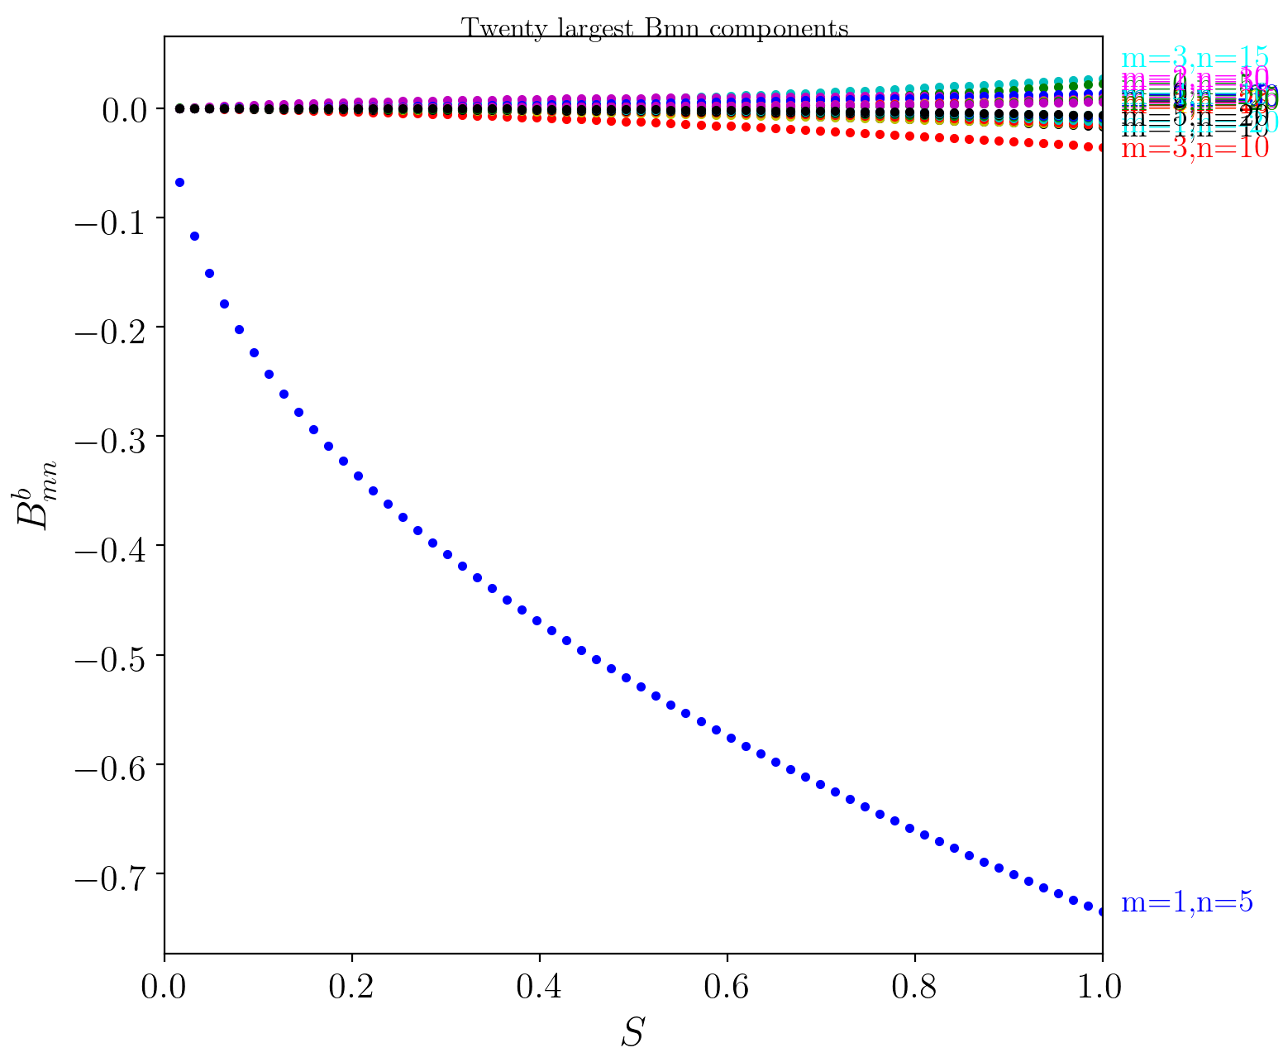
Quasi-helically symmetric 5- field period configuration (cont.)
Boozer magnetic spectrum:
# n m
1 5 1
2 10 3
3 15 3
4 5 0
5 10 2
6 10 1
7 15 4
8 15 2

Slide 5
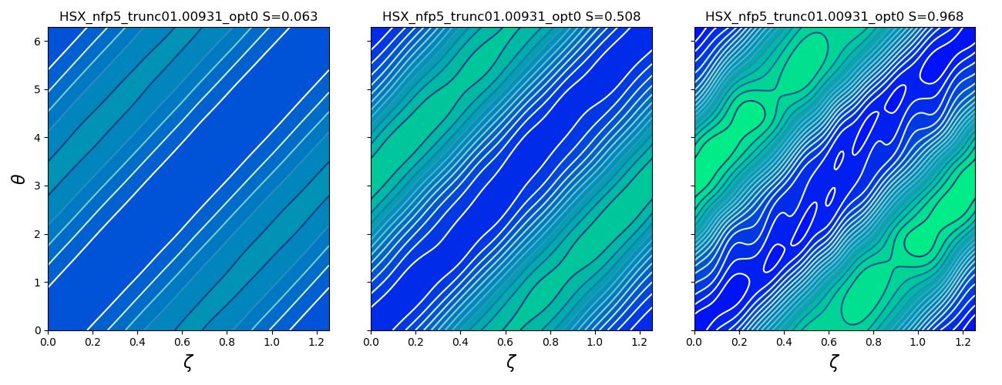
Quasi-helically symmetric 5- field period configuration (cont.)
Contours of |B| in Boozer coordinates:

Slide 6
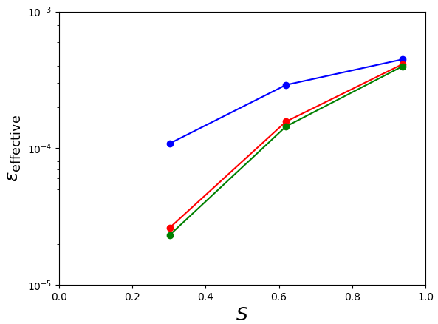
Quasi-helically symmetric 5- field period configuration (cont.)
Good neoclassical confinement:
NFP6, with current
NFP5, no current
NFP5, with current

Slide 7
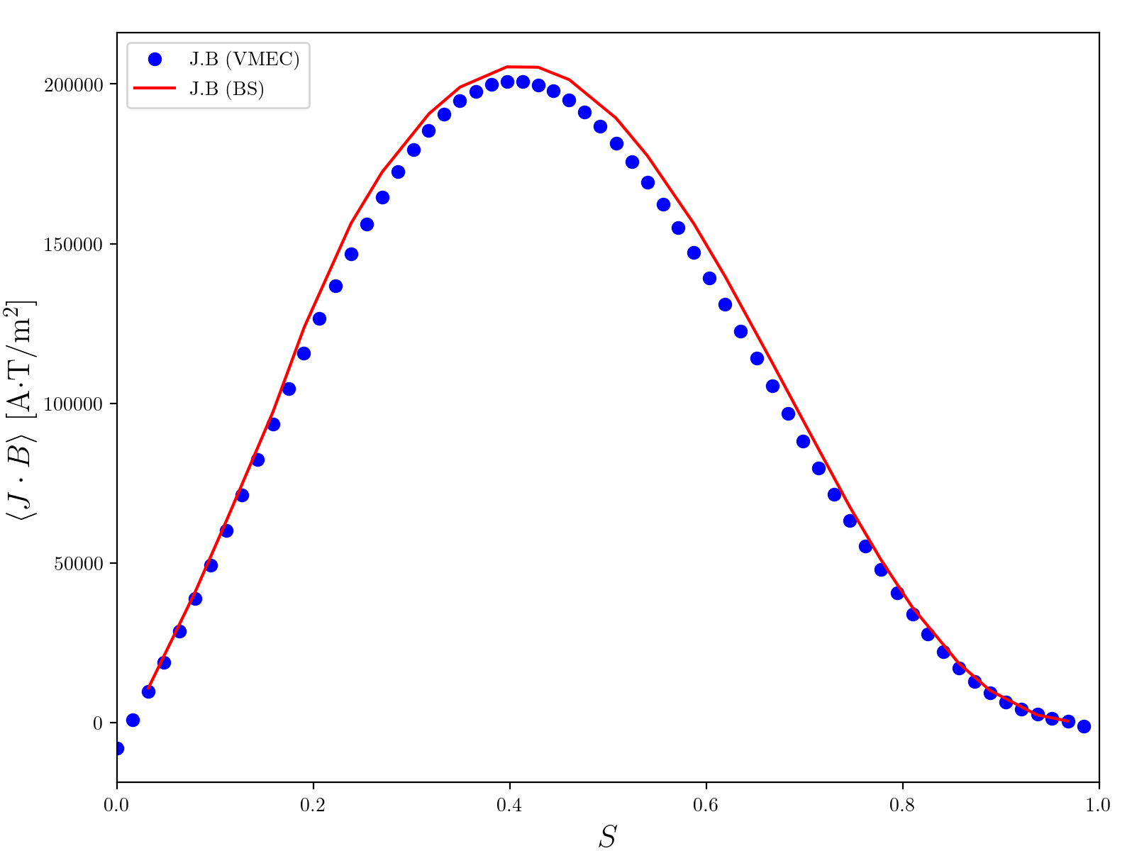
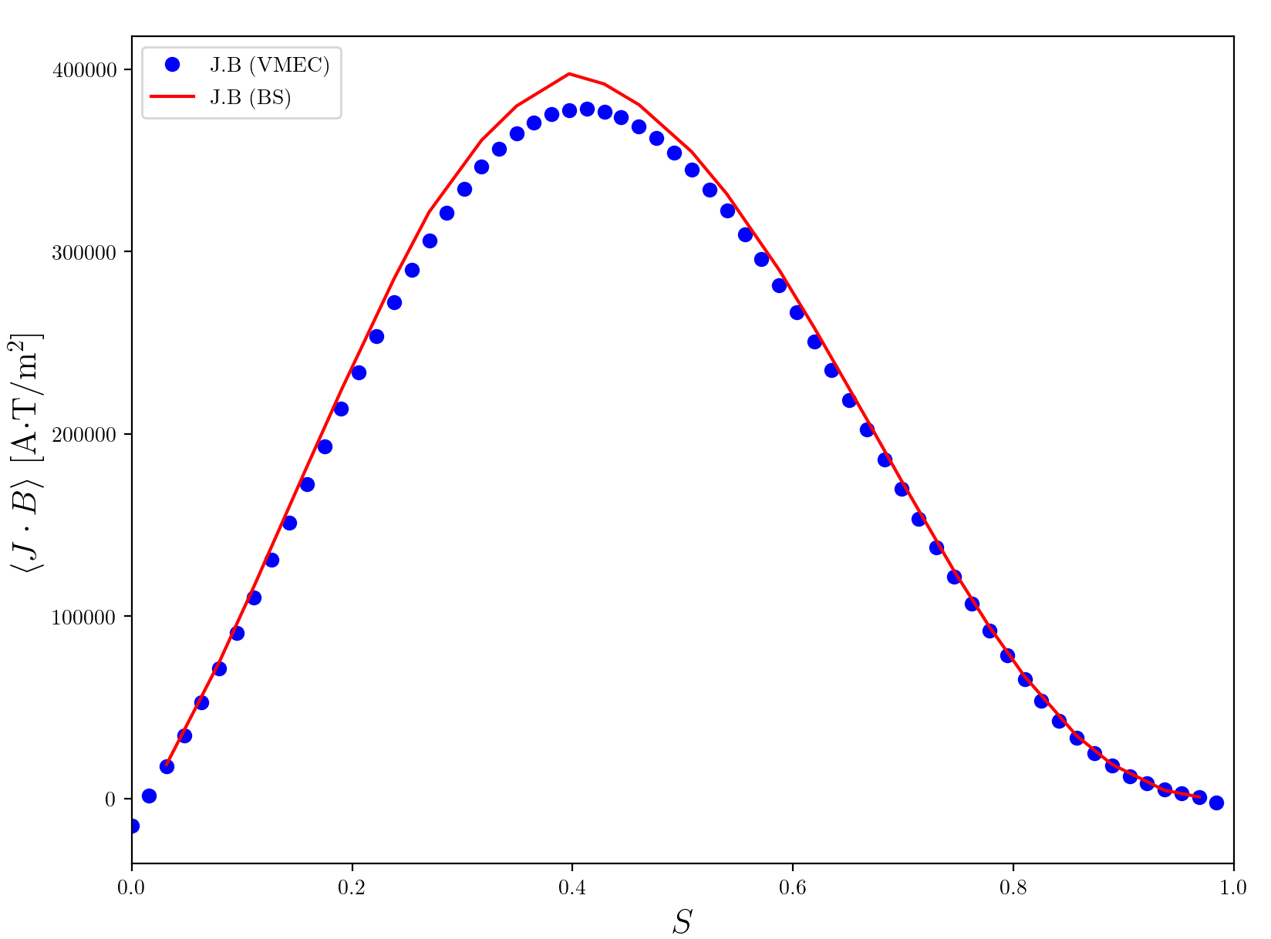
Quasi-helically symmetric 5- field period configuration (cont.)
Matched bootstrap current:
β = 1%, 115 kA
β = 2%, 220 kA
JBOOTS
JBOOTS
VMEC
VMEC

Slide 8
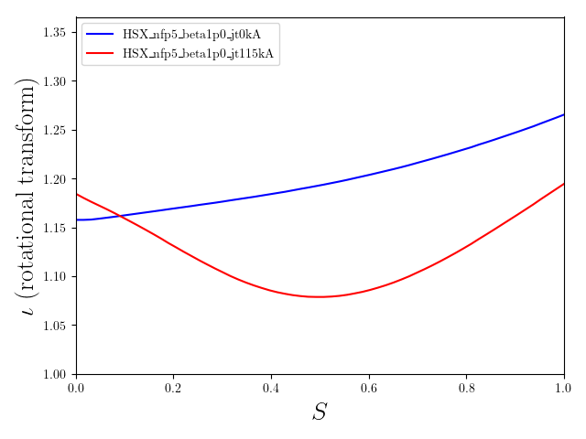
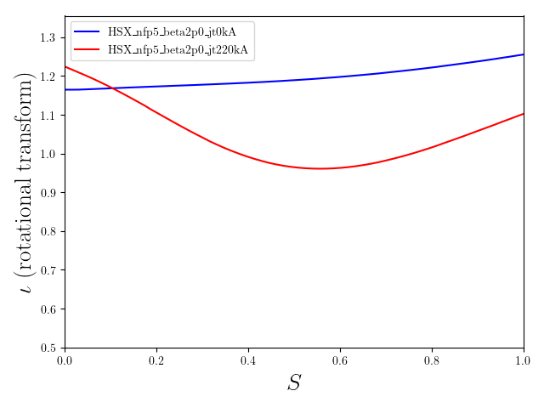
Quasi-helically symmetric 5- field period configuration (cont.)
For β = 1%, ι > 1 even with current:
β = 1%
β = 2%
0 kA
0 kA
220 kA
115 kA

Slide 9
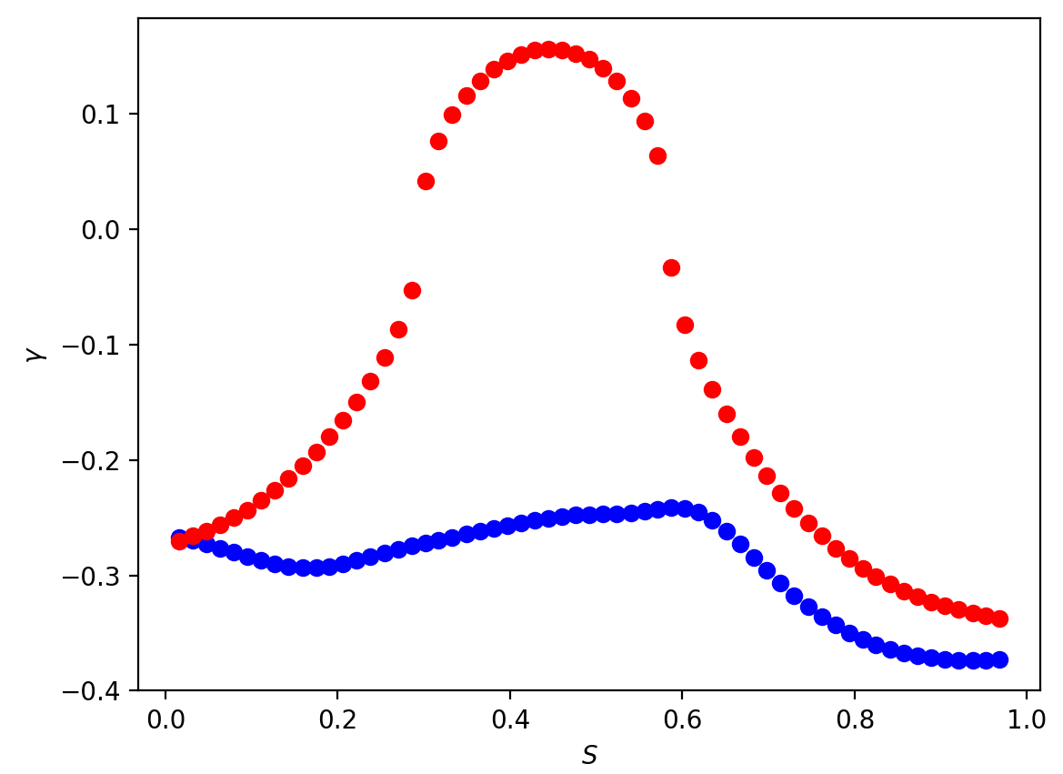
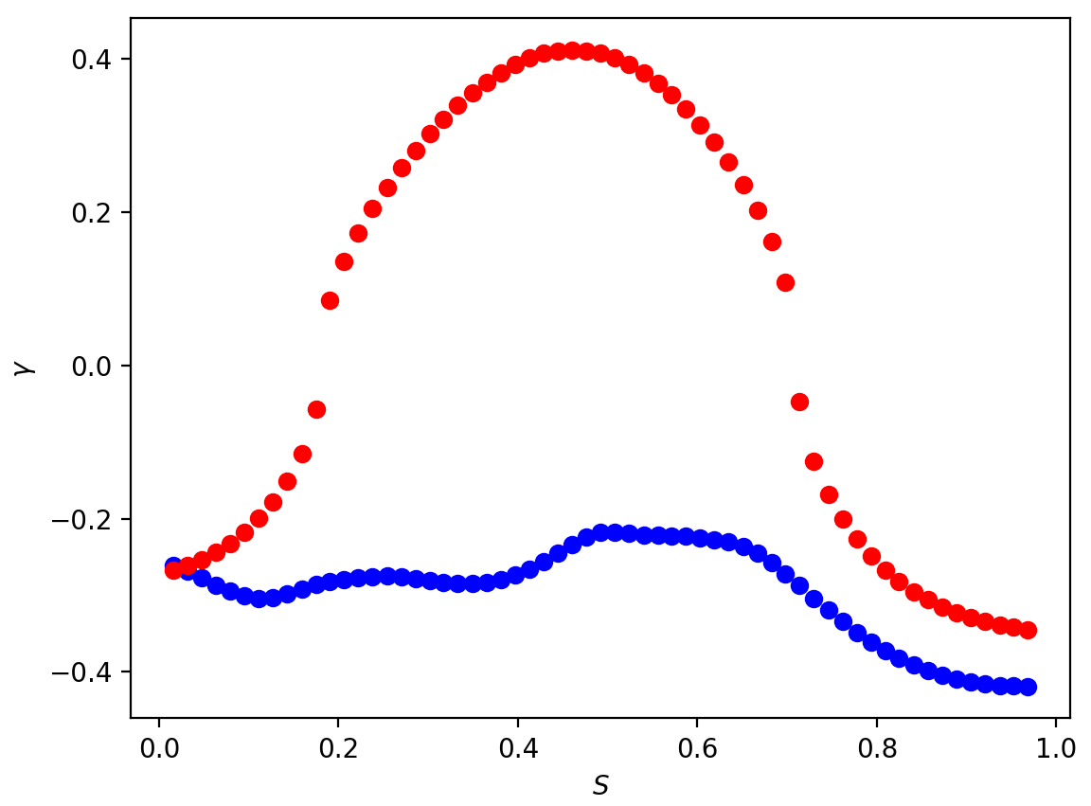
Quasi-helically symmetric 5- field period configuration (cont.)
Ballooning stability improves with bootstrap-matched current:
β=1%, 0 kA
β=2%, 0 kA
β=1%, 115 kA
β=2%, 220 kA

Slide 10
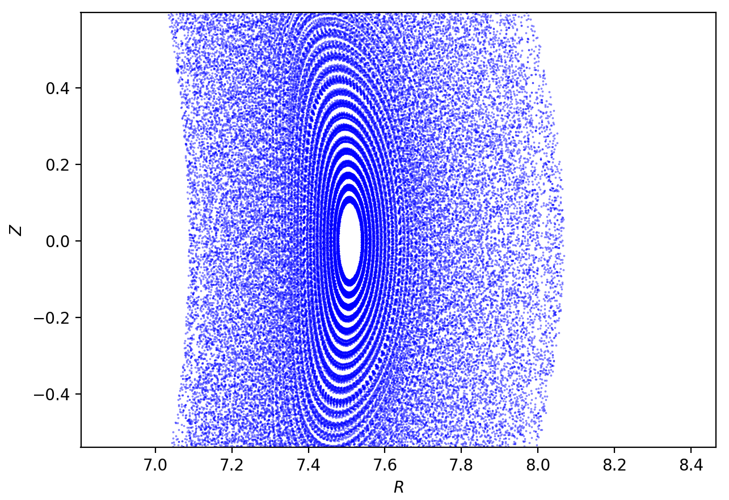
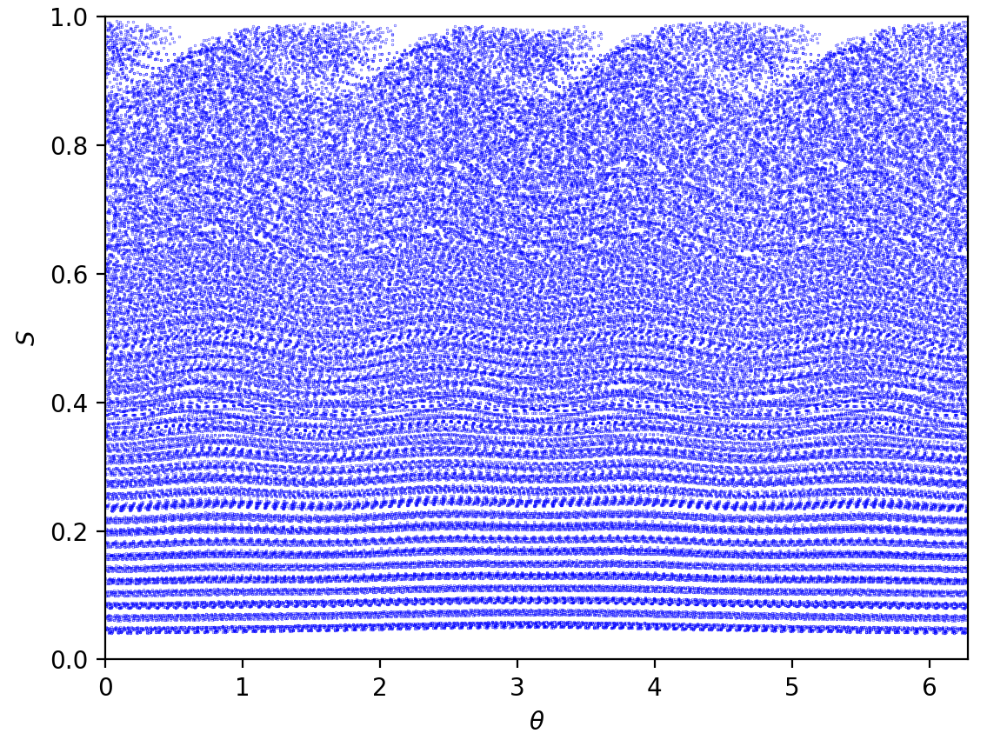
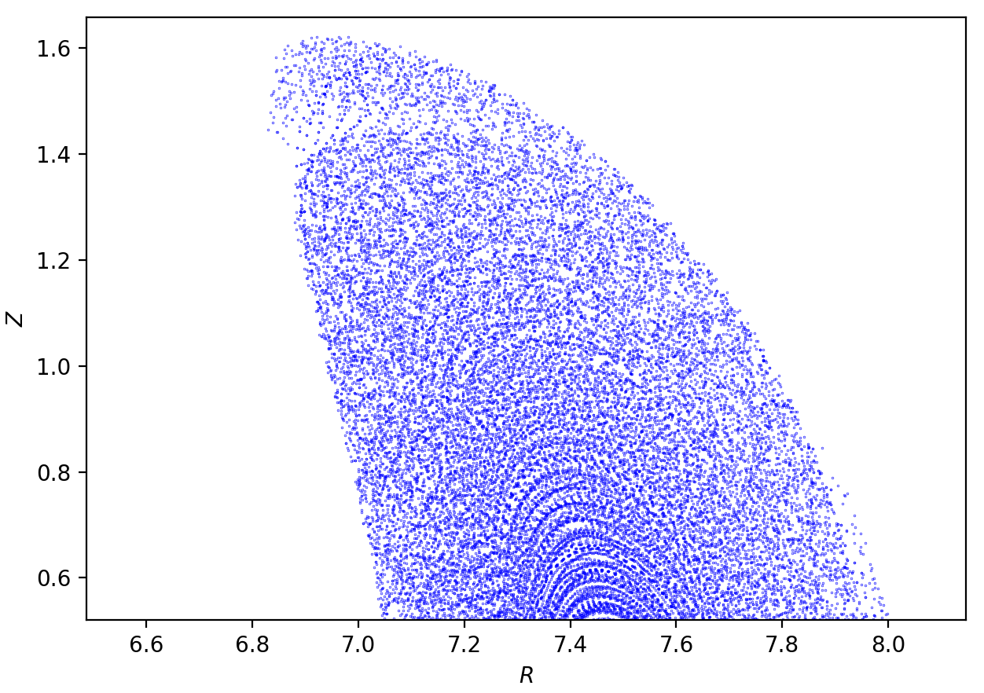
Quasi-helically symmetric 5- field period configuration (cont.)
Siesta indicates an island at the edge
(ι = 5/4 surface):
β=1%, 0 kA, Poincaré plots following field lines

Slide 11
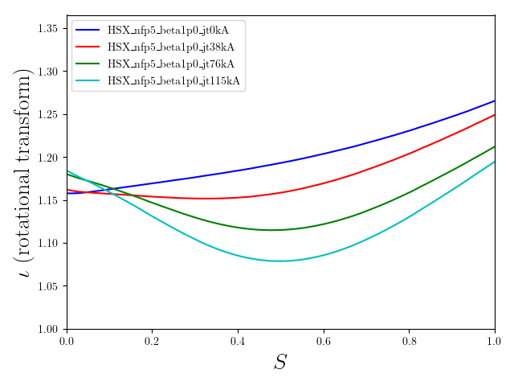
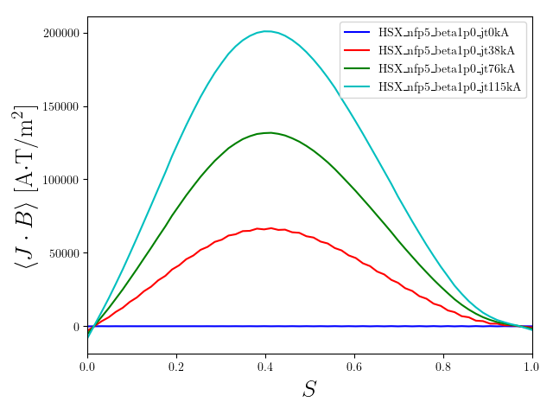
Quasi-helically symmetric 5- field period configuration (cont.)
Adding current removes the ι = 5/4 surface from the plasma:
0 kA
38 kA
76 kA
115 kA

Slide 12
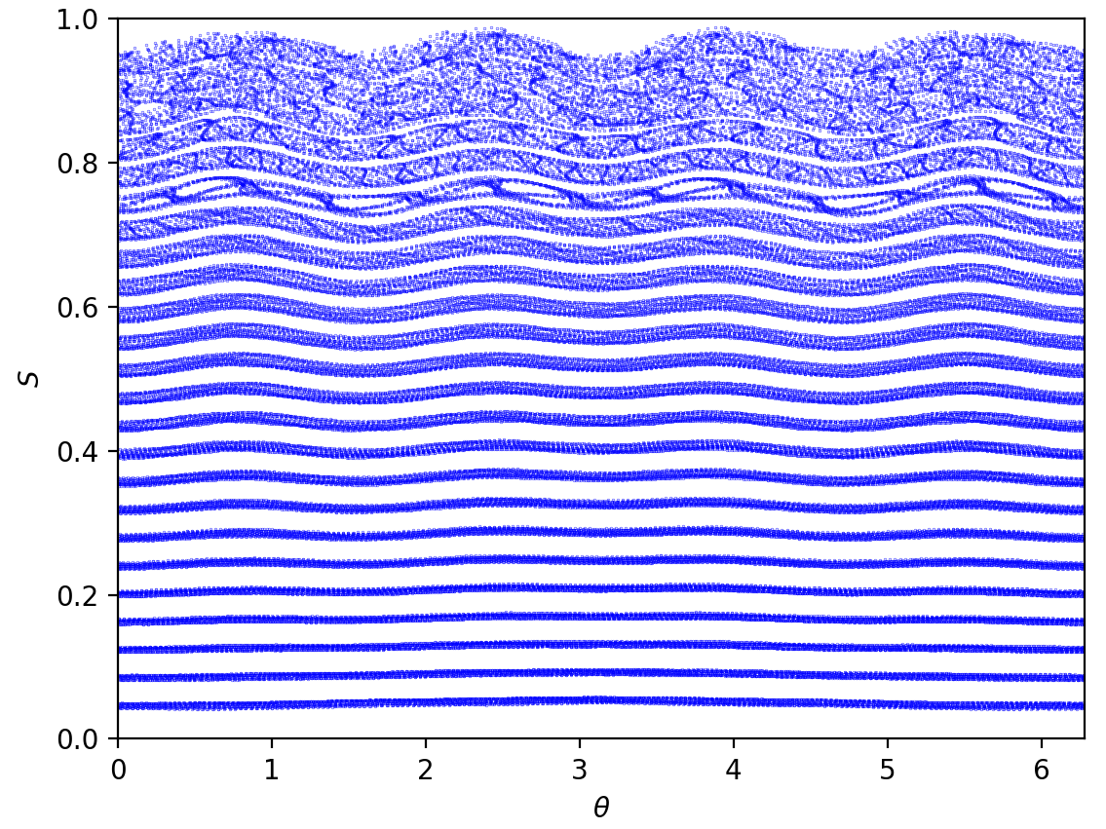
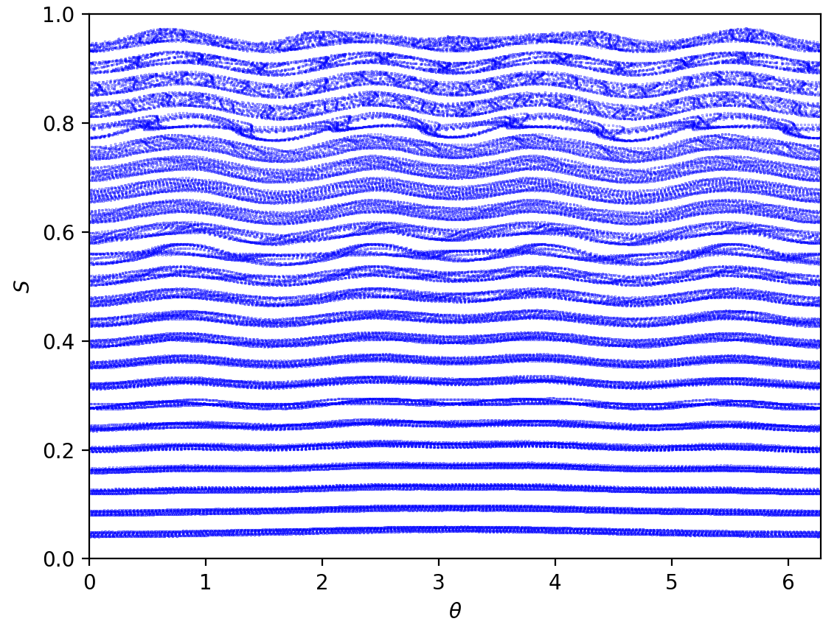
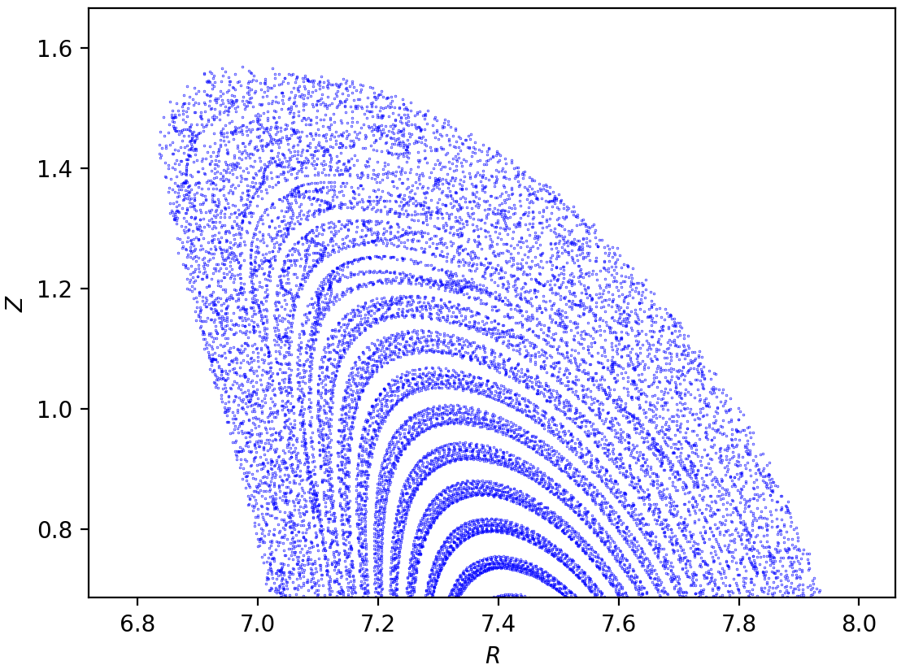
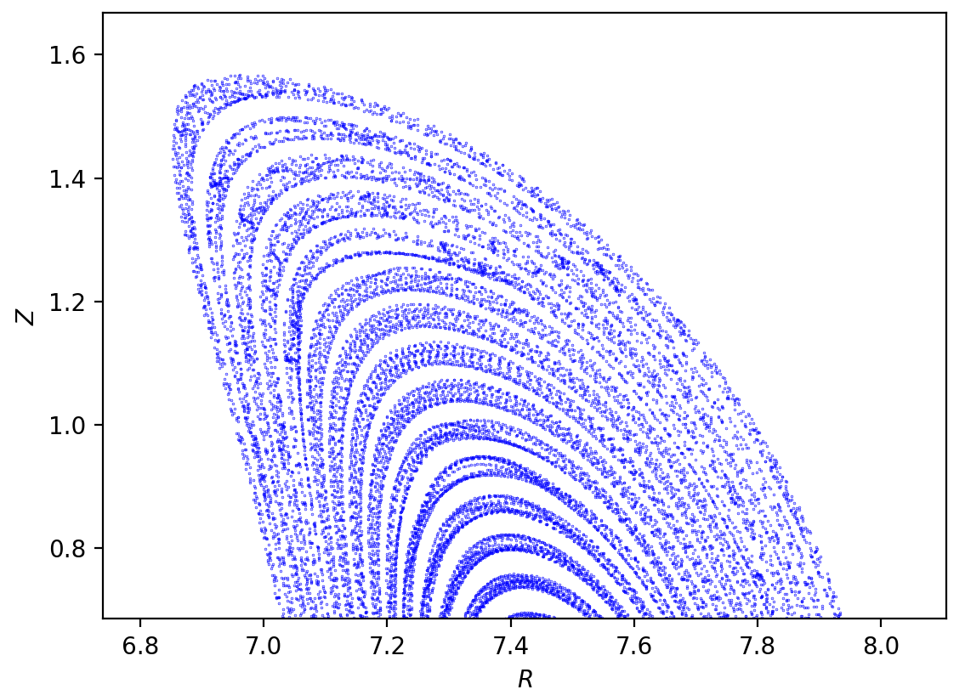
Quasi-helically symmetric 5- field period configuration (cont.)
The island leaves as current is added:
β=1%, 0 kA, Poincaré plots
β=1%, 38 kA, Poincaré plots
β=1%, 76 kA, Poincaré plots

Slide 13
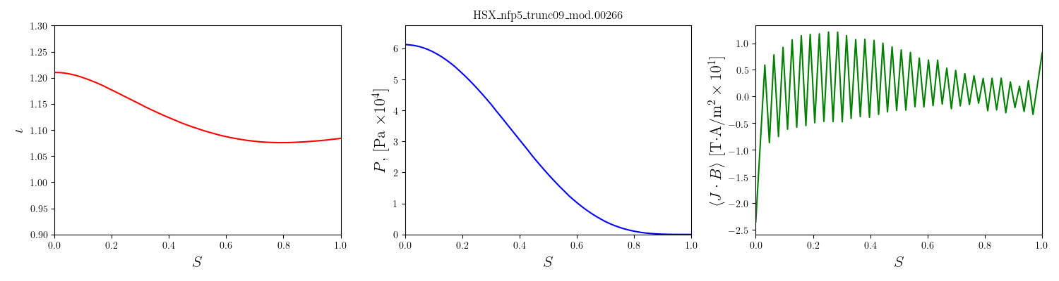
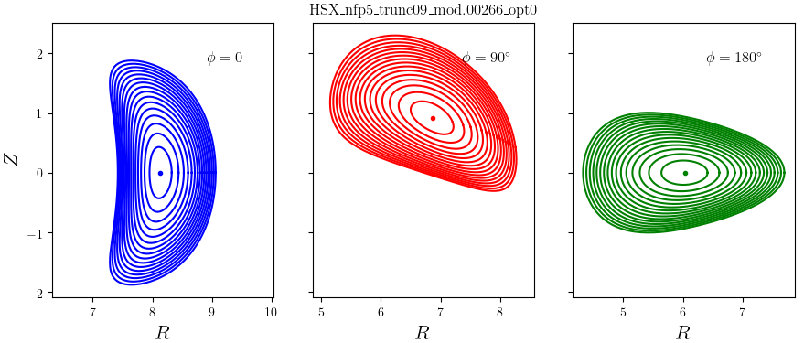
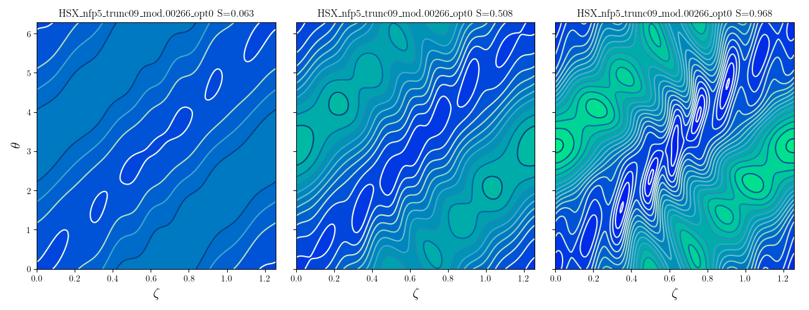
Hegna request: Tokamak shear…
Searching for a configuration with tokamak shear
  It’s possible but so far the quasi-symmetry gets worse

