Slide 1
Optimizing for quasi-helical symmetry in STELLOPT
Jack Schroeder
Wistell meeting, July 19, 2019

Slide 2
outline
optimization for QHS on single flux surface
optimization for QHS on multiple flux surfaces

Slide 3
optimization runs for quasi-helical symmetry on single flux surface
heavily weight one flux surface for QHS
  set SIGMA_HELICITY = -10³⁰ on all flux surfaces except one where SIGMA_HELICITY = 10⁻⁴
  vary the surface that is heavily weighted
  runs labeled by the surface at which QHS is heavily weighted
also optimize for NEO, but at a lower rate than QHS
  weights and sigma values fixed for all runs
  only see significant impact on runs optimizing QHS at edge (about 1/2 to 1/3 contribution compared to QHS)
keep ASPECT fixed at 6.7

Slide 4
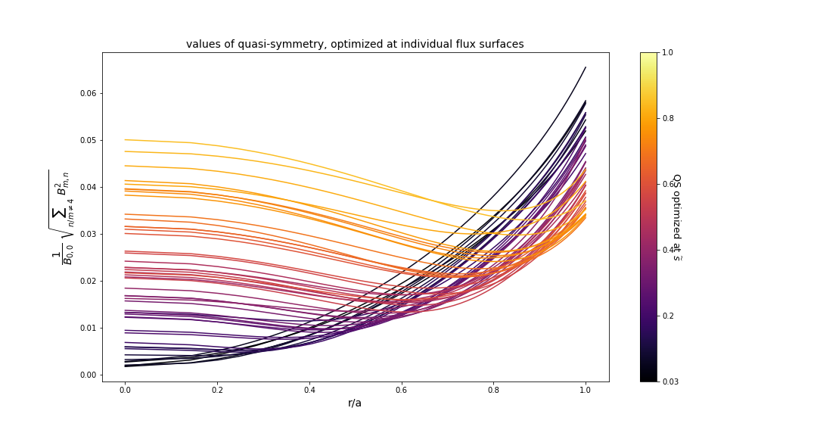
optimizing qhs46 configuration for QHS
darkest curves are optimized closer to core of plasma, brightest curves are optimization at outer surfaces

Slide 5
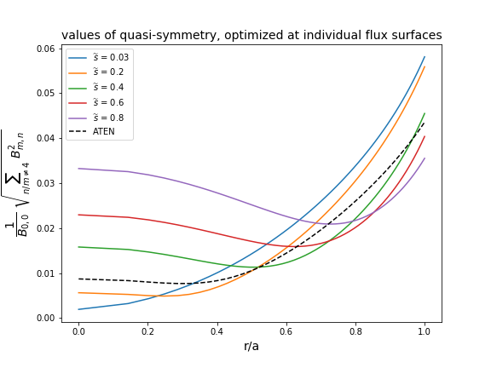
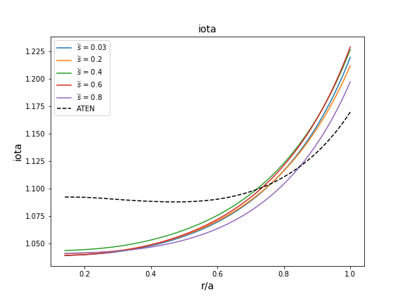
closer look at several of these runs vs ATEN: iota
iota not optimized - does not change much with QS optimization

Slide 6
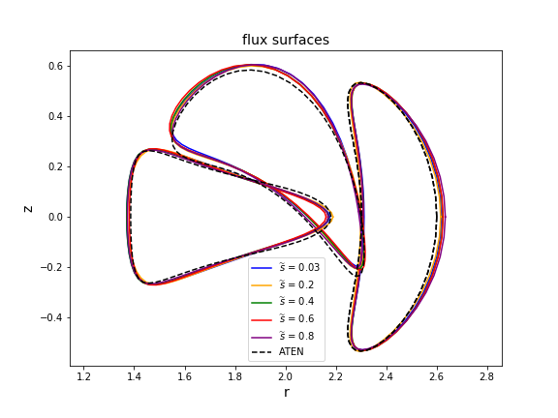
closer look at several of these runs vs ATEN: flux surfaces
flux surface shape not strongly affected
takeaway: QHS profile sensitive to small boundary changes

Slide 7
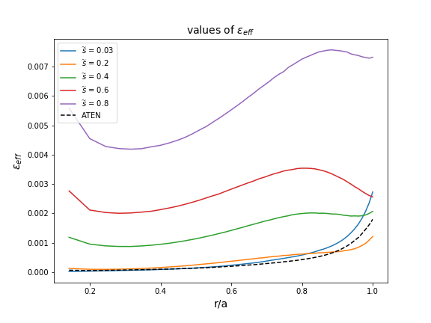
closer look at several of these runs vs ATEN: neoclassical transport
it appears that optimizing core surfaces for QHS results in considerably better neoclassical transport than optimizing outer flux surfaces
best configuration nearly equivalent to ATEN

Slide 8
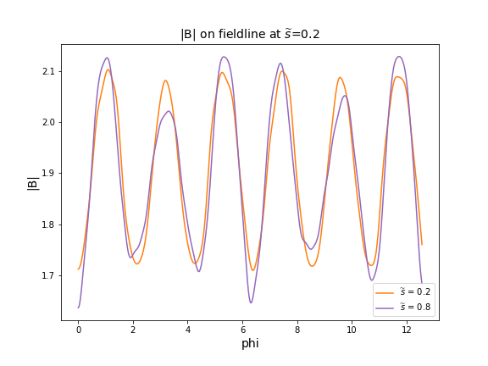
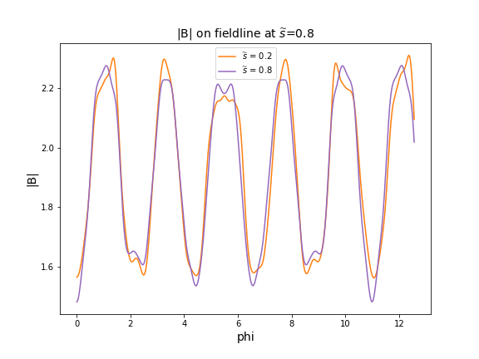
closer look at several of these runs: magnetic field strength
orange curve is optimized for QHS at s=0.2, purple curve is optimized for QHS at s=0.8
left plot shows |B| on a field line at s=0.2
right plot shows |B| on field line at s=0.8
takeaway: core optimized |B| profile looks good near core, not as good further out; outer optimized |B| looks fairly poor in both core and further out

Slide 9
optimization runs for QHS on multiple flux surfaces
did a series of runs targeting multiple flux surfaces with different weighting on each surface
keep ASPECT fixed at 6.7
Case I: QHS weighted highly at
  s = 0.03, relative weight 100
  s=0.08, relative weight 100
  s=0.12, relative weight 1
  s=0.16, relative weight 1
  s=0.58, relative weight 1000
Case II: QHS weighted highly at
  s = 0.03, relative weight 100
  s=0.08, relative weight 100
  s=0.12, relative weight 1
  s=0.16, relative weight 1
  s=0.65, relative weight 1000

Slide 10
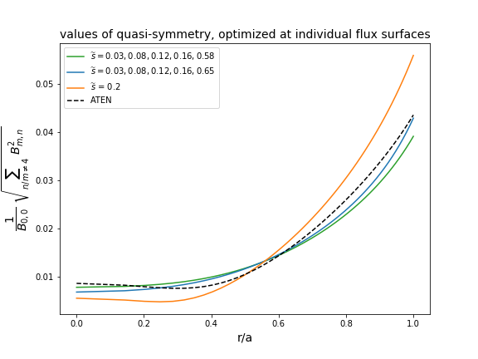
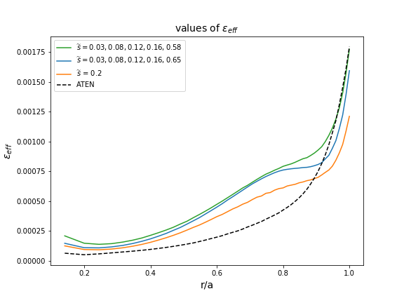
optimizing QHS on multiple flux surfaces
similar if not better QS is achievable through educated guess approach
downside is that there are many options for different weightings and there is no clear path for efficiently exploring parameter space

Slide 11
ideas for next steps
further analysis of QHS data set
include additional parameters in optimization
  set a specified iota profile (already have started some work on this)
  REGCOIL metric
  second principal curvature metric
optimize from constructed boundary surface using Landreman’s direct construction method

